Slide 1
Visual Arts Professional Development
CKV Online and Performance Assessment Protocols
Postmodern Principles of Art
Creativity
Raymond Veon
Education Coordinator
November 2nd, 2010
North Atlanta High School

Slide 2
General
Arts Assessment Testing Window:
March 28th through May 13th, 2011
All materials due to R. Veon by May 13th
By May 13th:
VTS Pre-Post Test
CKV Assessment completed online
Performance Assessment

Slide 3
CKV Online Assessment Orientation
Assessment Dates: March 28-May 13 2011
Completed by: May 13th
Interrupted/incomplete assessments & retakes
Submit Button
Reminder: BOTH CKV and Performance Assessment results will be shared with building leaders

Slide 4
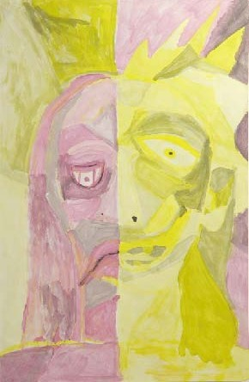
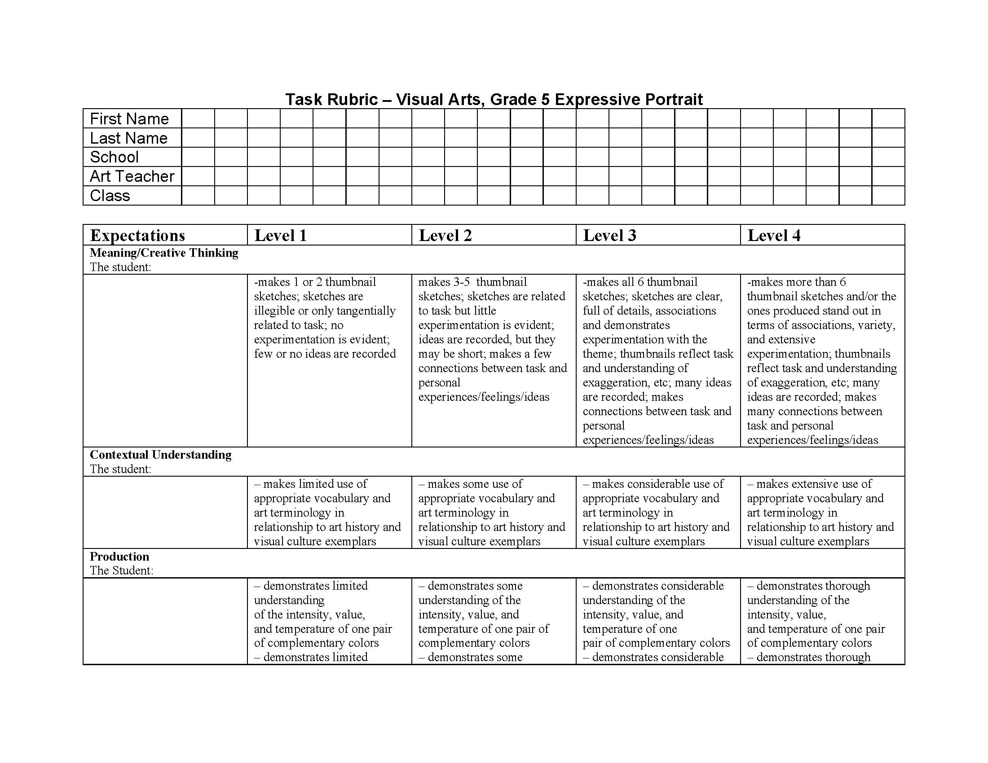
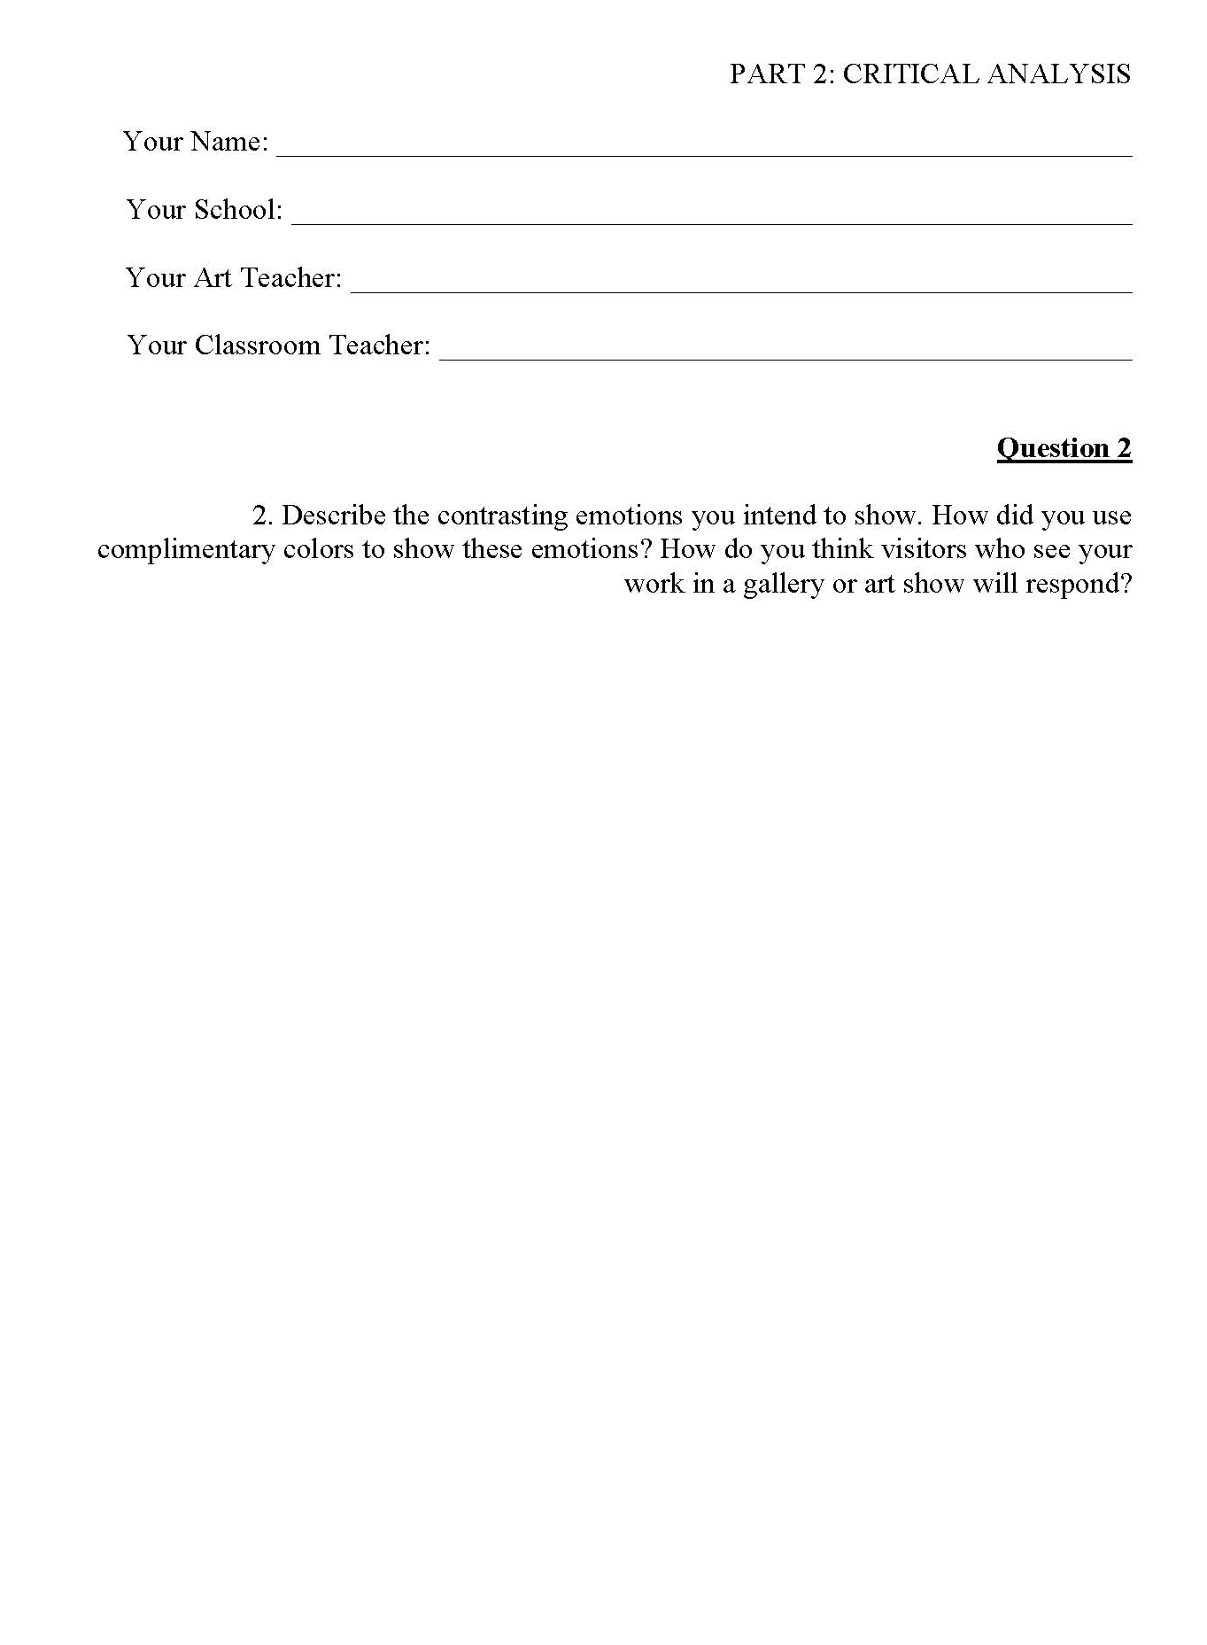
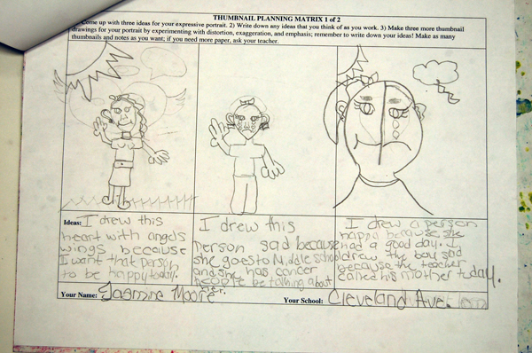
Parts of the Performance Assessment You Will Turn In

Slide 5
Performance Assessment Rubric (2)
Fill out student info on TWO Rubrics
Complete ONE
(Your assessment of your student; this will be used to “assess your assessment” and to align external and internal assessments)
Leave one BLANK
(For outside assessors)

Slide 6
Artifact Order
TOP:
1. Two Rubrics
One You Fill Out
One You Add Student Info Only—Judges Will Use This One
THEN
2. Actual Finished Artwork
THEN
3. Thumbnails/Creative Planning Matrix
LAST
4. Written Critical Reflection Answers
You fill out top Rubric
2nd Rubric: Student info ONLY

Slide 7
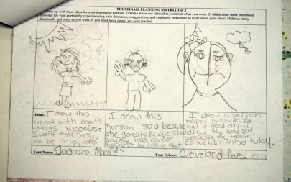
Make FOUR Stacks:
LEVEL 1
LEVEL 2
Put ALL of your Level 1’s together
Put ALL of your Level 2’s together
Put ALL of your Level 3’s together
Put ALL of your Level 4’s together
LEVEL 3
LEVEL 4

Slide 8
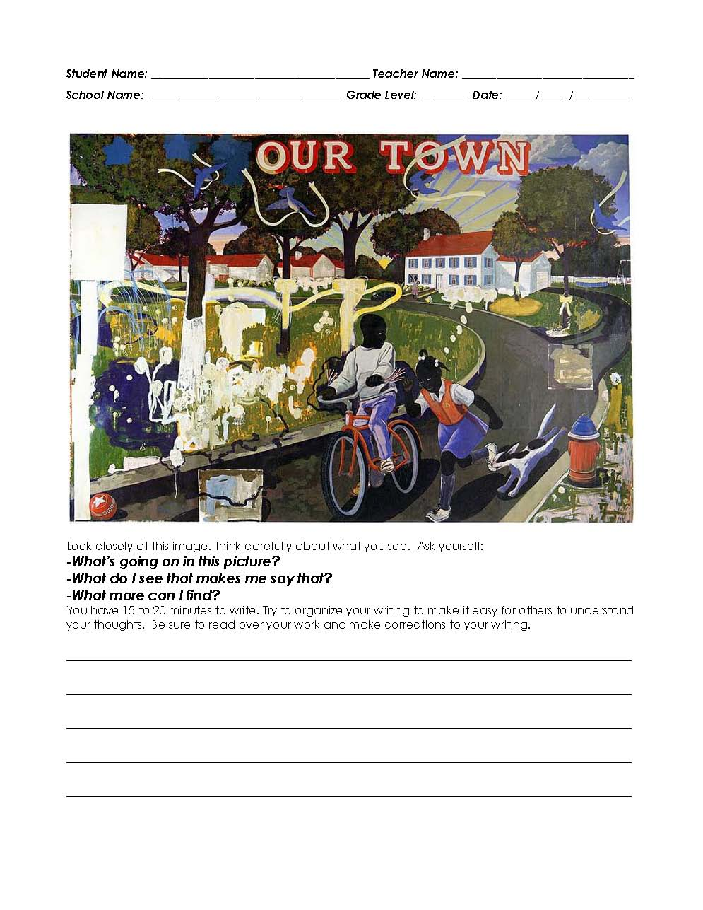
VTS Pre/Post Writing Assessments
All Pre Tests Should Now Be Complete
Post Tests Given:
Pre/Post Test Due Date:
Pre-Test on TOP
Post-Test on BOTTOM

Slide 9
Postmodern Principles of Art
Appropriation
Juxtaposition
Recontextual-ization
Different formulations
Gude’s Principles of Postmodernism:
-based on work with inner city youth
-identified by looking at what and how young people made art
-our students are “postmodern” whether we want them to be or not
Spiral Workshop Curricula:
http://naea.digication.com/Spiral/Spiral_Workshop_Theme_Groups/published
E&P can not capture meaning of contemporary art
Foundations programs (such as WARP @ University of Florida/Gainesville
Rhythm
Pattern
Repetition

Slide 10
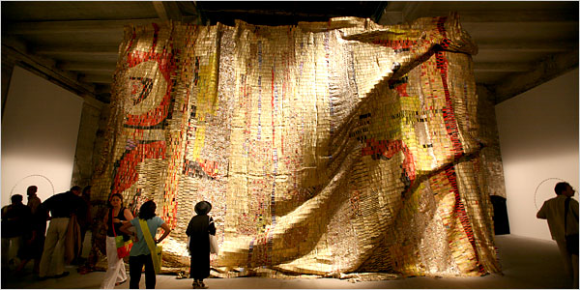
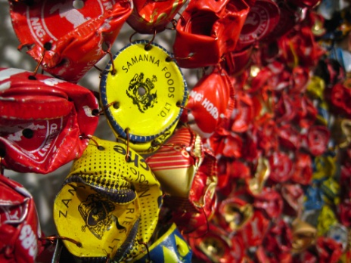
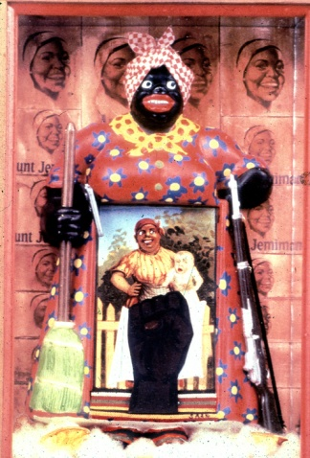
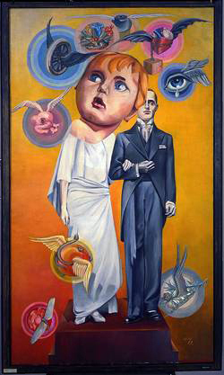
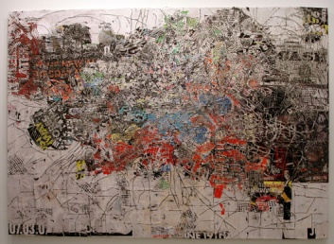
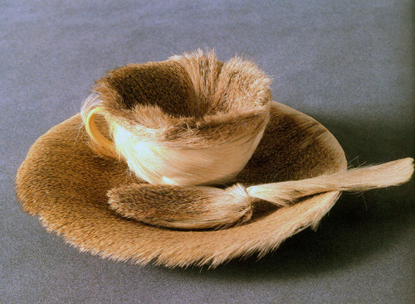
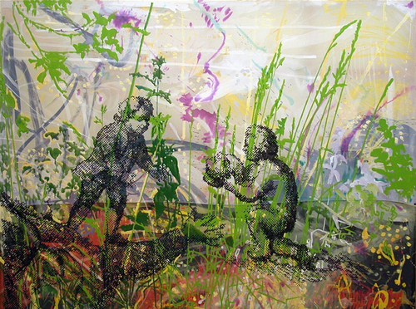
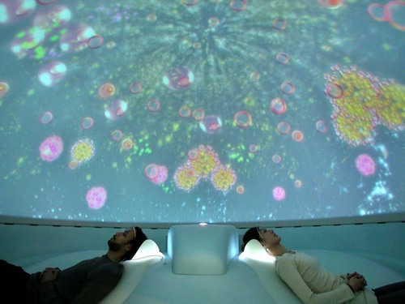
Postmodern Principles of Art
Juxtaposition
Recontextualization
Appropriation
Layering
Interaction of Text and Image
Hybridity
Gazing
Representin’

Slide 11
Appropriation or Recontextualization?
“What’s it all about you ask? Instead, I’ll ask you: What do you think it’s all about?” --Guy Johnson
Guy Johnson Vermeer with Model, 1986, oil on paper on aluminum
Raymond’s Definition of Context:
The implicit and explicit cues and clues that tell us how to assign meaning or how to interpret something

Slide 12
Just remember….

Slide 13
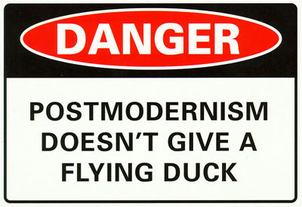

Slide 14
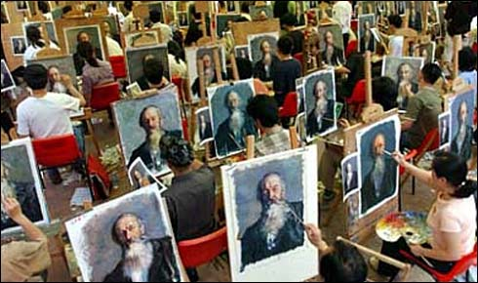
Chinese Oil Painting Village
Art as commodity

Slide 15
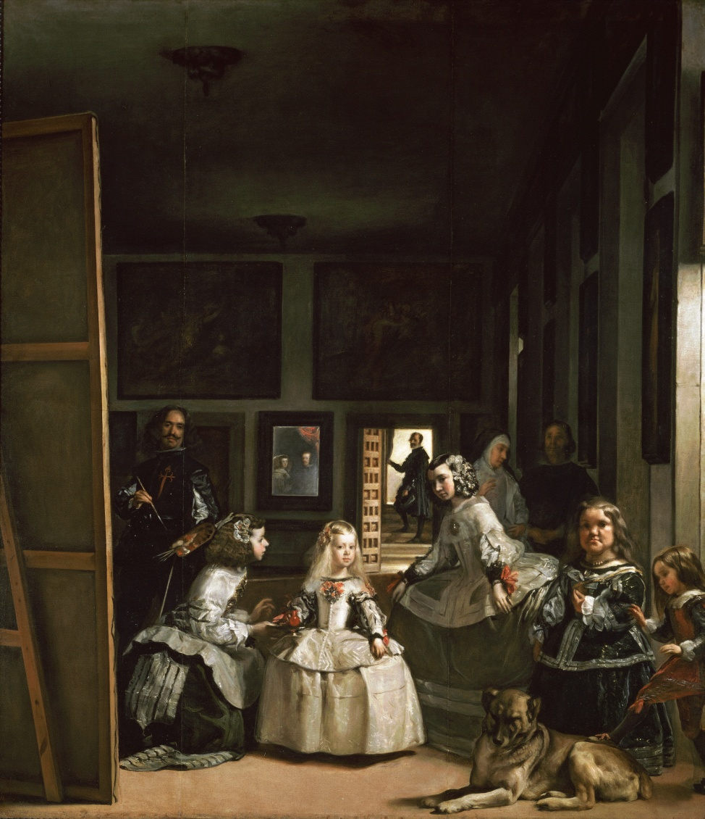
Velazquez
"Las Meninas" is self-aware in the sense that:
1. The painter paints himself;
2. The paints his own act of painting.
3. The object of the represented painter's gaze (the subject of his painting) is the invisible authority that makes his painting possible, indeed, that authorizes all activity, including representation, in Spain: the king and queen of Spain who can be seen in the mirror behind the painter.
B. The self-awareness in "Las Meninas" reinforces the code of signs that grounds representation in 17th C. Spain. It does not put this code of representation into question.
C. More rigorously, however, one must say that the painting in fact constructs the fiction of a hidden king who stands behind all representations and authorizes them.

Slide 16
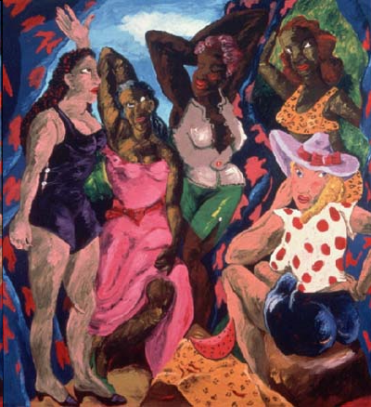
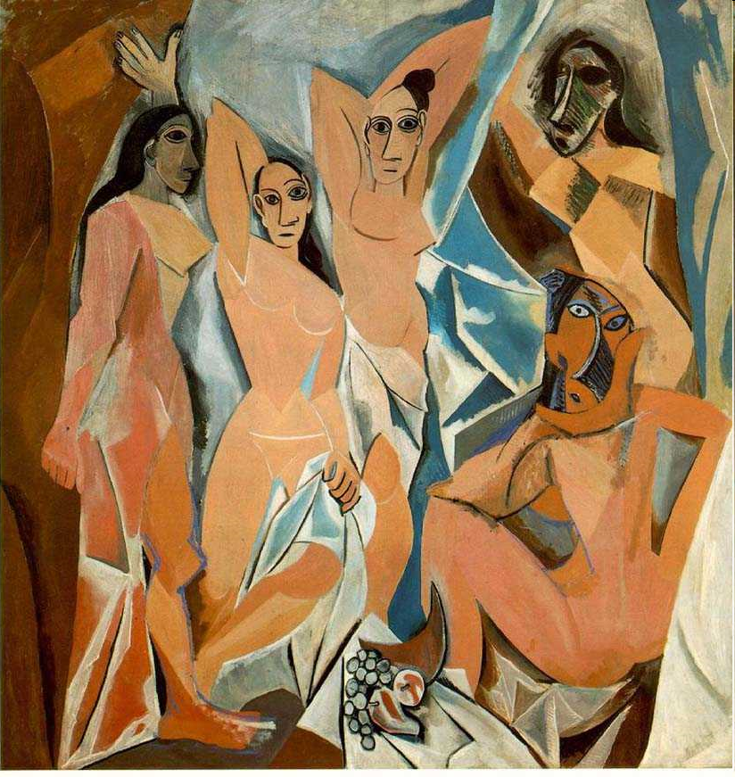
Robert Colescott

Slide 17
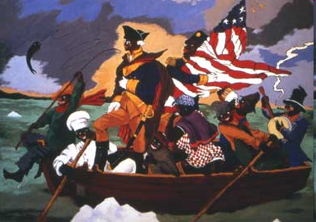
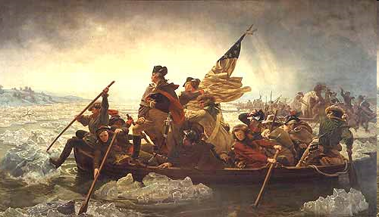
Robert Colescott

Slide 18
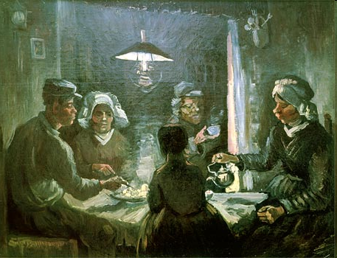
Robert Colescott
Appropriation, Recontextualization Juxtaposition, Hybridity, Layering, Gazing, Interaction of Text and Image, Representin’
-Postmodern Principles of Art, Olivia Gude

Slide 19
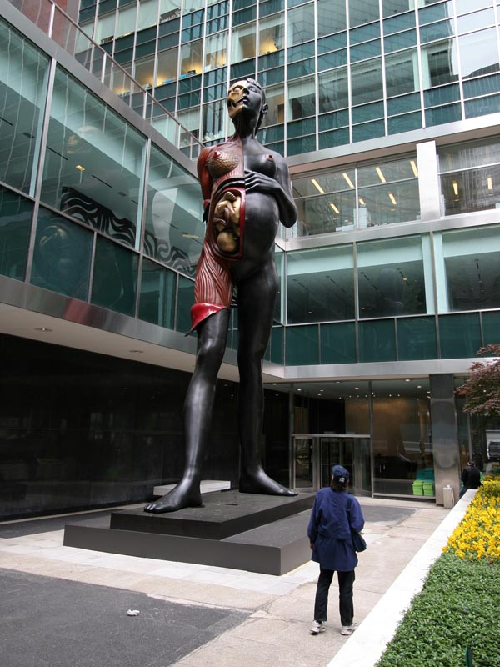
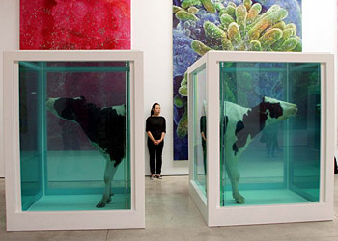
Damien Hirst
Hybridity, Recontextualization

Slide 20
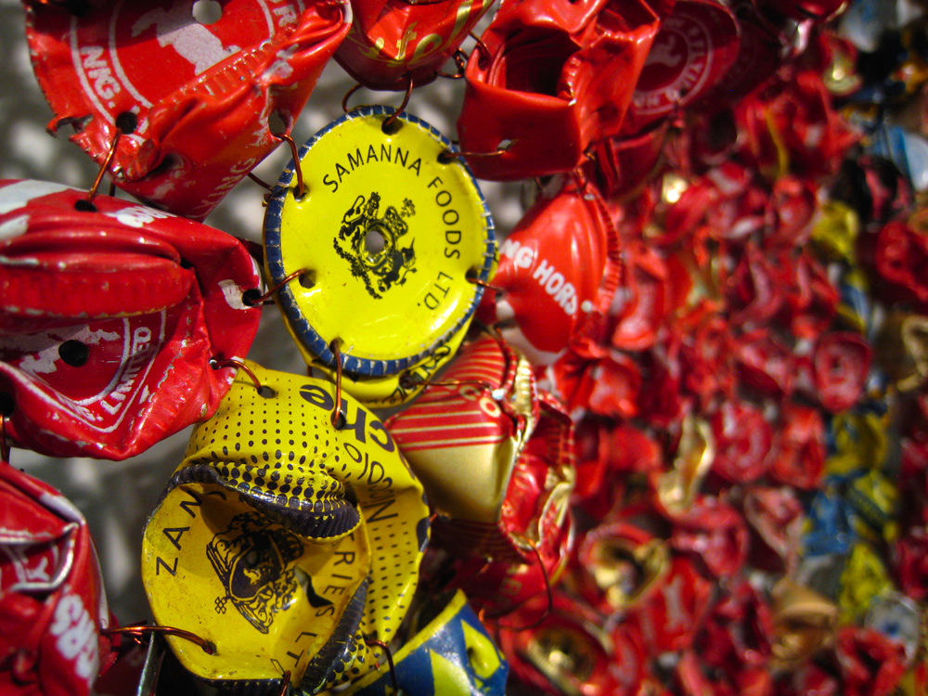
Appropriation

Slide 21
Hybridity
Cremaster Cycle/Barney
Art:21

Slide 22
Gazing

Slide 23
Juxtaposition

Slide 24
Layering

Slide 25
Recontextualization

Slide 26
Interaction of Text and Image

Slide 27
Interaction of Text & Image
In a 1990 montage, artist Barbara Kruger paired a
Photograph of a woman, peering through a magnifying
glass, which greatly enlarges our view of one of her
eyes, with the text “It’s a small world but not if you
have to clean it” (Emerson, 1999). The text does not
describe the work, nor does the image illustrate the text,
but the interplay between the two elements generates
rich, (and ironic), associations about gender, social
possibilities, and cleanliness. Students making and
valuing art in the 21st century must to be taught not
to demand the literal matching of verbal and visual
signifiers, but rather to explore disjuncture between
the two modes as a source of meaning and pleasure.

Slide 28
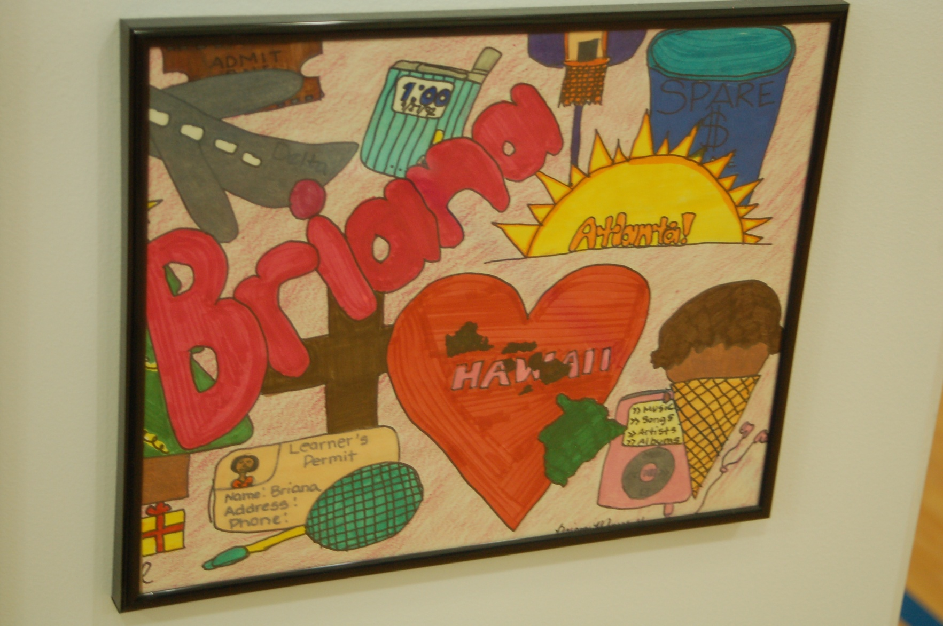
This is not what is meant…..

Slide 29
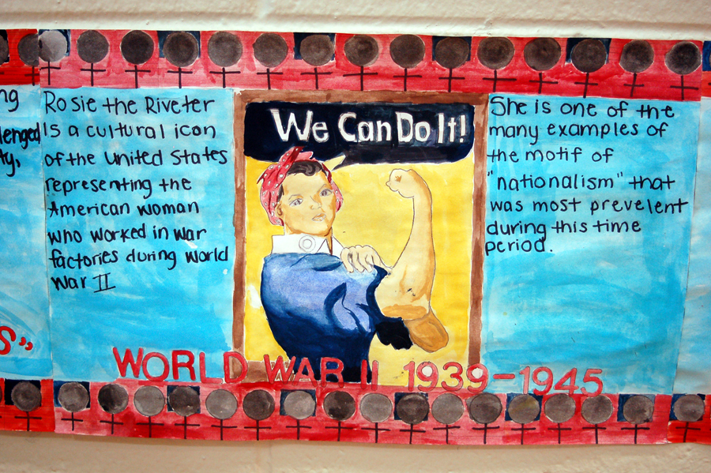
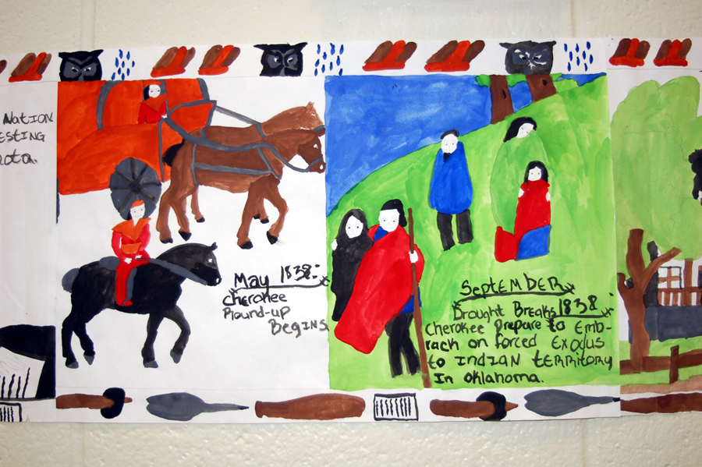
While having their own charm, these are not what is meant…..

Slide 30
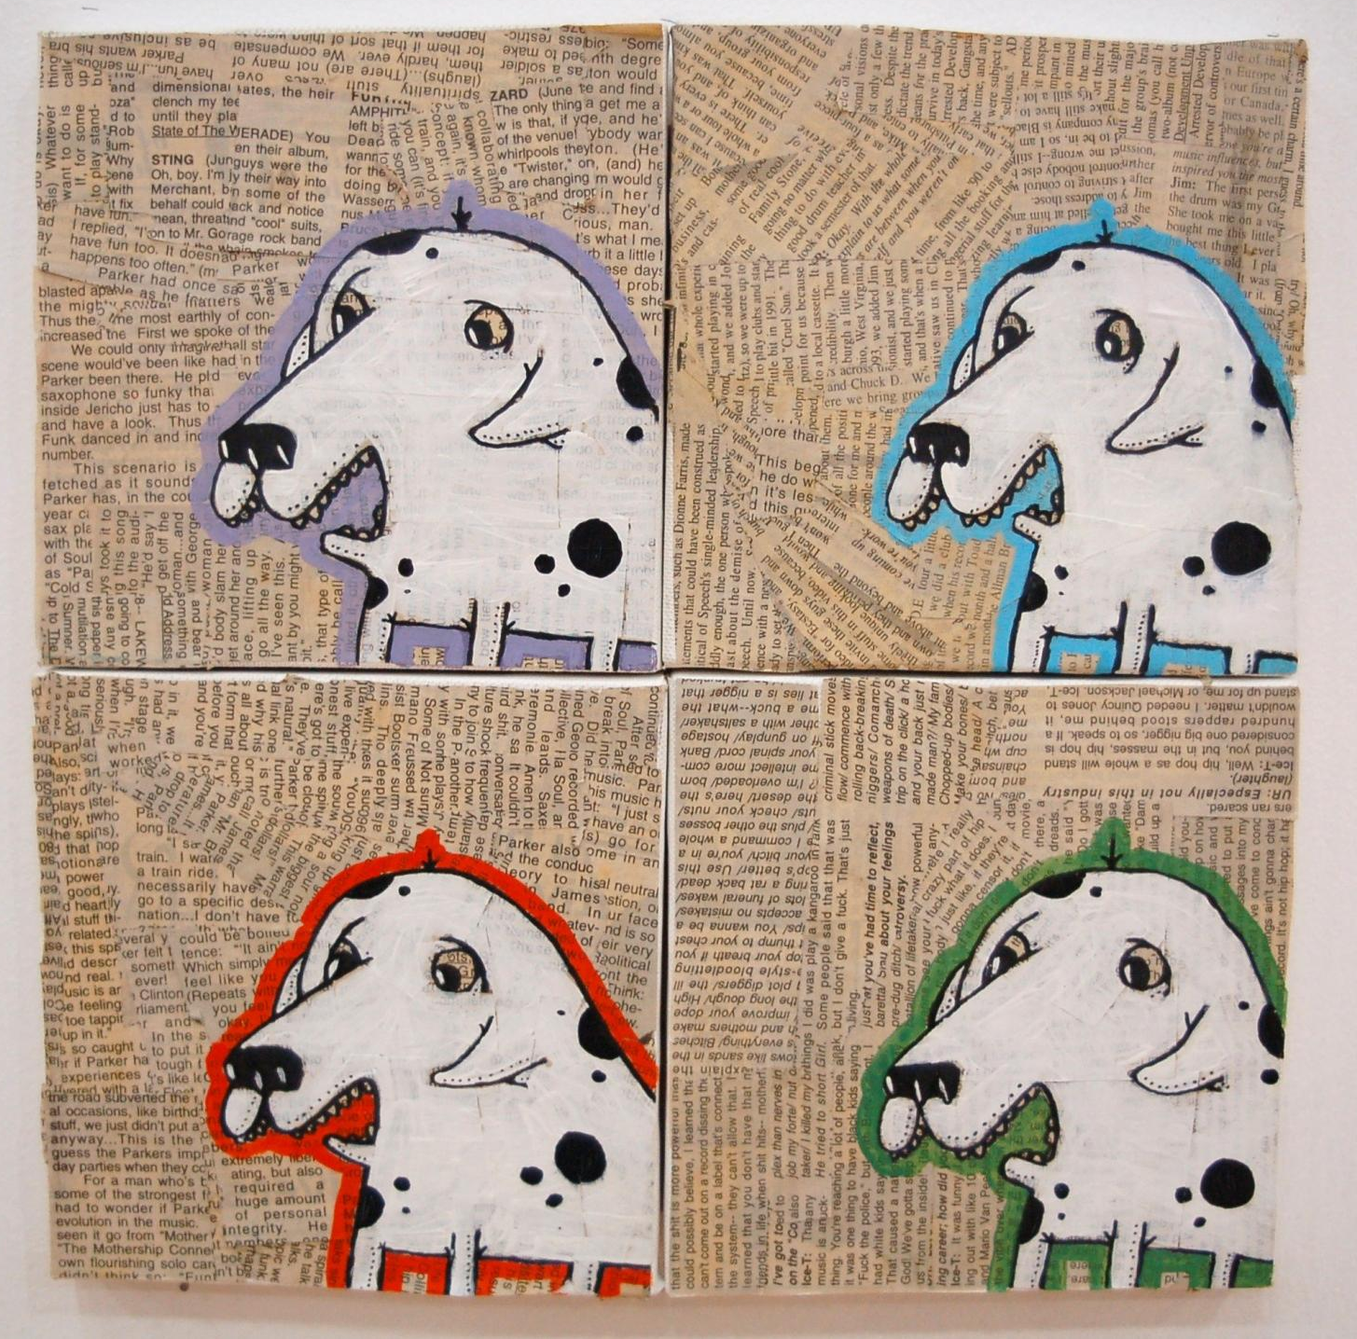

Slide 31
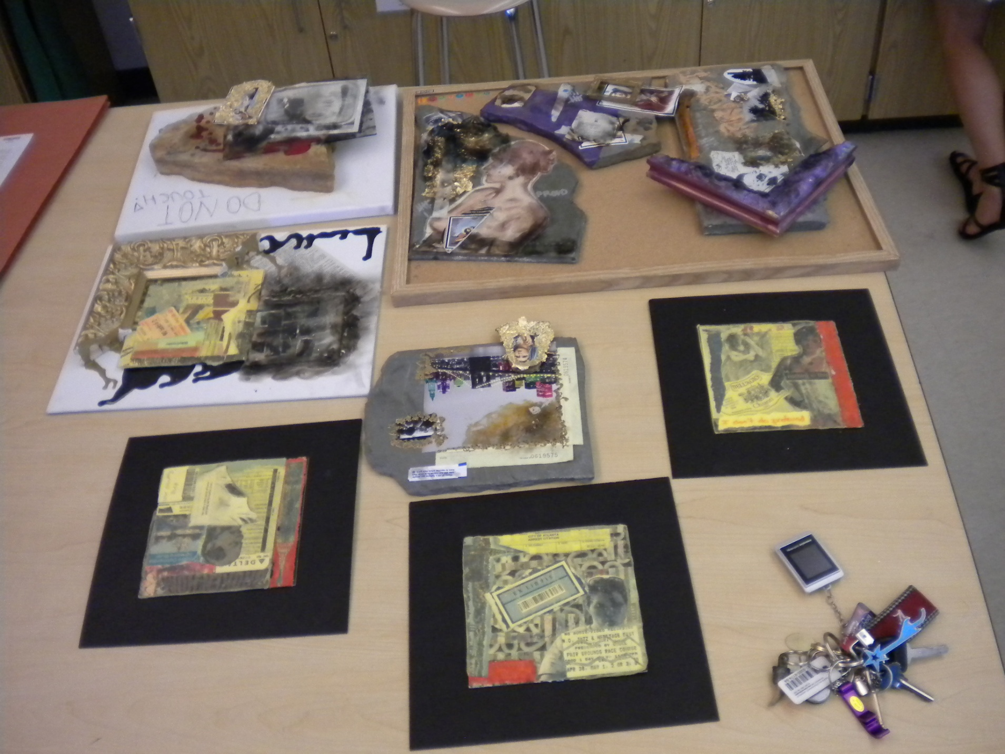

Slide 33
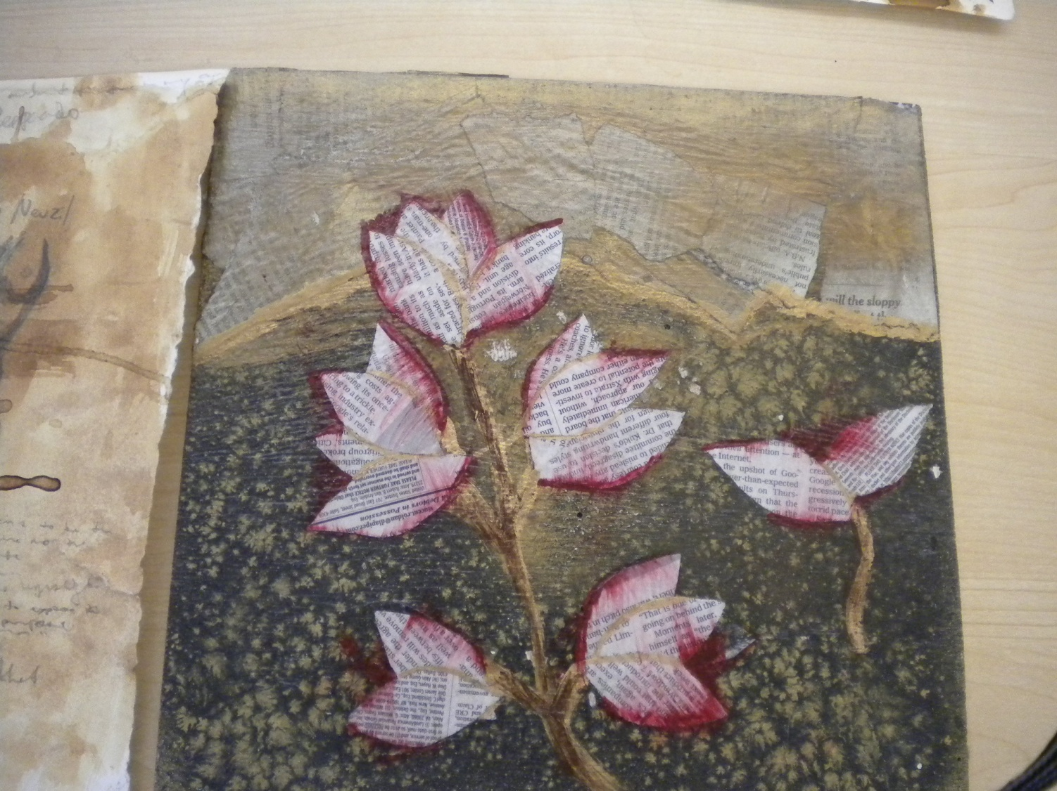

Slide 34
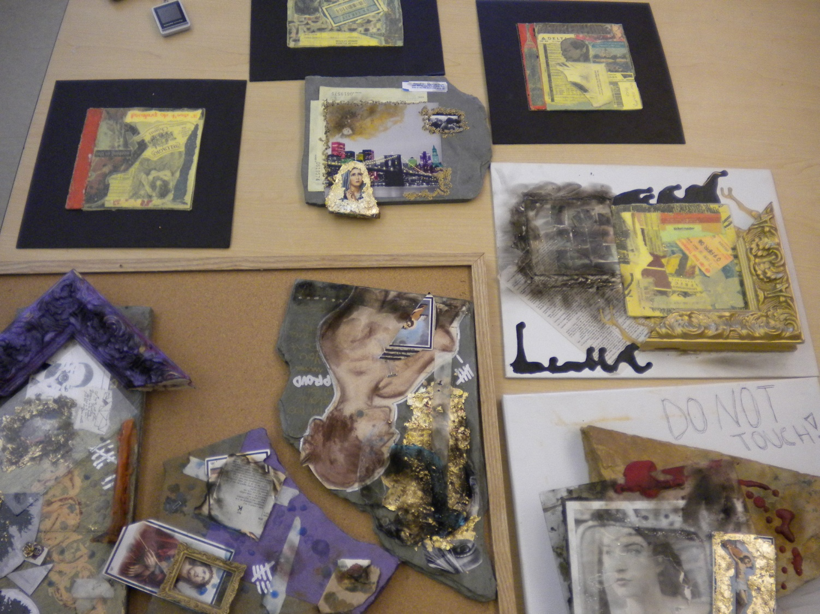

Slide 35
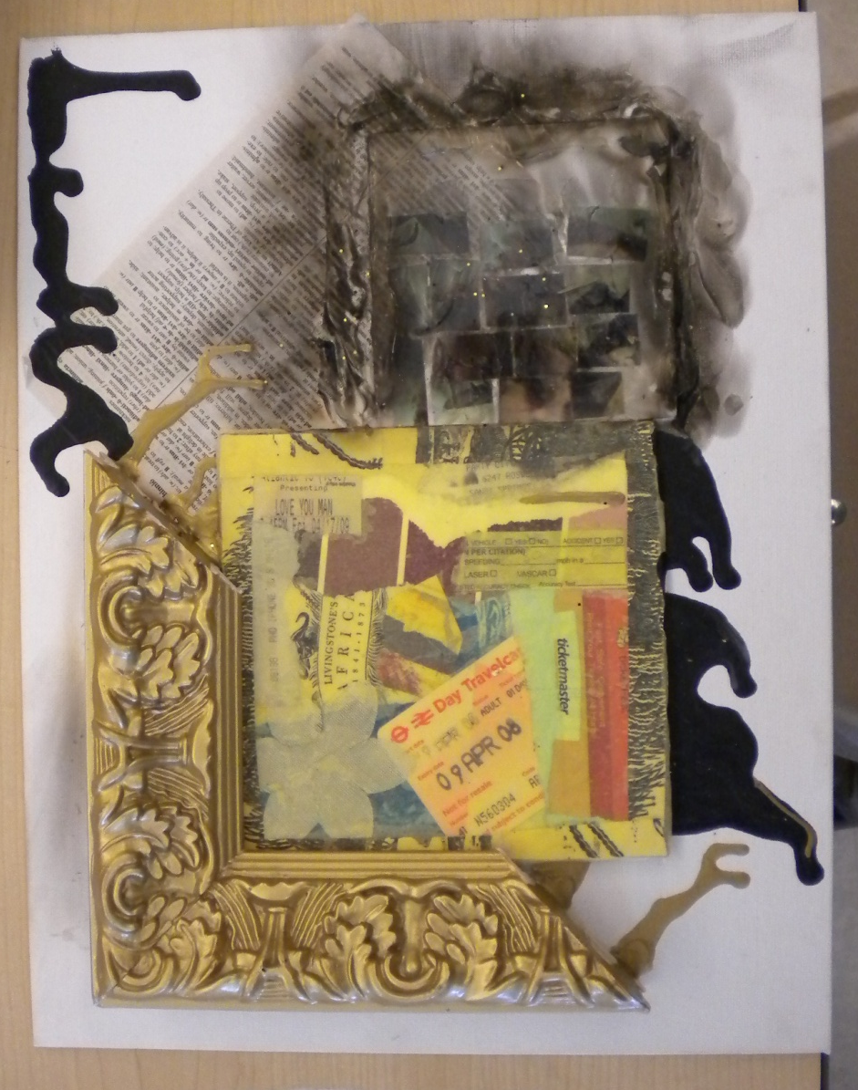
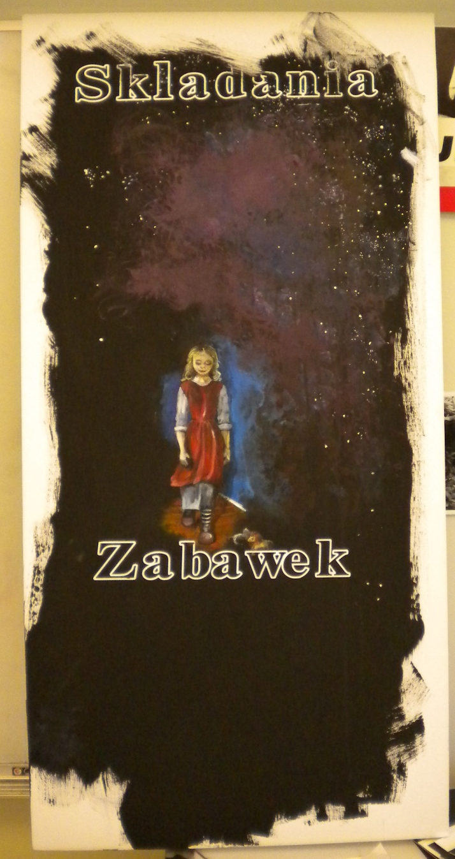

Slide 36
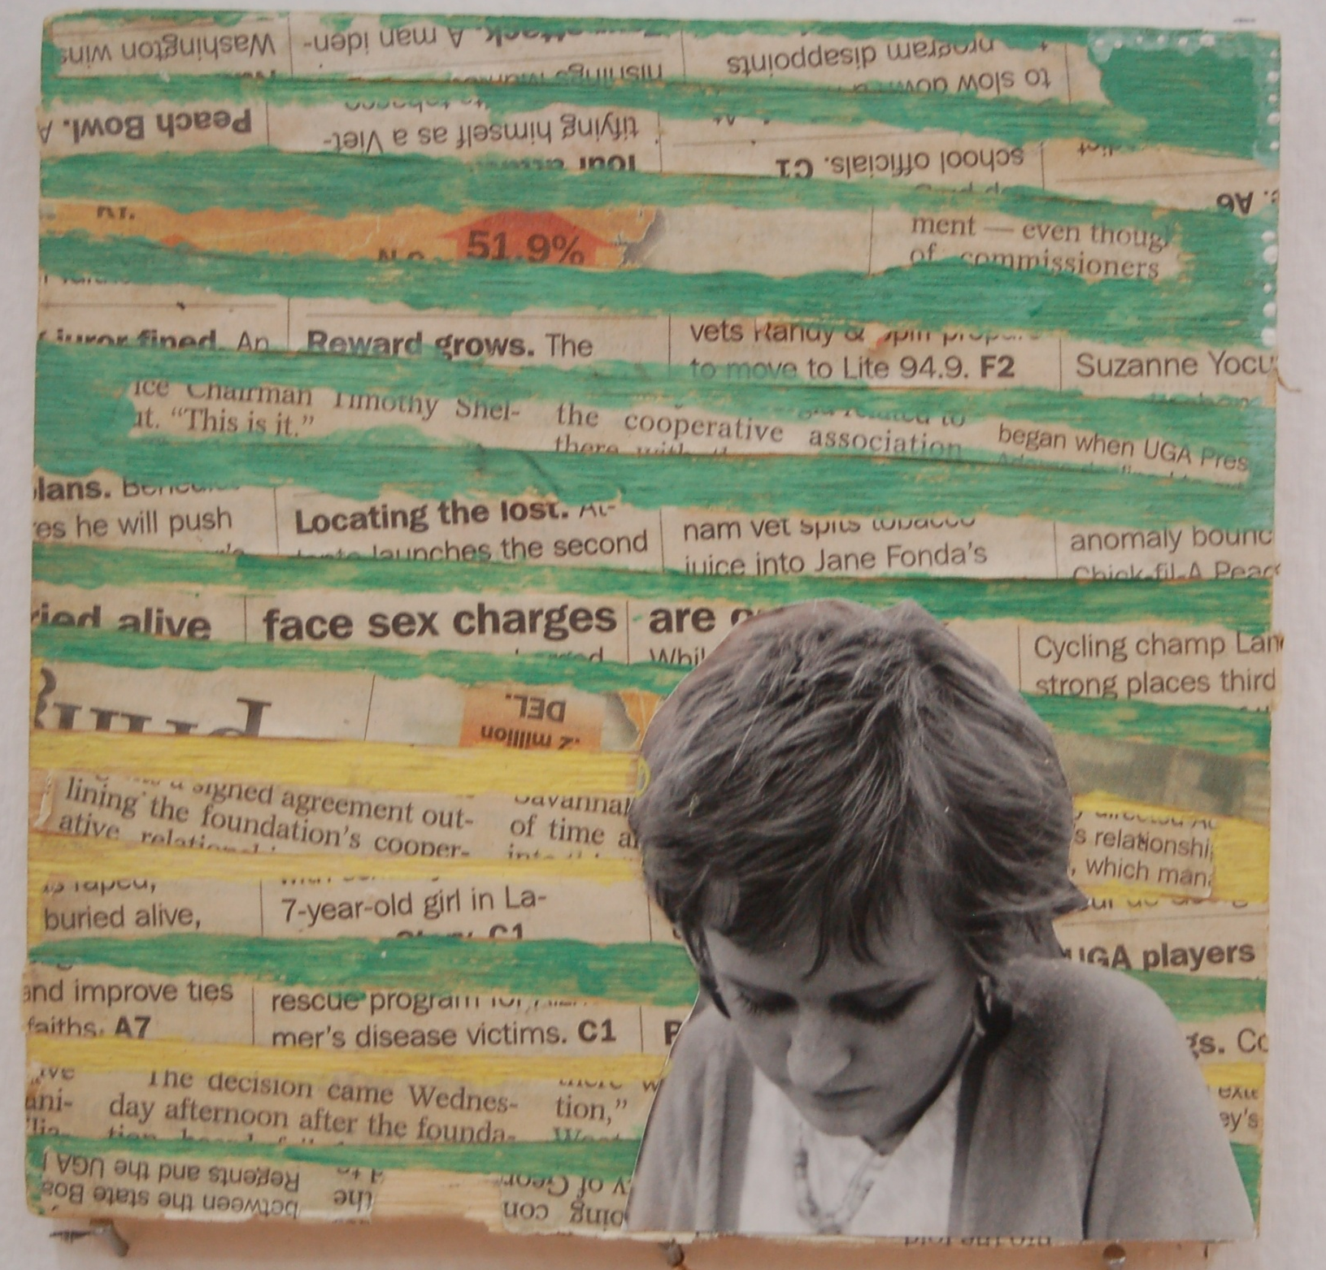

Slide 37
Exploring the disjuncture between the two modes as a source of meaning and pleasure
We in the arts are about teaching RELATIONSHIPS (in and among the cognitive, emotional, & perceptual realms) not items on a checklist

Slide 38
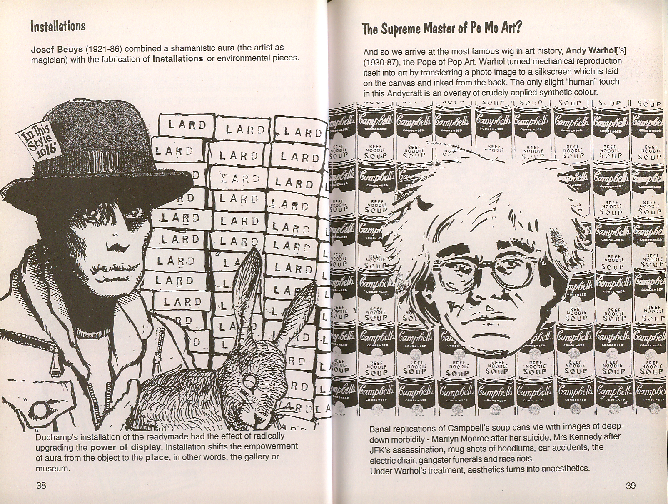

Slide 39
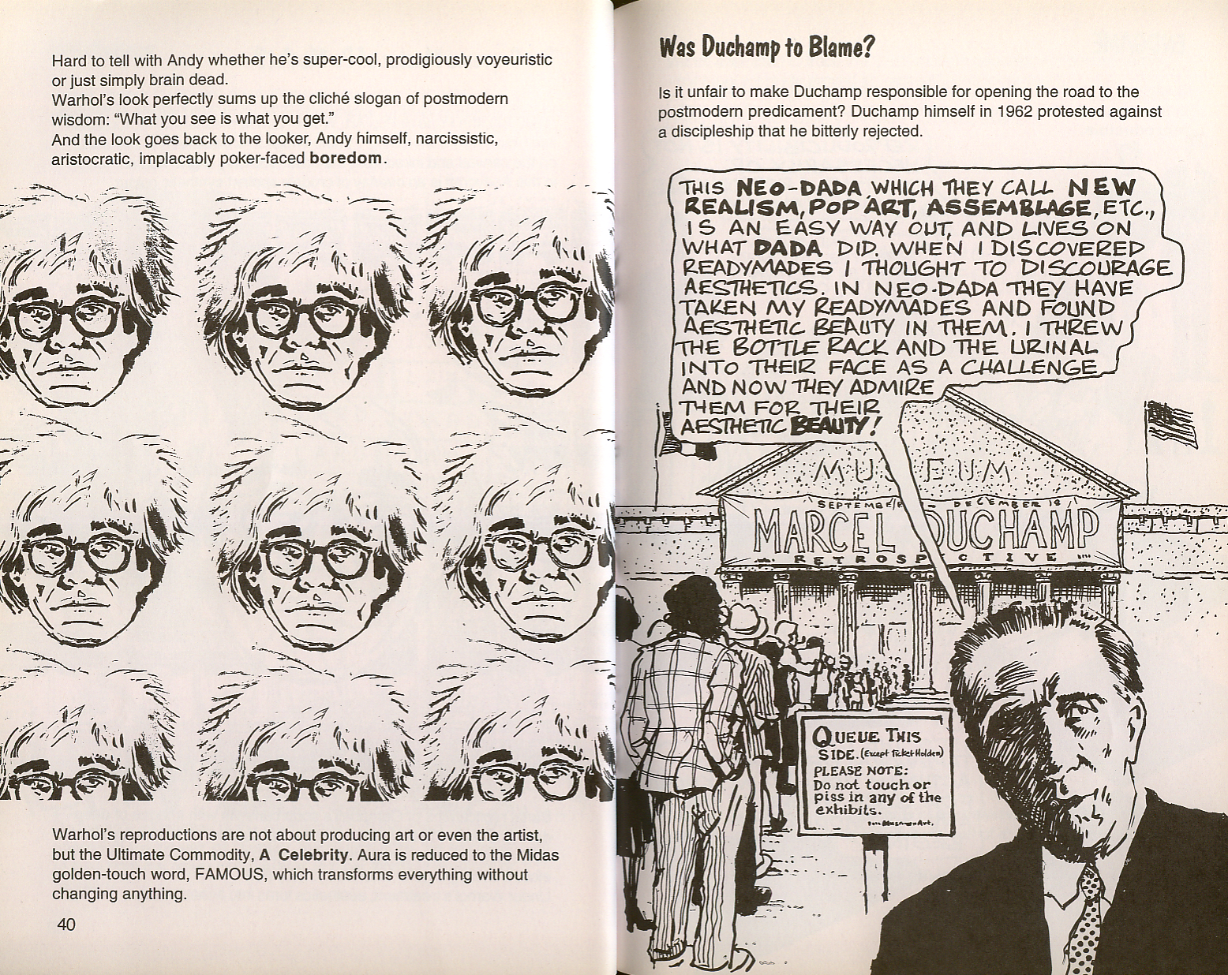
Aesthetics as a verb: We aestheticize in
Response to our ideals and aspirations rather than there being something essentially aesthetic in objects

Slide 40
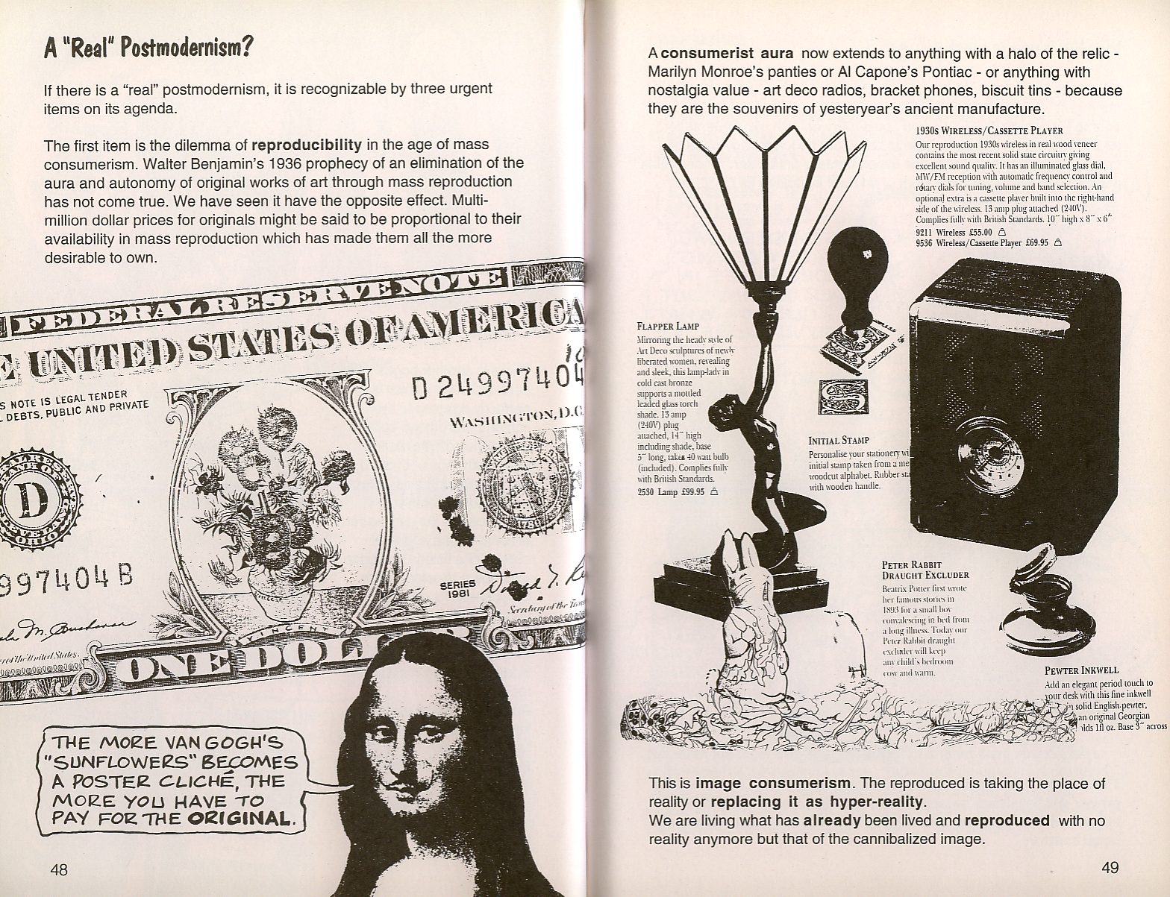

Slide 41
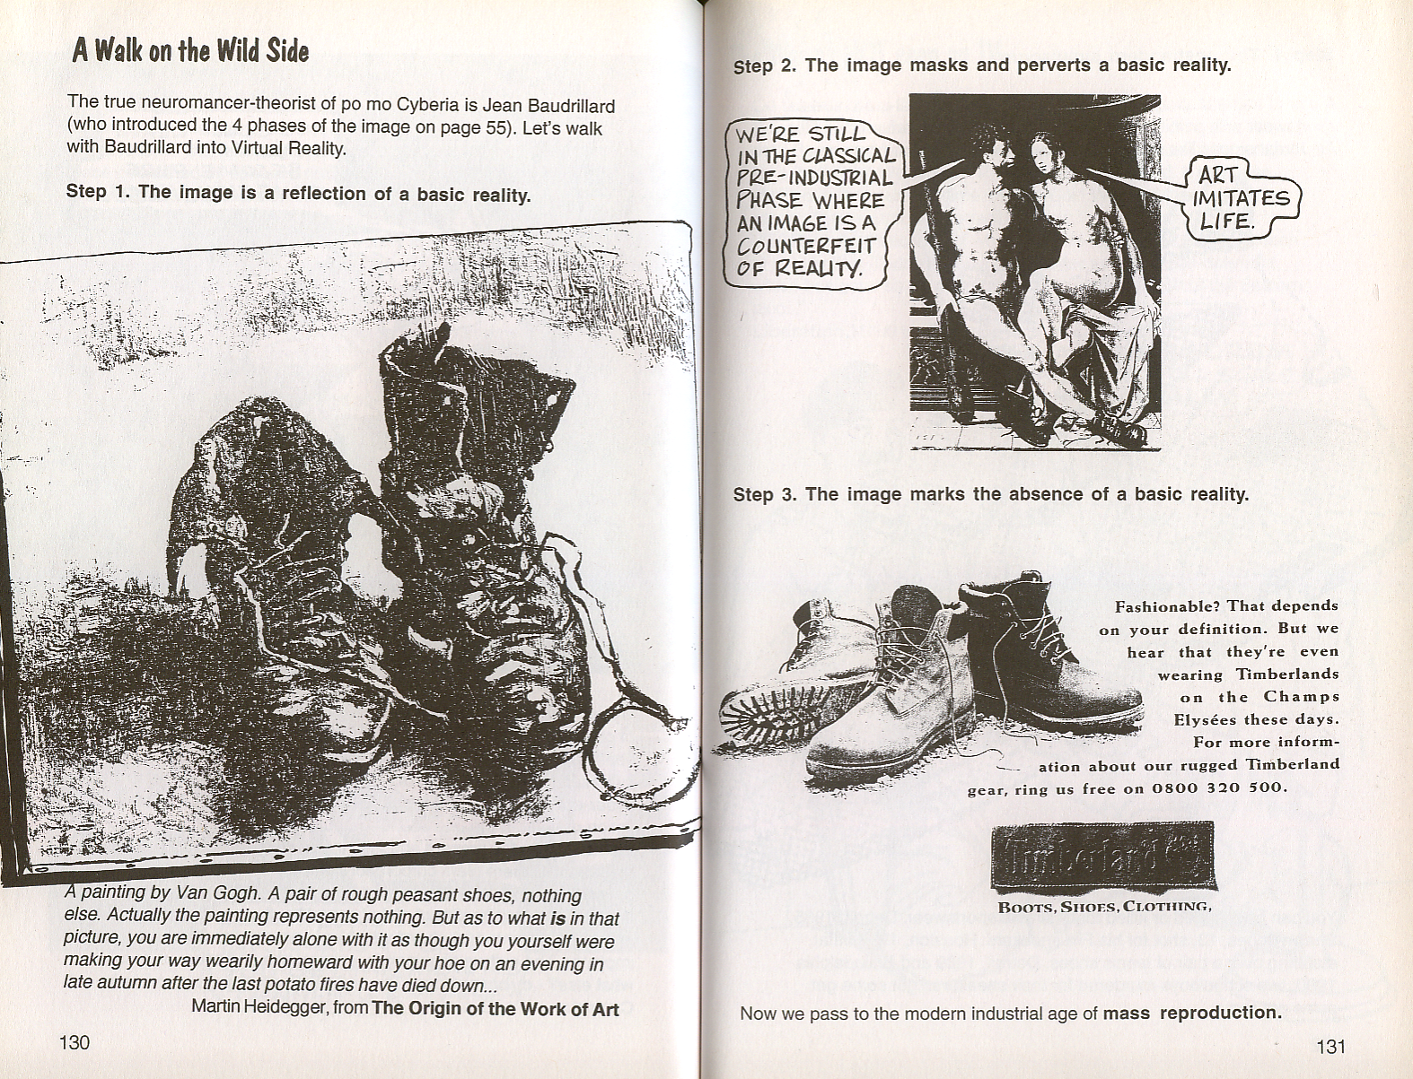

Slide 42
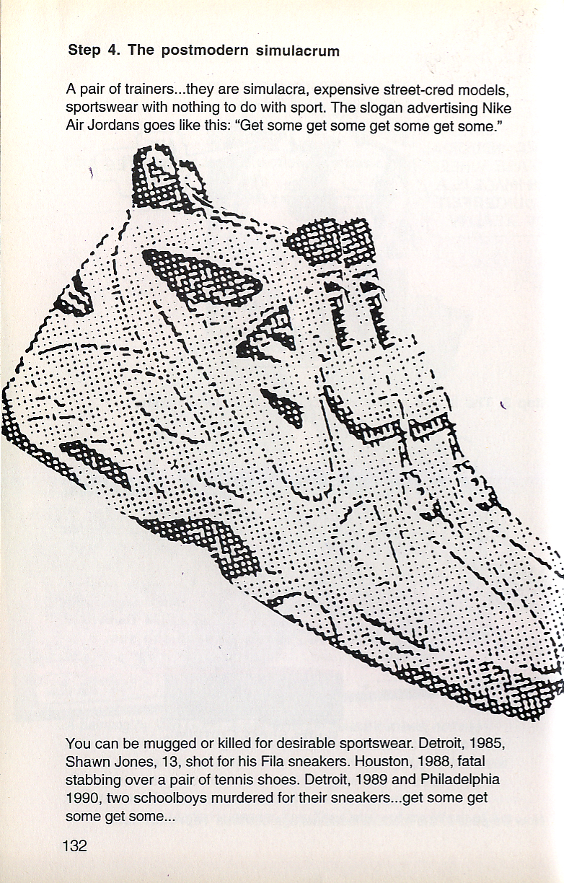

Slide 43
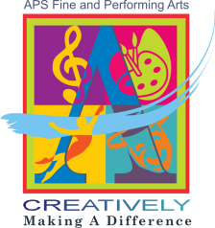
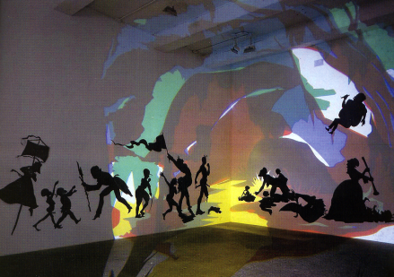
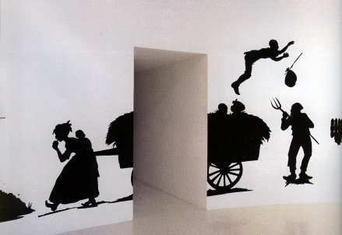
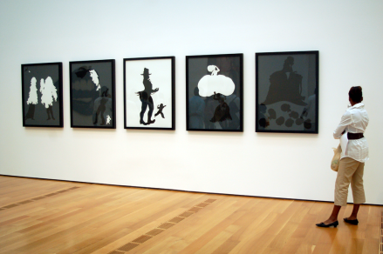
Stage Three: Creative Stance
“When stereotypes attempt to take control of their own bodies, they can only do what they are made of and they are made of the pathological attitudes of the Old South. Therefore, racist stereotypes occurring in my art can only partake of psychotic activities.”
Notes:
43
Evolving out of the creative stance, it alters and transforms basic models of thought that we use in everyday life, causing us to dig up and reorganize unconscious assumptions, attitudes, and filters while creating new standards and targets. Walker digs deep into the heart of racism and the fundamental elements of storytelling, using them to reach beyond the actual world to a created realm of heightened psychological, social, and philosophical trauma. However, her use of narrative is only one of many possible conceptual models.

Slide 44
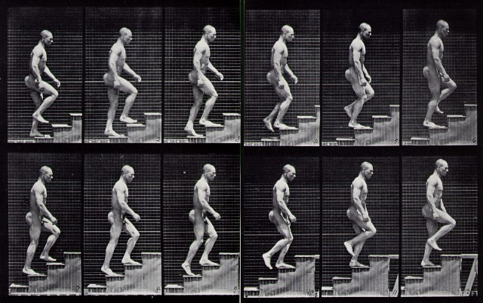
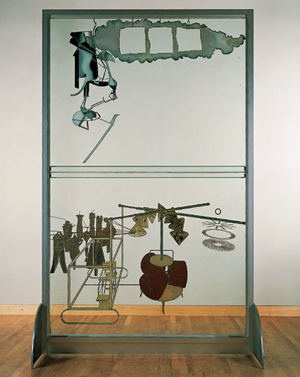
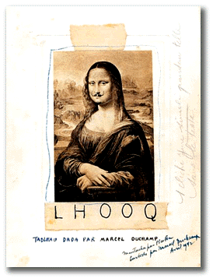
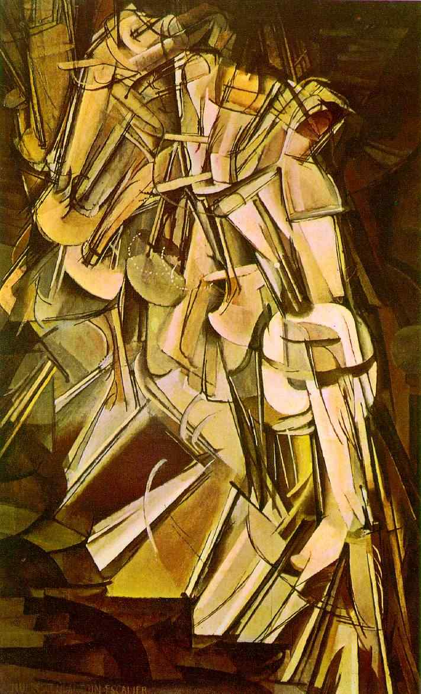
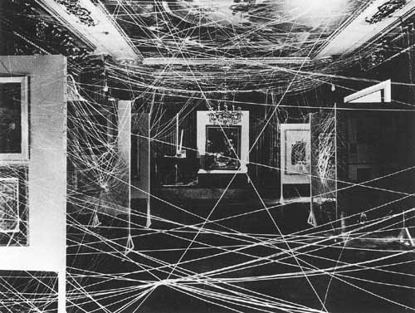
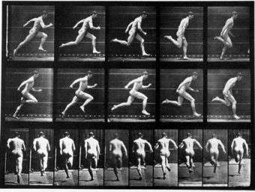
"I believe that the artist doesn't know what he does.
I attach even more importance to the spectator than to the artist."
http://images.google.com/imgres?imgurl=http://cefn.com/blog/photos/muybridge_stairs.jpg&imgrefurl=http://cefn.com/blog/muybridge.html&h=402&w=640&sz=96&hl=en&start=43&tbnid=wvuxqu0S_C1jbM:&tbnh=86&tbnw=137&prev=/images%3Fq%3Dmuybridge%26start%3D40%26gbv%3D2%26ndsp%3D20%26svnum%3D10%26hl%3Den%26sa%3DN
Notes:
Ready made—taking the infinitely reproducible and making it an irreproducible artwork by making turning it into an event—the idea only works once…The Bride Stripped Bare By Her Bachelors, Even…Duchamp's ideas for the Glass began in 1913, and he made numerous notes and studies, as well as preliminary works for the piece. The notes reflect the creation of unique rules of physics, and myth which describes the work. He published the notes and studies as The Green Box in 1934.[1]
The notes describe that his "hilarious picture" is intended to depict the erratic encounter between the "Bride," in the upper panel, and her nine "Bachelors" gathered timidly below in an abundance of mysterious mechanical apparatus in the lower panel.
The Large Glass was exhibited in 1926 at the Brooklyn Museum before it was accidentally broken and carefully repaired by Duchamp. It is now part of the permanent collection at the Philadelphia Museum of Art.
Duchamp sanctioned replicas of The Large Glass, the first in 1961 for an exhibition at Moderna Museet in Stockholm and another in 1966 for the Tate Gallery in London.[2] Duchamp's art does not lend itself to simple interpretations, and The Large Glass is no exception; the notes and diagrams he produced in association with the project, ostensibly as a sort of guidebook, complicate the piece by, for example, describing elements that were not included in the final version as though they nevertheless exist, and "explaining" the whole assembly in stream-of-consciousness prose thick with word play and jokes.
Linda Dalrymple Henderson picks up on Duchamp's idea of inventing a "playful physics" and traces a quirky Victorian physics out of the notes and The Large Glass itself; numerous mathematical and philosophical systems have been read out of (or perhaps into) its structures.[3]
Most critics, however, read the piece as an exploration of male and female desire as they complicate each other. One critic, for example, describes the basic layout as follows: "The Large Glass has been called a love machine, but it is actually a machine of suffering. Its upper and lower realms are separated from each other forever by a horizon designated as the 'bride's clothes.' The bride is hanging, perhaps from a rope, in an isolated cage, or crucified. The bachelors remain below, left only with the possibility of churning, agonized masturbation."[4]
However, modern critics see the painting as an expression of the artist to ridicule criticism. Marjorie Perloff interprets the painting as "enigmatic" (34) in her piece "The Poetics of Indeterminacy: Rimbaud to Cage" (Princeton UP: 1999). She concludes that Duchamp's "'Large Glass' is also a critique of the very criticism it inspires, mocking the solemnity of the explicator who is determined to find the key" (34). Hence, she follows the school of deconstruction established by the French philosopher Derrida and helps to break down the hegemony of interpretation held by the Enlightenment bourgeoisie. To quote the artist: "I believe that the artist doesn't know what he does. I attach even more importance to the spectator than to the artist."

Slide 45
Image: A Urinal
Imagination
Belief/Context: Art is pure context
Language/Framework for
Reasoning: The Language
Of Institutional Display or
“Framing” (Signature,
Pedestal as elements of a
Symbolic system of aesthetic
value)
Idea: The Readymade
Speculating
Conduct/
Style:
Negation
Creating
Concept: “Fountain”
Creation
(Consciousness of created content)
Art at perpetual war with itself;
Art as Dialectics (Non-teleological)
Interpreting Duchamp
(Hypothetical)
Original diagram © 1980 Arne Ludvigsen; modified by R. Veon
Updated/Interpreting Duchamp © 2007 Raymond E. Veon

Slide 46
The Interface Model of Creativity
Art is…
-the inventive arrangement
of formal qualities without
personal or social meaning
-a language/symbol system
-an infinite regress of signs
-anything (meaningless)
-pure context
-a network of suggestive
ambiguity
-a social code
-an expression of
ideological power
-a system exhibiting the
slippage of meaning
-emotional embodiment
The image is…
-irrelevant
-secondary to language
-socially determined
The artist is…
-a businessman
(Warhol, Kastabi)
Change the belief/image—
Change the idea!
Image
Belief,
Context,
Or
Frame
But what if the belief/context
is about art itself?
Idea

Slide 47
Case Study: Sometimes Context CAN Be Everything!

Slide 48
Image
Imagination
Belief: The Meaning Of An
Artwork Lies Outside Of The
Object
Idea
Speculating
Language: Basic Visual
Shapes/Forms; Industrial
Materials; Commodities
Conduct/
Style:
Placement;
Challenging
Preconceptions
About Art
Creating
Concept
Mapping Minimalism
(Carl Andre Floor Piece)
Creation
(Consciousness of created content)
© 1980 Arne Ludvigsen
Updated, R. Veon 1991
Notes:
Once you have this map or model in your head you can use it t remember and explain various art movements; Since minimalism is philosophically opposed to personal expression and the presence of the self/mark of the artist, I have thought that it’s artistic expression was limited to this first two triangles—which doesn’t make it inferior, ust different—since it is being consistent with its stated aims. But the placing of Andre’s pieces on the floor at the Tate—almost forcing you to walk on it—adds another level—the use of social context, challenging assumptions about art…

