Slide 1
Visual Thinking Strategies
R. Veon
Education Coordinator

Slide 2
Visual Thinking Strategies
Take a minute to look at this picture.
What is going on in this picture?
What do you SEE that makes you say that?
What more can we find.
Paraphrase! Point! Link!

Slide 3
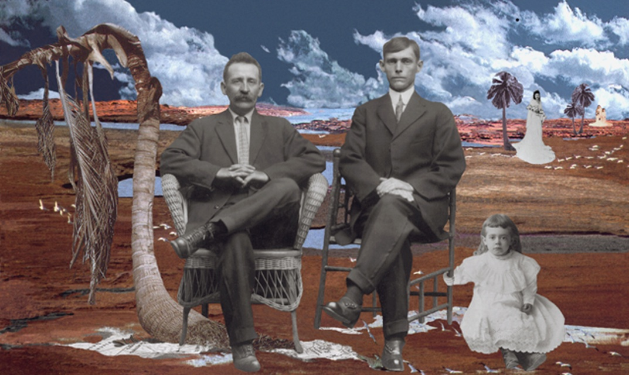

Slide 4
Visual Thinking Strategies
Ten lessons per year (Two 15 minute VTS sessions=1 lesson)
Increases writing skills
Over three years, raises reading/LA and math scores (12% and 16%, Grades 3-5 in Miami-Dade County)
Create confidence in student’s ability to comprehend complexity
Foster a desire to learn and take risks
Encourage students to value their own ideas while listening and building on the ideas of others

Slide 5
Visual Thinking Strategies
In a typical VTS lesson, students:
  Look carefully at works of art
  Talk about what they observe
  Back up their ideas with evidence
  Listen to and consider the views of others
  Discuss multiple interpretations

Slide 6
Visual Thinking Strategies
Proven to increase critical thinking skills required in over 70% of questions on state tests
Proven to work with all students, including disadvantaged youth
Builds cognition through art
Students apply the skills of observing carefully, thinking deeply, expressing themselves, and listening to others in other subjects.

Slide 7
Visual Thinking Strategies
Thinking behaviors
  Making complex observations
  Drawing conclusions
  Expressing and articulating ideas in discussion and writing
  Considering a range of possibilities (Speculative Inquiry, one of the stages of the creative process)
  Revising
  Elaborating
  Applying these behaviors to new situations without prompting

Slide 8
Visual Thinking Strategies
In order to write well, we must speak well—too little time is spent with students in conversation to allow speaking skills to develop
By paraphrasing, teachers build grammar, syntax, and vocabulary
Teaches how to make observations, draw inferences, and justify statements by citing evidence…skills useful in what other subject?

Slide 9
Visual Thinking Strategies
Research based on tens of thousands of Aesthetic Development Interviews (ADI’s) that were then statistically analyzed to arrive at the five stages of aesthetic development

Slide 10
During VTS Lessons
all students must have ample opportunity to point out what they see in the art they
examine and express their opinions about it;
students must know that their thoughts are heard, understood, and valued;
students must provide evidence to explain their interpretive comments; and
students must see that each comment contributes to the group process of mining
the art for multiple meanings.*
* See creativity matrix (Nov 2)

Slide 11
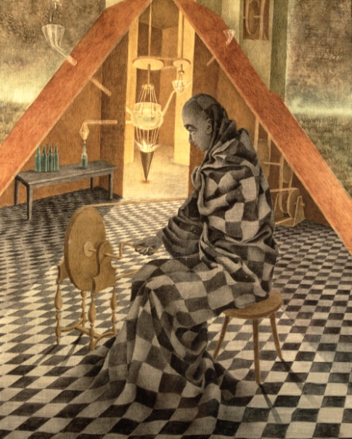
Take a minute to look at this picture.
What’s going on in this picture?
What do you see that makes you say that?
What more can we find?
Paraphrase. Point. Link.

Slide 12
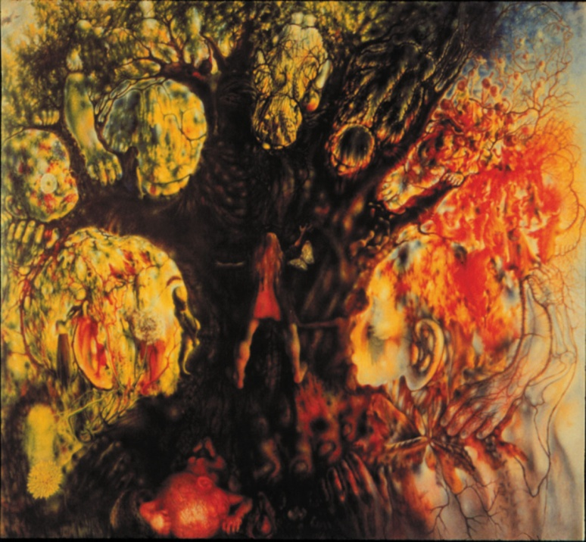

Slide 13
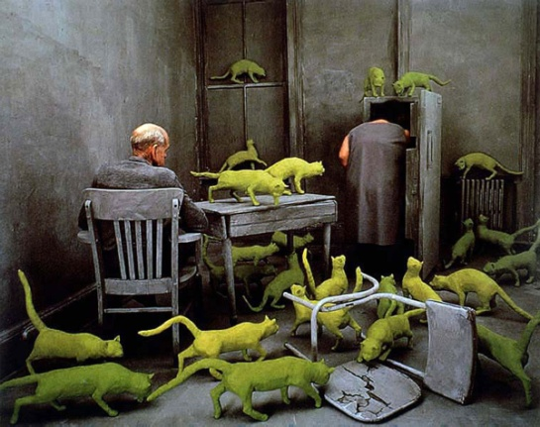

Slide 14
Stage 1 and 2
Stage I Accountive Stage
  Accountive viewers are storytellers. Using their senses, memories, and personal associations, they make concrete observations about a work of art that are woven into a narrative. Here, judgments are based on what is known and what is liked. Emotions color viewers’ comments, as they seem to enter the work of art and become part of its unfolding narrative.
Stage II Constructive Stage
  Constructive viewers set about building a framework for looking at works of art, using the most logical and accessible tools: their own perceptions, their knowledge of the natural world, and the values of their social, moral and conventional world. If the work does not look the way it is “supposed to”—if craft, skill, technique, hard work, utility, and function are not evident, or if the subject seems inappropriate—then these viewers judge the work to be “weird,” lacking, or of no value. Their sense of what is realistic is the standard often applied to determine value. As emotions begin to go underground, these viewers begin to distance themselves from the work of art.

Slide 15
Stages 3 and 4
Stage III Classifying Stage
  Classifying viewers adopt the analytical and critical stance of the art historian. They want to identify the work as to place, school, style, time and provenance. They decode the work using their library of facts and figures which they are ready and eager to expand. This viewer believes that properly categorized, the work of art’s meaning and message can be explained and rationalized.
Stage IV Interpretive Stage
  Interpretive viewers seek a personal encounter with a work of art. Exploring the work, letting its meaning slowly unfold, they appreciate subtleties of line and shape and color. Now critical skills are put in the service of feelings and intuitions as these viewers let underlying meanings o f t h e work—what it symbolizes—emerge. Each new encounter with a work of art presents a chance for new comparisons, insights, and experiences. Knowing that the work of art’s identity and value are subject to reinterpretation, these viewers see their own processes subject to chance and change.

Slide 16
Stage 5
Stage V Re-creative Stage
  Re-creative viewers, having a long history of viewing and reflecting about works of art, now “willingly suspend disbelief.” A familiar painting is like an old friend who is known intimately, yet full of surprise, deserving attention on a daily level but also existing on an elevated plane. As in all important friendships, time is a key ingredient, allowing Stage V viewers to know the ecology of a work—its time, its history, its questions, its travels, its intricacies. Drawing on their own history with one work in particular, and with viewing in general, these viewers combine personal contemplation with views that broadly encompass universal concerns. Here, memory infuses the landscape of the painting, intricately combining the personal and the universal.

