Slide 1

The New APS Arts Assessments: How They Help You
By Raymond Veon
www.igniteart.weebly.com and click on Principal Arts Workshop

Slide 2
I need to know…
What my students are learning in the arts
How well are they learning it
How it helps them succeed

Slide 3
Why?
So I can make decisions about my arts programs based on clear data.

Slide 4
Our Time Together…
Explain the Who, What, When, Where, Why and How
Show what the arts assessments look like
Show the kind of data and how it helps you
Show how you can help ensure success

Slide 5
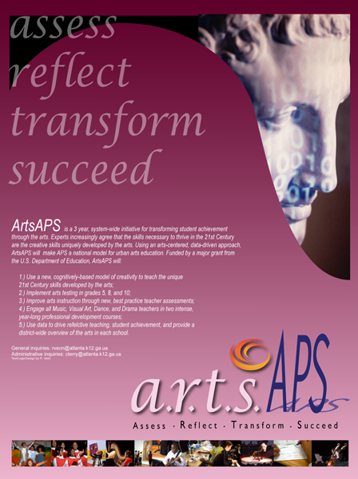
Professional Development for Arts Educators Grant
US DOE
2007
3 Year, $660,000
Unique: How do you transform arts teaching and learning across an entire district?

Slide 6


Slide 7
Ahead of the Curve
Creativity
Qualitative Assessment
No sloganeering on 21st Century Skills
Embedded in all arts assessments

Slide 8
The APS Arts Assessments…
Do not measure a laundry list of facts
They assess a student’s ability to generate and use conceptual and qualitative relationships

Slide 9
The Basics…

Slide 10
Arts Assessments: Who and What
5th Grade
8th Grade
Introductory High School Arts Courses
All Music (Orchestra, Chorus, Band, General)
All Visual Art
Theatre
Dance

Slide 11
Arts Assessments: How
On-Line Assessment: Conceptual Knowledge and Vocabulary
  Multiple Choice and Short Answer
Performance Assessment
Visual and Music Thinking Strategies
  Longitudinal: pre/post test
  Critical Thinking and Inquiry

Slide 12
Arts Assessments: When?
March 28th through May 13th, 2011
All assessment materials due to R. Veon by May 13th
Visual and Music Thinking Strategies
  Longitudinal: pre/post test
  Critical Thinking and Inquiry

Slide 13
What can you do?
Please make sure assessments are completed for:
The good of the students
The good of stakeholders
Reporting to the federal government
To help you

Slide 14
ArtsAPS Training
On-line and self directed PD for those who have not taken the workshop
Some teachers still need ArtsAPS training…
ArtsAPS training supports success on the arts assessments
Target: report 100% participation to the US DOE by September 30th.
I will email a list of on-line and self-directed courses by March 2nd.

Slide 15
Intervisitation Program
1 Day
Target ArtsAPS concepts, CLASS Keys, and any skills you identify for your teacher
Webinar orientation
$100 stipend; ArtsAPS reimburses school (one time payment form and substitute name/ID required)

Slide 16
But why arts assessments?

Slide 17
The Arts Assessments support academic success
Writing is heavily emphasized
Analysis, Interpretation, Synthesis, Creativity
  Few recall items
  Math connections
VTS/MTS
  Speculative thinking and evidentiary reasoning
  Develops cognitive skills used on 70% of CRCT
  Inquiry skills aligned with National Science Standards

Slide 18
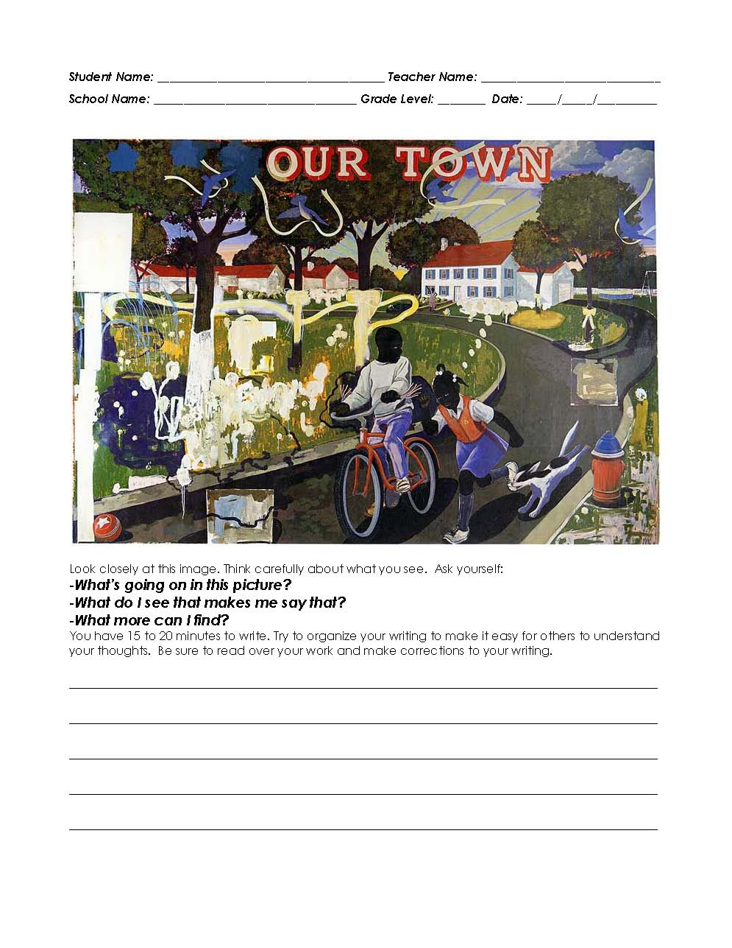
VTS Pre/Post Writing Assessments
All Pre Tests Should Now Be Complete
Pre/Post Test Due Date:
May 13th, 2011
Pre-Test on TOP
Post-Test on BOTTOM
MTS pilot this spring (PD opportunity)

Slide 19
What are my students doing for the Performance Assessments?
Designed to feel like a regular unit of instruction.
5th Grade:
Expressive Portrait with Written Commentary
4-Measure Rhythm Pattern with Written Commentary
8th Grade:
Digital Story Telling with Written Commentary
Music Composition with Written Commentary: Theme and variation
High School:
2-D Community-Based Graphic Design with Written Commentary
Music Composition with Written Commentary: Unity and Variety

Slide 20
This is not your father’s arts class …
Inquiry-based processes align with the National Science Standards
Creativity
  Music composition: a true test of performance skills
  Problem finding and problem framing
  Iterative process & critical reflection
  Reframing experience and knowledge
  Coherently articulating the intangible

Slide 21
What does an arts performance assessment look like?
?

Slide 22

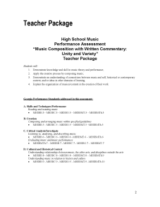
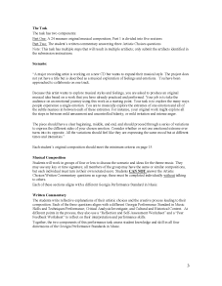
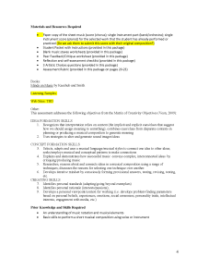
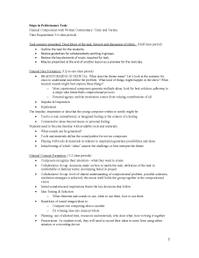
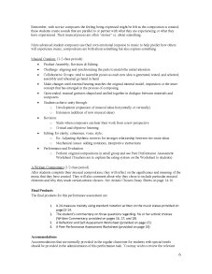
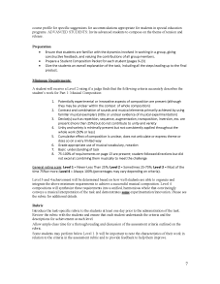
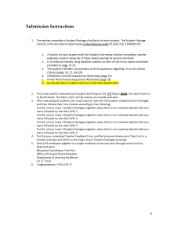
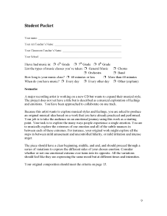
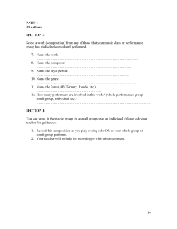
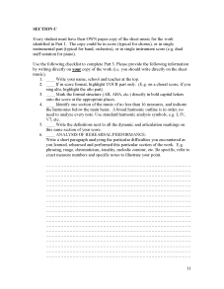
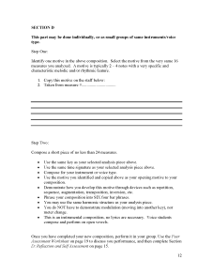
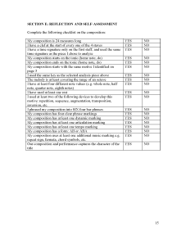
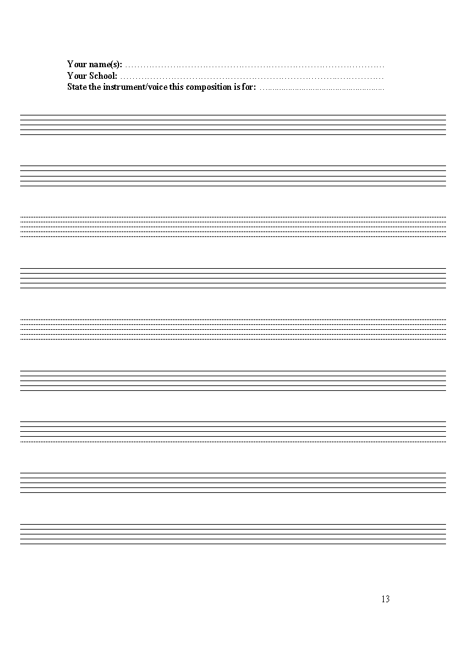

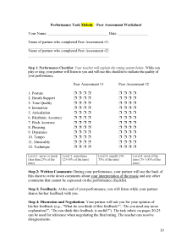
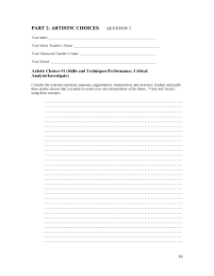
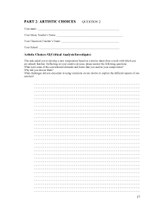
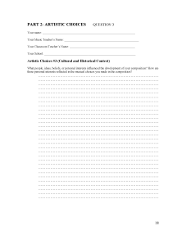
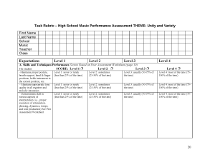
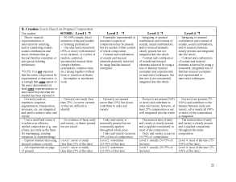
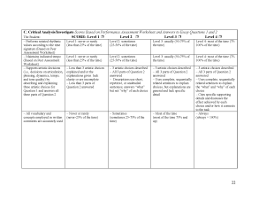
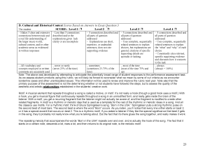
Each teacher gets a comprehensive teaching package following best practices.

Slide 23
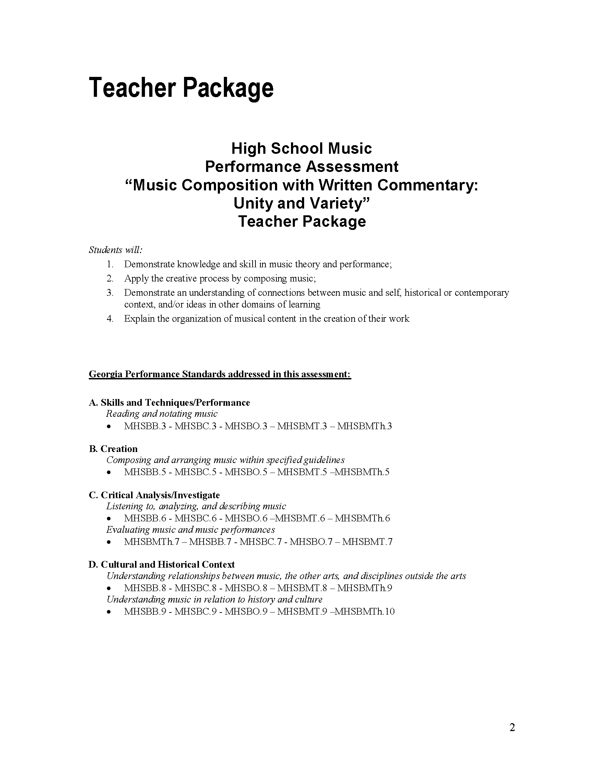
Teacher Packages clearly state what students and teachers will do
GPS clearly identified

Slide 24

Teacher Packages provide clear step by step instructions for teachers.
Embeds PD by asking teachers to perform best practices.

Slide 25

Minimum requirements are clearly listed so teachers understand how to target synthesis and creativity

Slide 26

Clear, step by step submission instructions provided

Slide 27
Teacher Package provides all needed worksheets and forms
These will be the artifacts that are turned in for evaluation

Slide 28
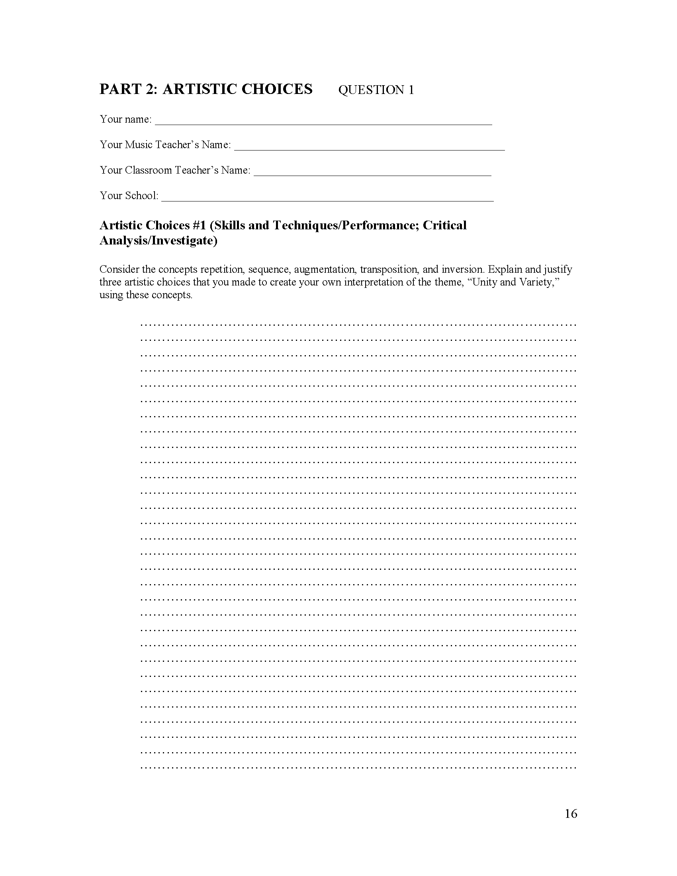
Part 2 always requires students to write and critically reflect on their performance
Supports qualitative assessment

Slide 29

Clear rubrics guide students toward synthesis and creative performance.

Slide 30
Evaluation samples from 2010 pilot
Spring 2010: What is it like to do large-scale arts assessments?
5th Grade Example: “The local art museum has let another museum borrow their Picasso painting. You’ve been asked to create an expressive portrait to replace it while it is on loan.”
A test for synthesis: Can the student juggle the minimum requirements?

Slide 31
Level 2: Does the student understand the minimum requirements?
Level 1 and 2 are lower level; Levels 3 and 4 require synthesis and creativity
Can the relationships between the major shapes be visually read as a portrait?
Does it only use one set of complimentary colors?
Does it show two different emotions?
Does it have tints and shades?

Slide 32
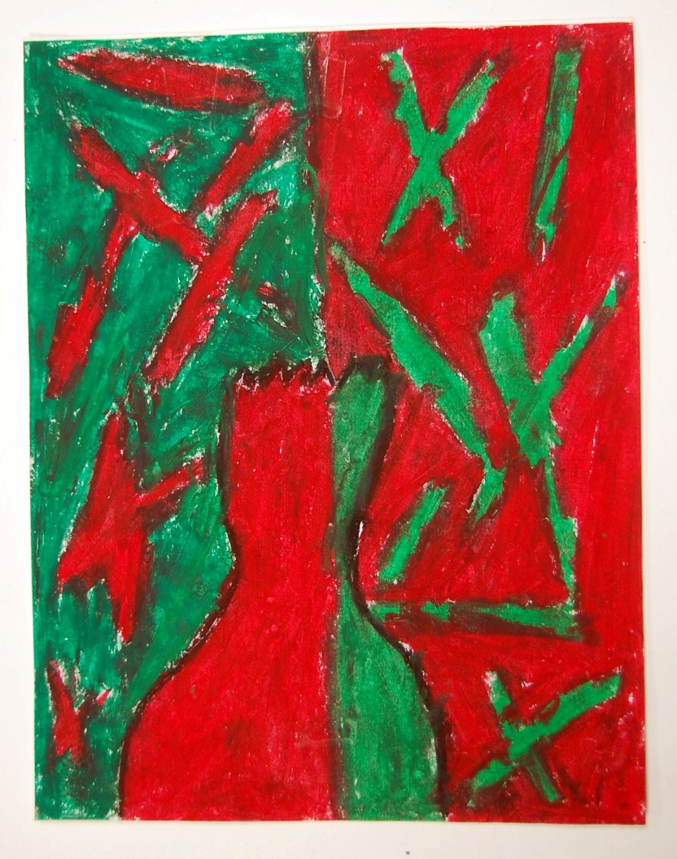
Evaluation samples from pilot
Can the relationships between the major shapes be visually read as a portrait?
Does it reflect an understanding
Of the task? Although it can be
Read as a “portrait” figure,
It does not show 2 different
Emotions (see Question 3)

Slide 33
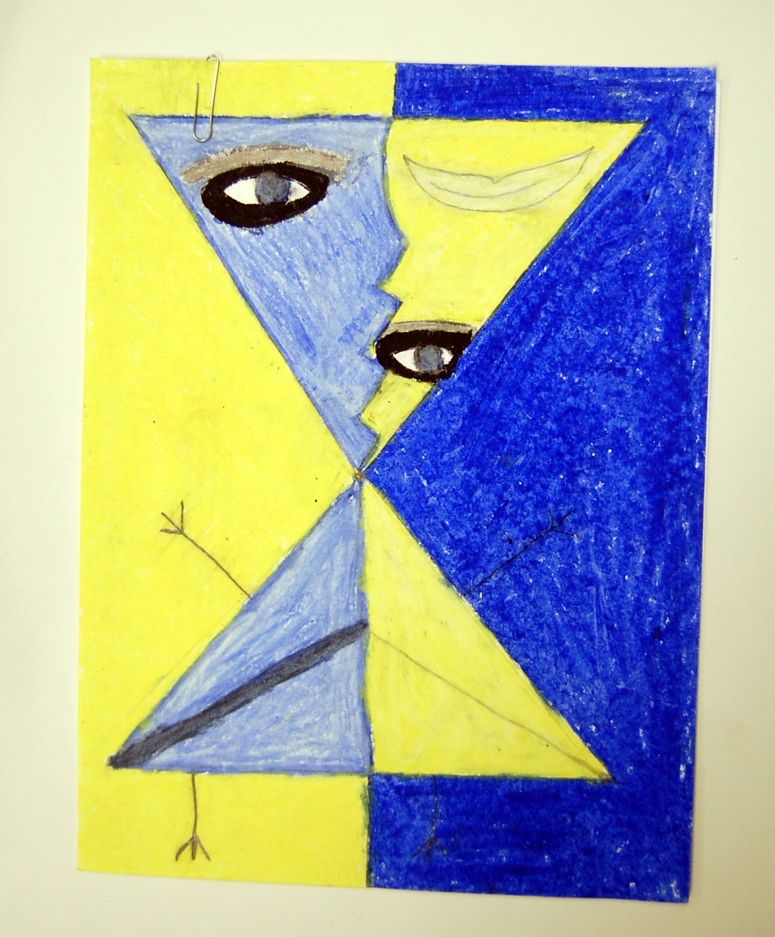

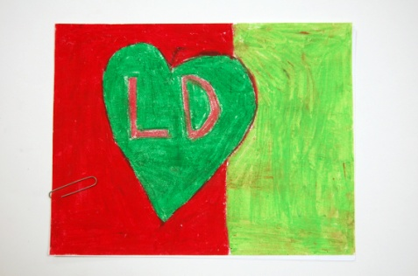
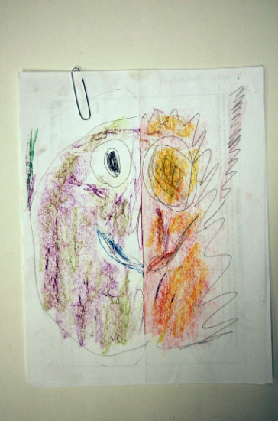

Slide 34
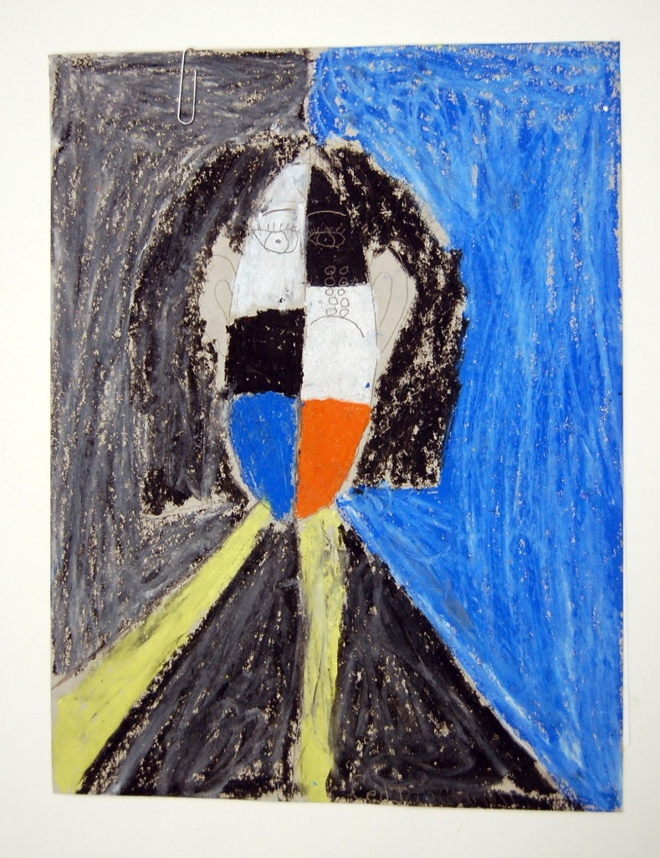
Evaluation samples from pilot
Does it only use one set of complimentary colors?

Slide 35
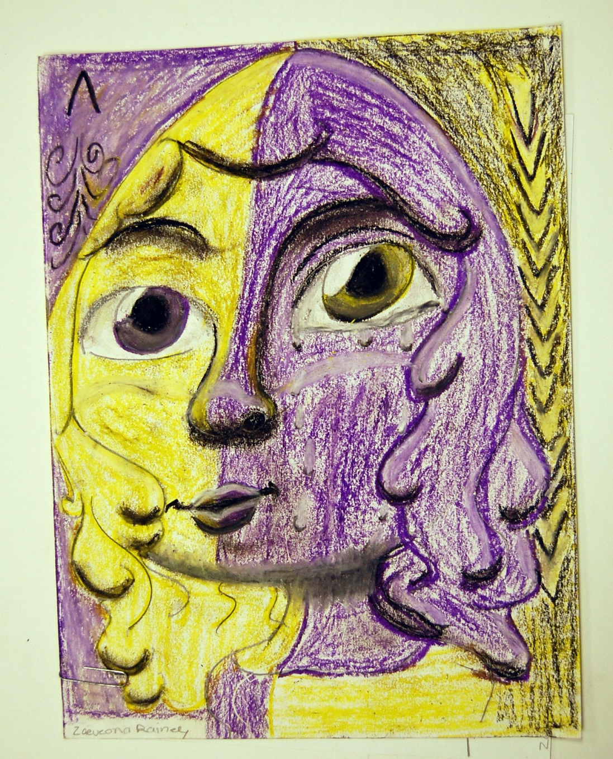
Does it show two different emotions?

Slide 36
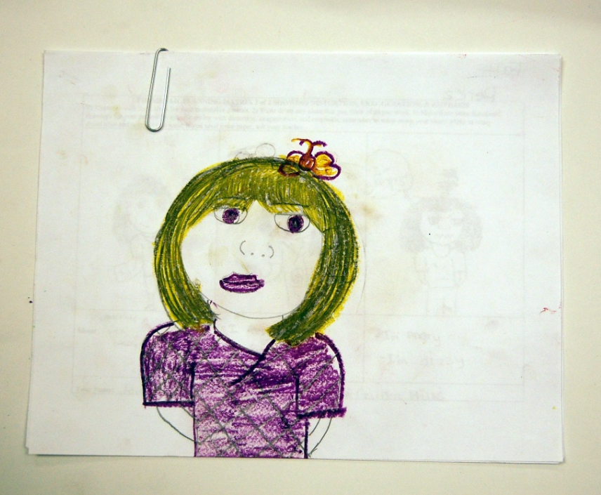
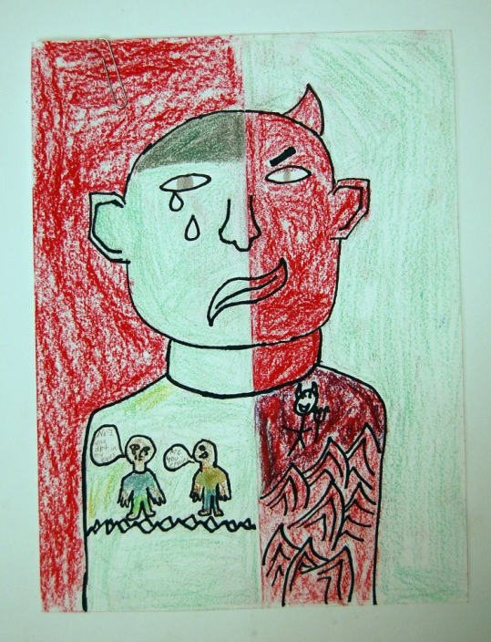
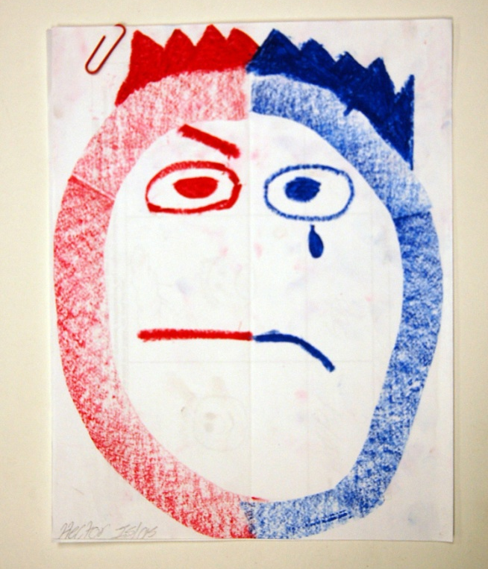
Which demonstrates BOTH an understanding
Of the task AND synthesis of several variables?
Do any demonstrate use of all variables in
Achieving the task?

Slide 37
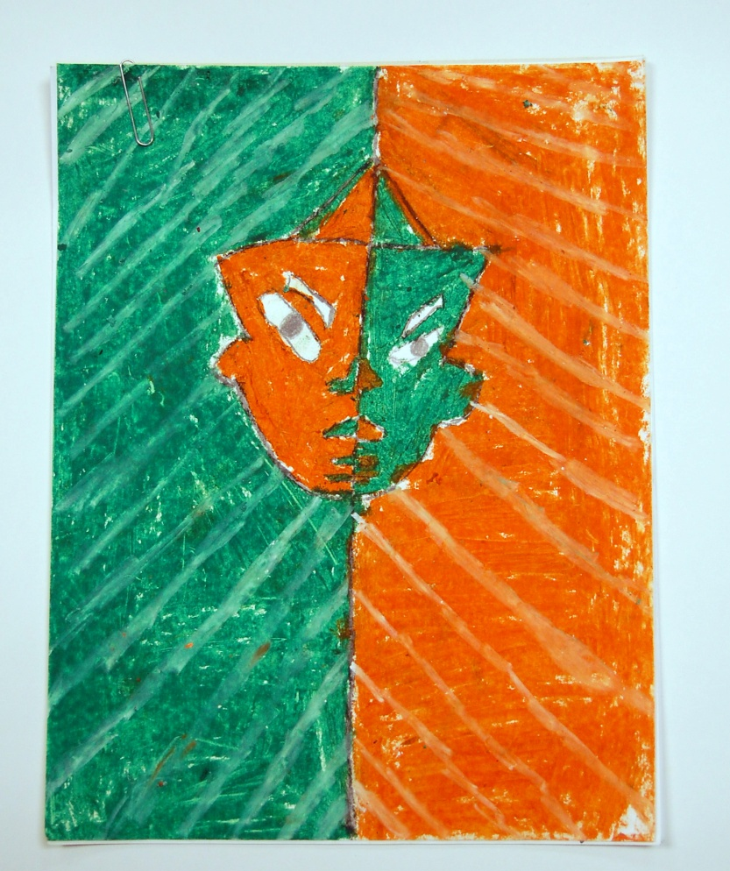
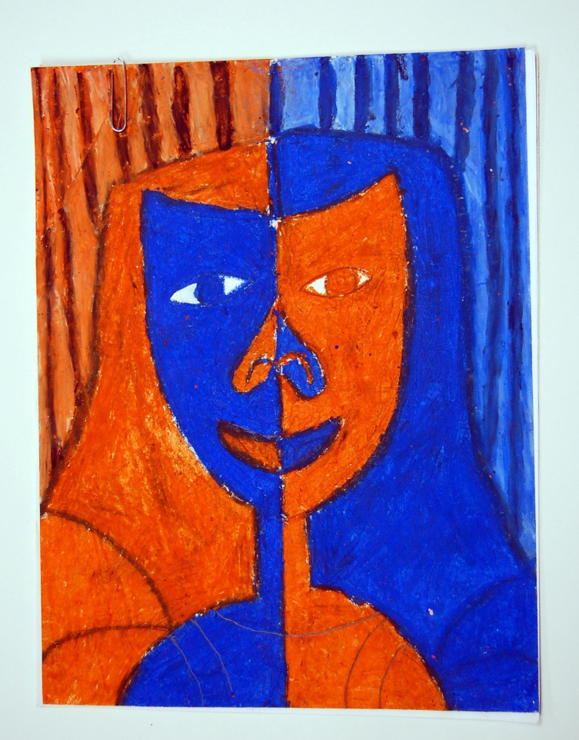
Evaluation samples from pilot
Does it have tints and shades?

Slide 38
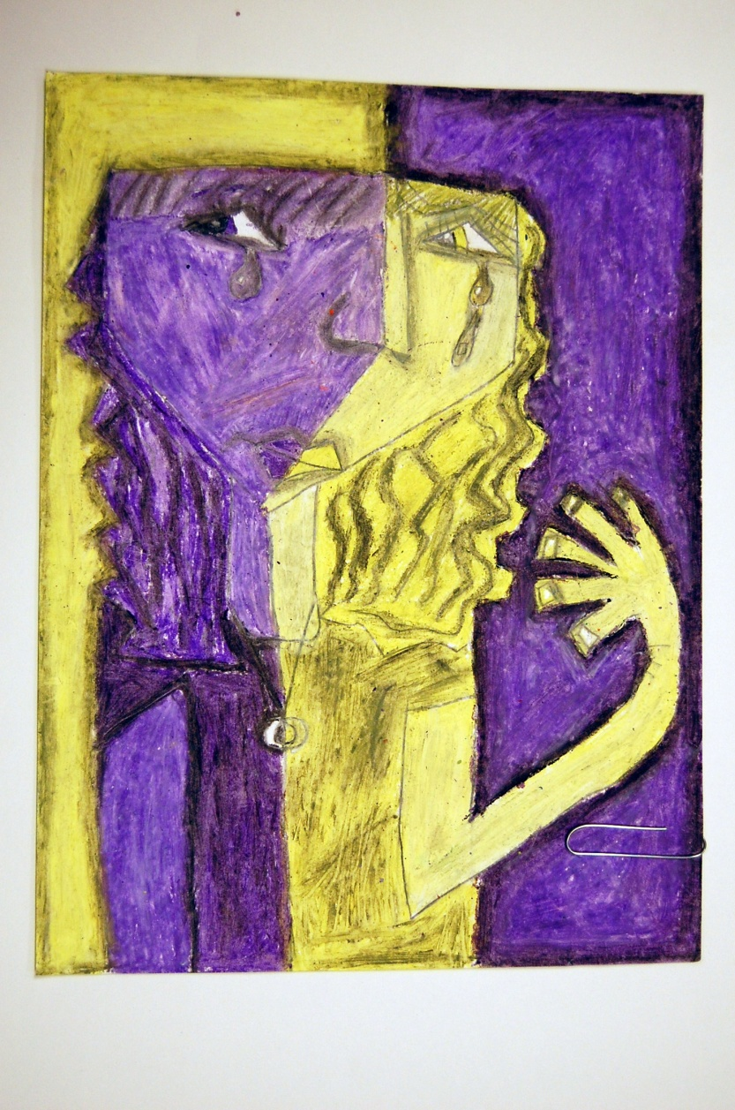
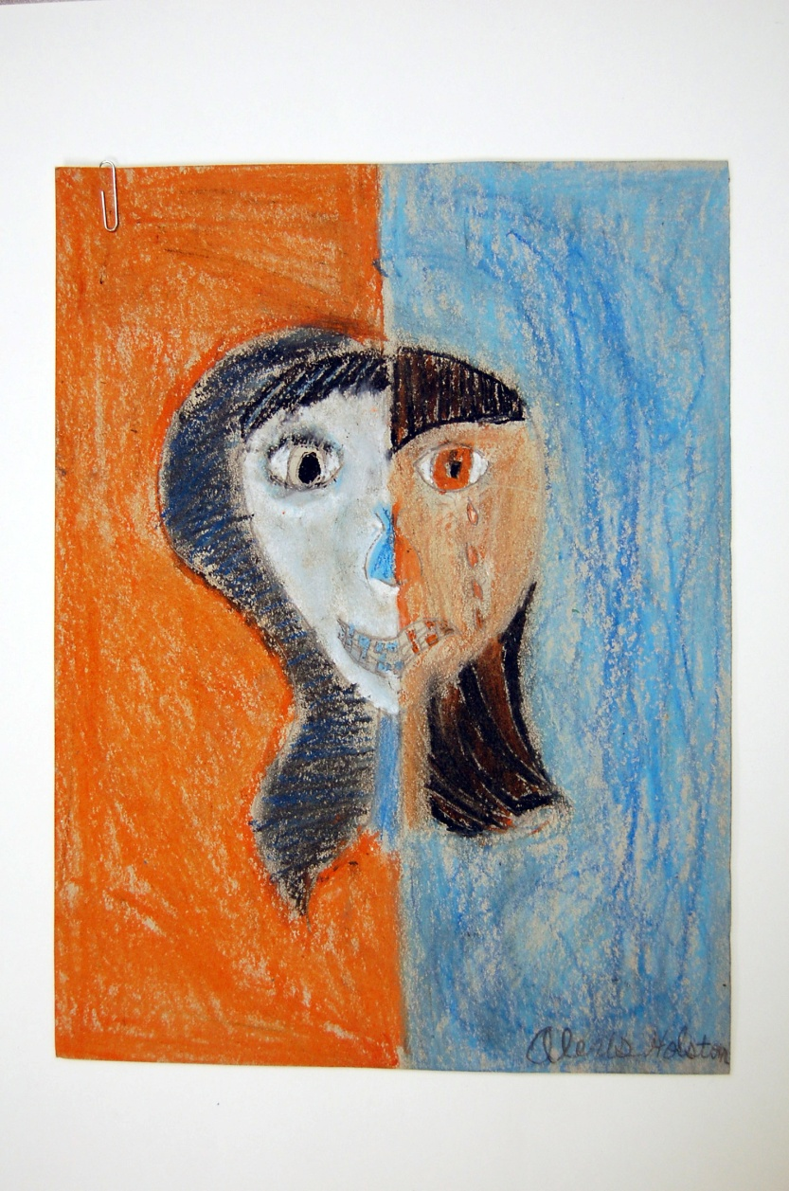
Tints and shades, but 2 emotions? 2 emotions and tints/shades

Slide 39
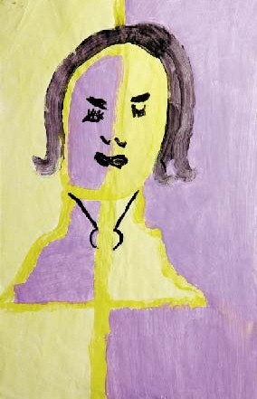
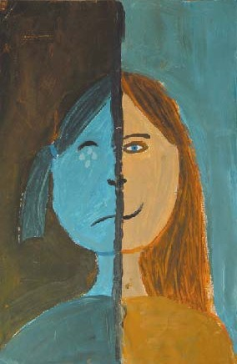
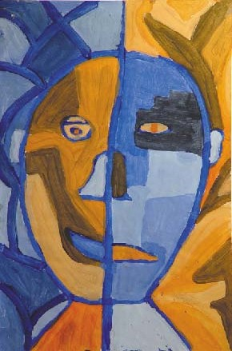

Exemplars from Ontario
Level One Level Two Level Three Level Four

Slide 40
Teacher Preparation
Art teachers notified in August and oriented during the Fall
Support materials posted online
Teacher packages sent via email
Music teachers oriented January 4th

Slide 41
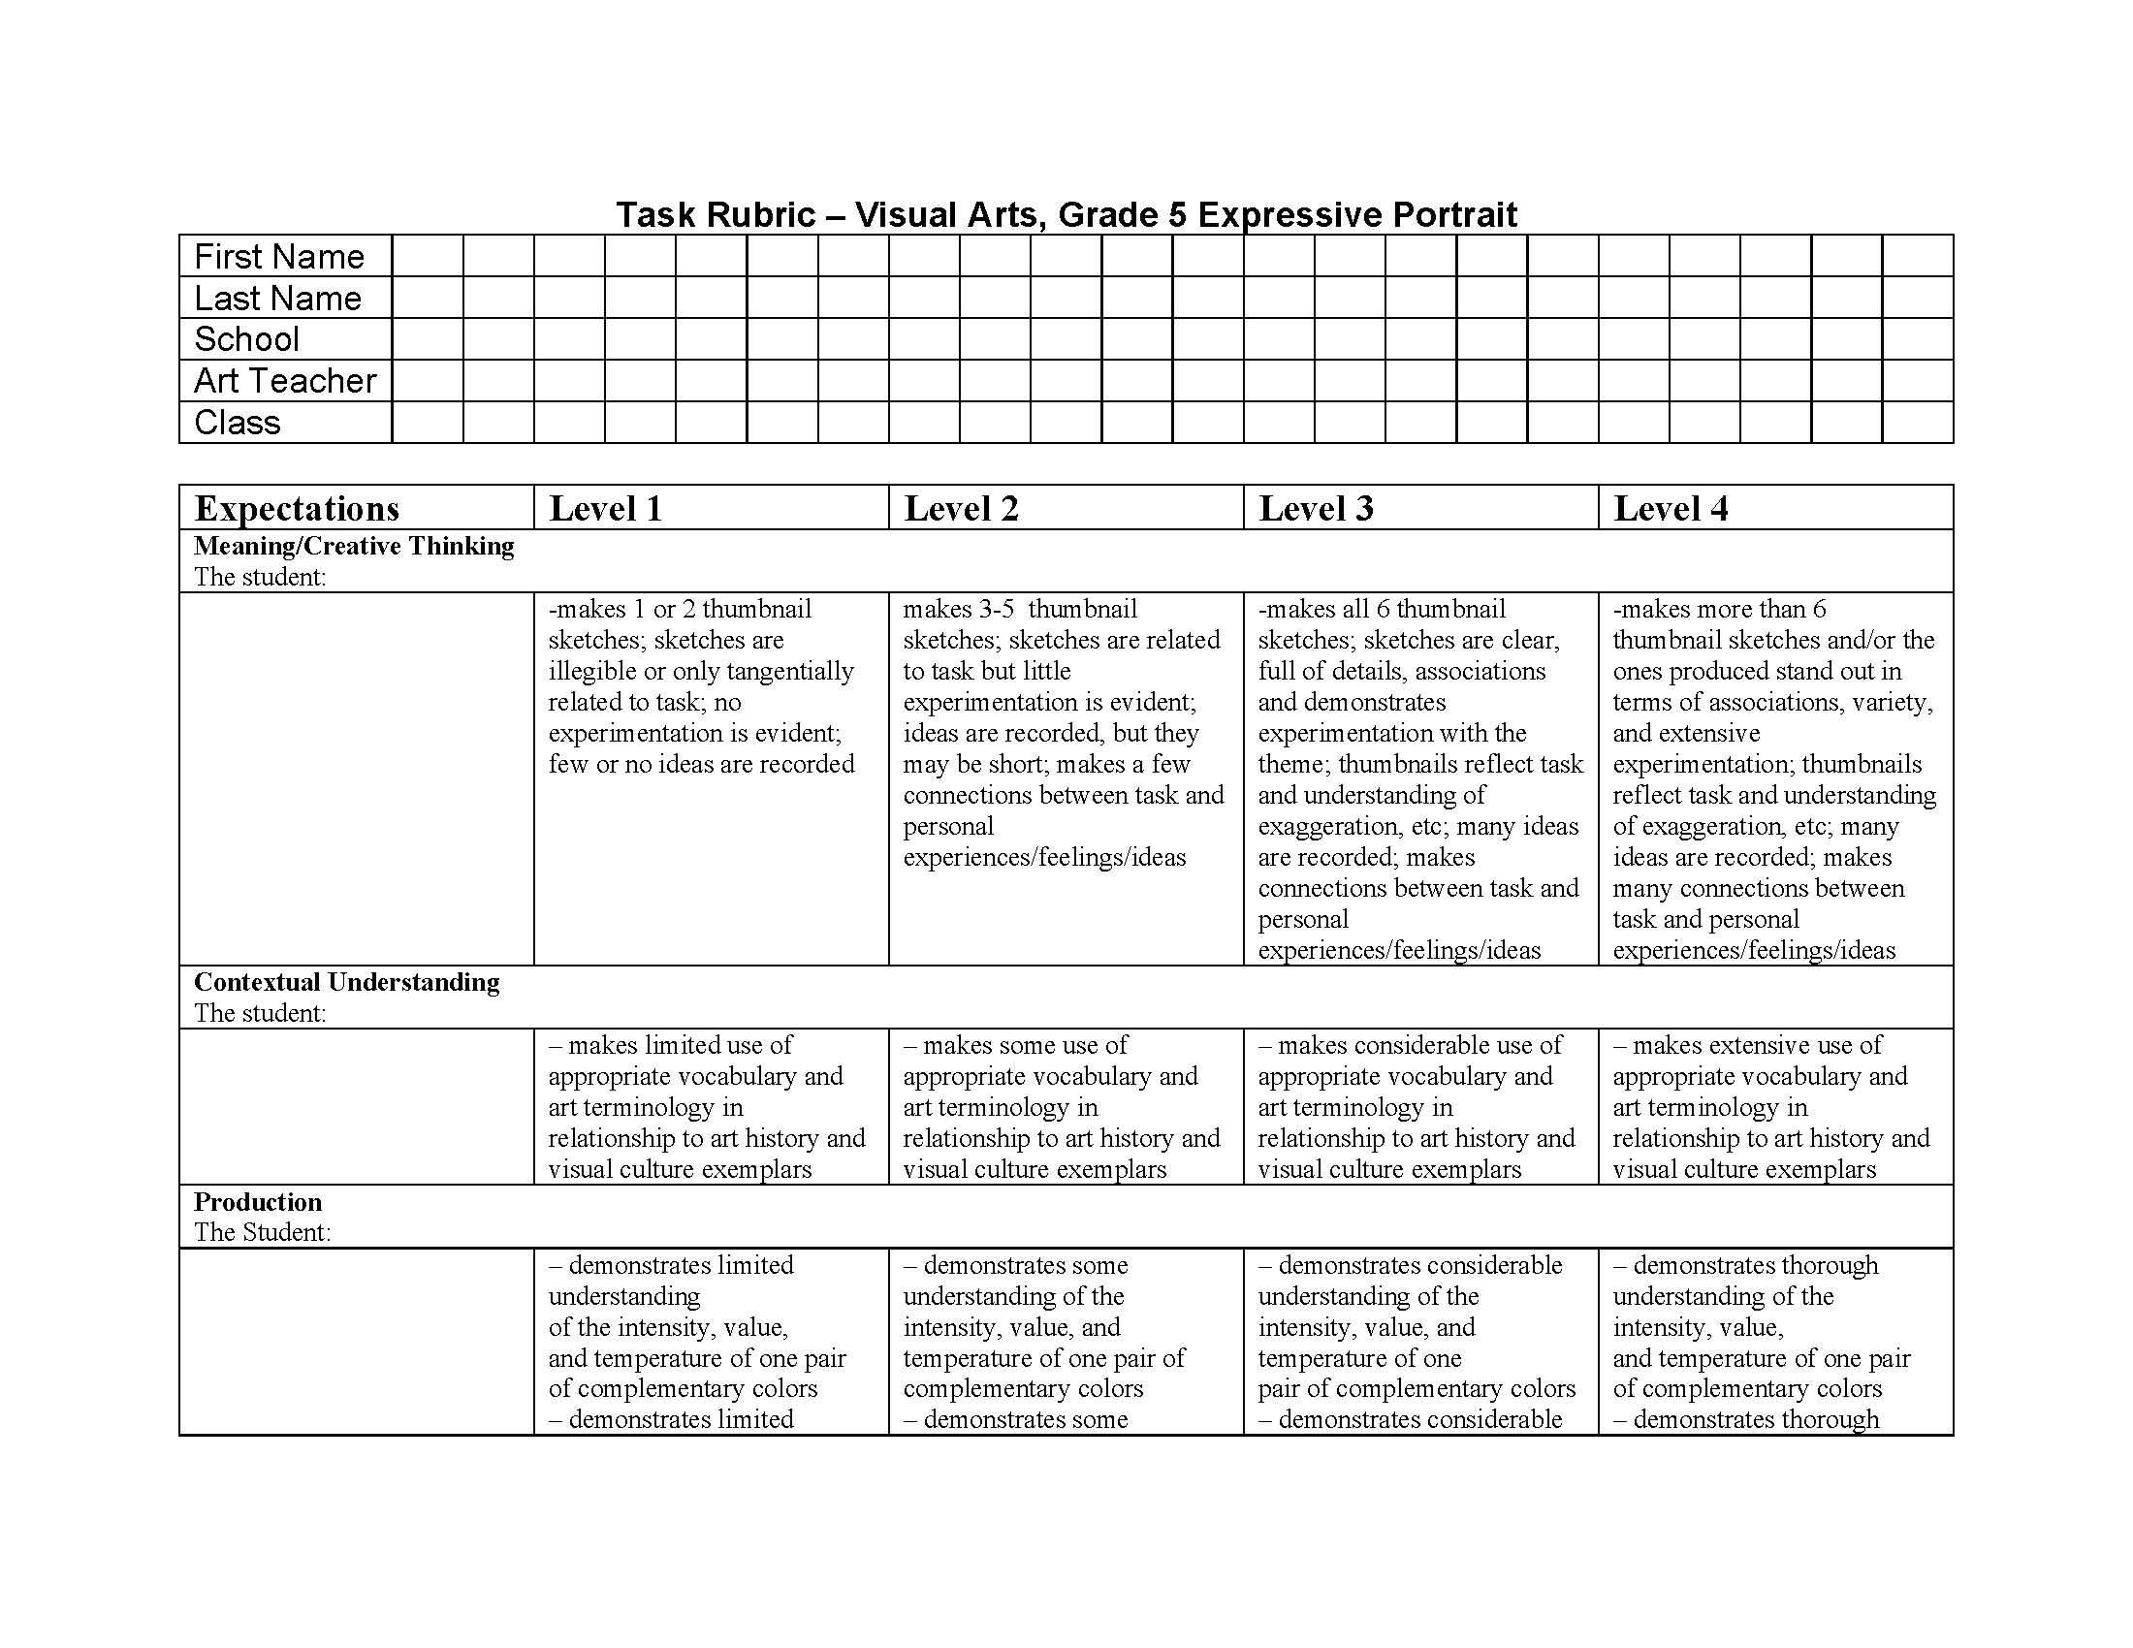
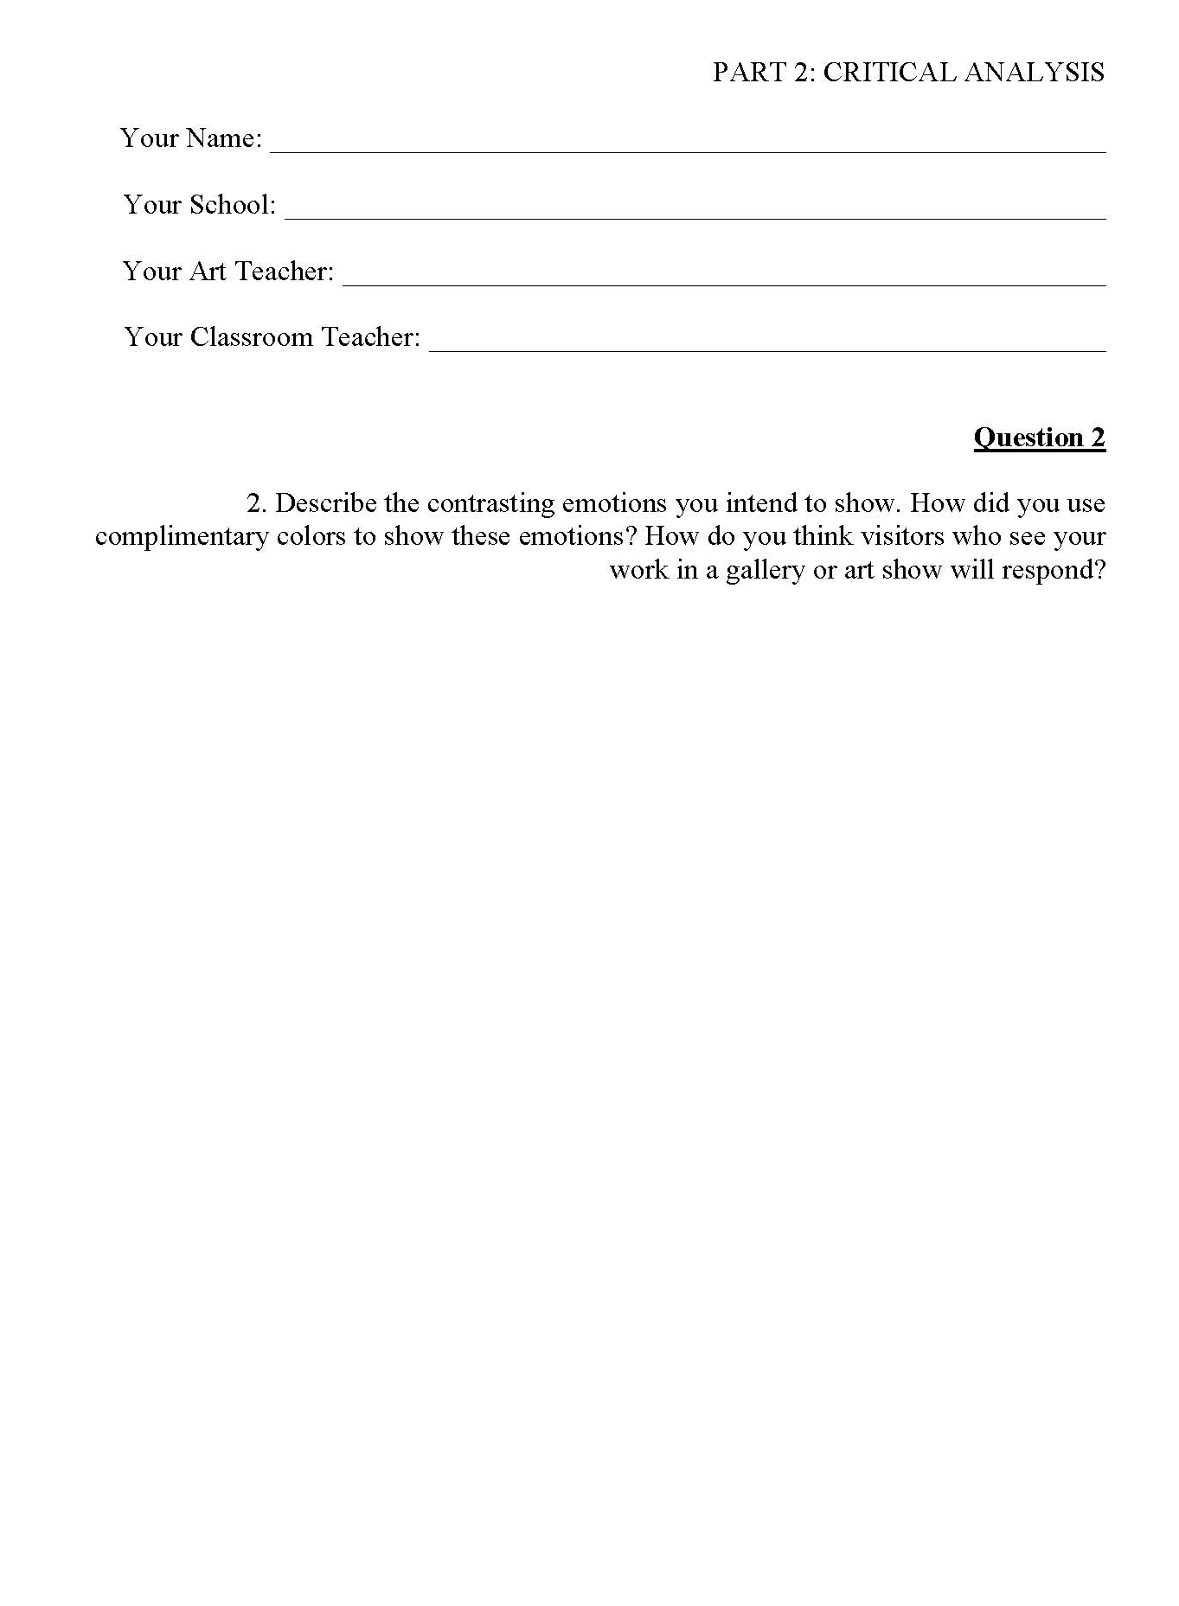
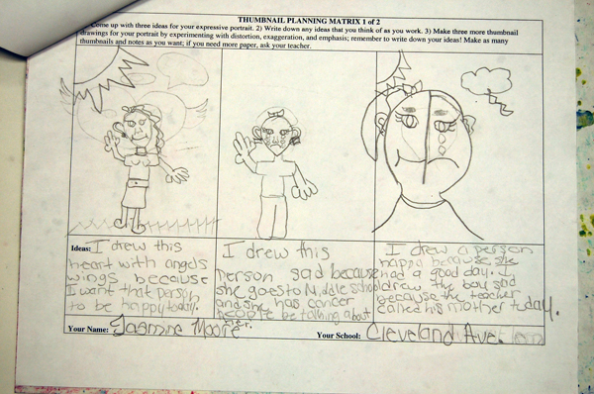
Teacher Will Turn In A Range of Artifacts

Slide 42
Performance Assessment Rubric (2)
Fill out student info on TWO Rubrics
Teacher completes ONE
(Teacher assessment of student; this will be used to “assess the teacher’s assessment” and to align external and internal assessments)
Leave one BLANK
(For outside assessors)

Slide 43
Artifact Order
TOP:
1. Two Rubrics
  One You Fill Out
  One You Add Student Info Only—Judges Will Use This One
THEN
2. Actual Finished Artwork
THEN
3. Thumbnails/Creative Planning Matrix
LAST
4. Written Critical Reflection Answers
Teacher completes top Rubric
2nd Rubric: Student info ONLY

Slide 44

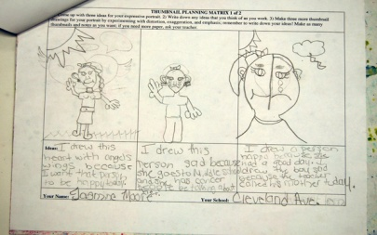
Make FOUR Stacks:
LEVEL 1
LEVEL 2
Put ALL of your Level 1’s together
Put ALL of your Level 2’s together
Put ALL of your Level 3’s together
Put ALL of your Level 4’s together
Do teachers understand the standards?
LEVEL 3
LEVEL 4
Notes:
This is one way we will assess the teachers—do they understand where there students are?

Slide 45
Please make sure your teachers follow submission guidelines
LEVEL 1
LEVEL 2
Time consuming
Streamlines process
Helps us identify teachers needing additional support
LEVEL 3
LEVEL 4
Notes:
This is one way we will assess the teachers—do they understand where there students are?

Slide 46
Outside Evaluators
Judge 1 |  |  |  |  |  | Student Name:
MC |  | CU | P | AR | C
Judge 2 |  |  |  |  |  | School:
MC |  | CU | P | AR | C
Judge 3 |  |  |  |  |  | Grand Total:
MC |  | CU | P | AR | C | From Row D M/CT _____ (add 2.5) Divided by # of Judges = _______ CU _____ Divided by # of Judges = _______ P _____ (add 2.5) Divided by # of Judges = _______ AR _____ Divided by # of Judges = _______ C _____ Divided by # of Judges = _______ Grand Percentage Total:
TOTALS
MC | CU |  | P | AR | C

Slide 47
What kind of data will I get?
Sample data from Spring 2010 Pilot Assessments

Slide 48
You will receive data in different forms.
Spread sheets with mean scores, etc.
 | All data from all listed schools
 | Total Correct Conceptual Knowledge and Vocabulary | # of students | Total Percentage 1 | Total Questions 1 | Mean of Scores Conceptual Knowledge | Std. Deviation 1 | Total Correct Performance Assessment | # of students | Total Percentage 2 | Total Questions 2 | Mean of Scores Performance Assessment | Std. Deviation 2
School A | 1575 | 49 | 2811 | 2744 | 57.3673469 | 13.7956724 |  | 0
School B | 586 | 16 | 586 | 896 | 65.375 | 12.2630882 | 189.5 | 18 | 758 | 450 | 42.11111111 | 20.92532631
School C | 818 | 25 | 1462 | 1400 | 58.48 | 8.22151649 | 241 | 29 | 964 | 725 | 33.24137931 | 17.84387685
School D | 333 | 11 | 595 | 560 | 59.5 | 13.6565003 | 168 | 12 | 672 | 300 | 56 | 17.58098146
School E | 347 | 12 | 619 | 616 | 56.2727273 | 23.0655193 | 109 | 12 | 436 | 275 | 39.63636364 | 15.04176005
School F | 186 | 4 | 332 | 224 | 83 | 4.24264069 | 108.5 | 13 | 434 | 350 | 31 | 3.902661814
School G | 238 | 9 | 426 | 504 | 47.3333333 | 7.08872344 | 187.5 | 18 | 750 | 450 | 46.875 | 14.17921013
School H | 245 | 7 | 438 | 392 | 62.5714286 | 9.89708952 | 62 | 7 | 248 | 175 | 42.74721351 | 16.07126984
School I | 577 | 14 | 1030 | 784 | 73.5714286 | 12.8883626 | 213.5 | 15 | 854 | 375 | 56.93333333 | 23.74708002
School J | 673 | 22 | 1202 | 1232 | 54.6363636 | 13.2505003 |  | 0
School K | 735 | 22 | 1313 | 1232 | 59.6818182 | 15.944506 | 311.5 | 25 | 1246 | 625 | 49.84 | 16.98940847
School L | 452 | 13 | 806 | 728 | 62 | 12.0968315 | 309.8 | 23 | 1239 | 575 | 53.86956522 | 20.45017081
School M | 454 | 15 | 810 | 840 | 54 | 20.6328448 | 179.5 | 18 | 718 | 450 | 39.88888889 | 14.46248245
School N | 566 | 16 | 1010 | 840 | 67.3333333 | 10.7215848 |  | 0
School O | 870 | 21 | 1553 | 1176 | 73.952381 | 12.001984 |  | 0
School P | 510 | 18 | 913 | 1008 | 50.7222222 | 7.01096247 |  | 0
School Q | 864 | 19 | 1544 | 1064 | 81.2631579 | 12.507074 |  | 0
School R |  | 0 |  |  |  |  | 158 | 16 | 632 | 400 | 39.5 | 12.20928608
School S | 460 | 17 | 822 | 896 | 51.375 | 25.0489521 | 171.5 | 17 | 686 | 400 | 47.36666667 | 12.13191384
School T |  | 0 |  |  |  |  | 120 | 15 | 480 | 375 | 32 | 0
Totals Each Test | 10489 | 310 | 18272 | 17136 | 62.1353078 | 5.43577178 | 2529.3 | 238 | 10117 | 5925 | 43.64353726 | 14.68110201
Total taking BOTH Tests |  | 165
Combined Assessments TC/TQ
TC | 13018.3 |  |  | There were 273 student scores recorded from 21 schools. 310 took the Conceptual Knowledge Assessment; 238 took the Performance Assessment; 165 took BOTH assessments and thus have two scores as well as one combined score. Legend for the worksheets TC = Total Correct TQ = Total Questions
TQ | 23061
 | 56
Combined Mean | 52.88941763
Total Assessment 1 TC/TQ | 61.21031746
Total Assessment 2 TC/TQ | 42.68860759

Slide 49
Visual reports so you can compare scores on each assessment.
Visual Art: CKV and PA Mean Score Comparison

Slide 50
You can see how each class in your school is doing.
Notice Applying Art Vocabulary

Slide 51
You can track individual student scores.
Notice Reading Music Notation

Slide 52
When will you get the data?
On line access: Mid-Summer 2011
  You will receive a website link and password via email
Final reports mailed beginning of ‘11-’12 School Year

Slide 53
Visual Thinking Strategies
Take a minute to look at this picture.
What is going on in this picture?
What do you SEE that makes you say that?
What more can we find.
Paraphrase! Point! Link!

Slide 54


Slide 55
Visual Thinking Strategies
Ten lessons per year (Two 15 minute VTS sessions=1 lesson)
Increases writing skills
Over three years, raises reading/LA and math scores (12% and 16%, Grades 3-5 in Miami-Dade County)
Create confidence in student’s ability to comprehend complexity
Foster a desire to learn and take risks
Encourage students to value their own ideas while listening and building on the ideas of others

Slide 56
Visual Thinking Strategies
Thinking behaviors
  Making complex observations
  Drawing conclusions
  Expressing and articulating ideas in discussion and writing
  Considering a range of possibilities (Speculative Inquiry, one of the stages of the creative process)
  Revising
  Elaborating
  Applying these behaviors to new situations without prompting

Slide 57
Visual Thinking Strategies
In order to write well, we must speak well—too little time is spent with students in conversation to allow speaking skills to develop
By paraphrasing, teachers build grammar, syntax, and vocabulary
Teaches how to make observations, draw inferences, and justify statements by citing evidence…skills useful in what other subject?

Slide 58
What will the On-line Assessments look like?
Conceptual Knowledge and Vocabulary (CKV)
Questions grouped by category
Multiple choice and short answer
Few recall items
Many analysis and interpretation questions

Slide 59
Breakdown of Questions
High School Categories:
Slides 2-7: Art Methods and Materials
Slides 8-17: Art Concepts
Slides 18-22: Artistic Thinking
Slide 23: Art Concepts
Slides 24-26: Art Concepts
Slides 27-29: Art and Technology
Slides 30-34: Design Concepts
Slides 35-39: Postmodern Concepts
Slides 40-43: Major Themes in Art
Slides 44-45: Creative Strategies

Slide 60
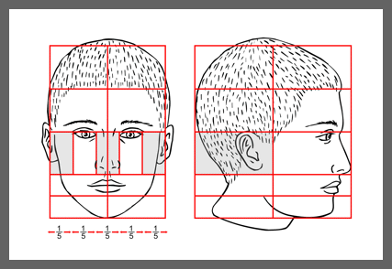
Art Connections to Math
21. The illustration above shows the proportions of a person’s face. Based on this illustration, the distance between the chin and the tip of the nose is what fraction of the total distance between the chin and the top of the head?
1/5
1/4
1/3
1/8

Slide 61
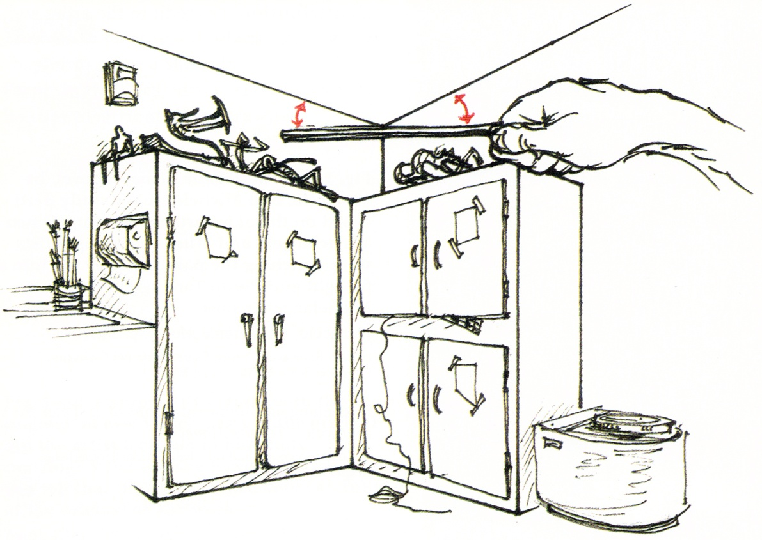
When drawing or painting from life, why would you use the sighting strategy illustrated above?
A. To determine how to draw a straight line
B. To determine the height of a vertical line
C. To measure the width of an area
D. To determine how to depict an angle

Slide 62
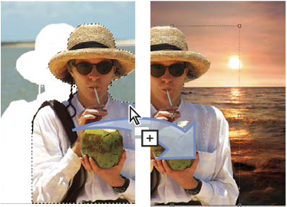
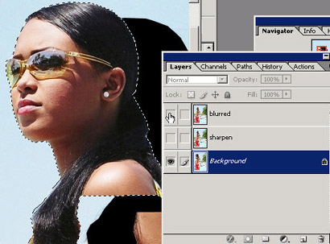
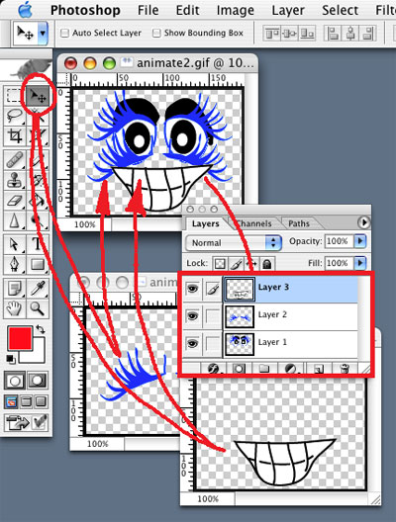
In the pictures above, what digital imaging tool is being used?
A. Eraser Tool
B. Drawing Tool
C. Move Tool
D. Fill or Paint Bucket Tool

Slide 63





Original
Look at the pictures. The four pictures below the original have been changed. What digital imaging tool was used to make the four variations that we see below the original?
A. Eraser Tool
B. Filter Tool
C. Move Tool
D. Selection Tool

Slide 64


Artists often use “hidden” basic shapes to organize the overall visual dynamics in their art. Which of the choices below shows the major, dominant shape motif that George Bellows used in composing his painting, Dempsey and Firpo (1924)?
A
B
C
D

Slide 65

A
B
C
D
Look at these pictures. Match the illustrations to the descriptions below by entering the correct letter by the description.
____ Fired clay; clay has been transformed and has shrunk another 3-7%
____ Green-ware clay; clay is dry with approx. 5% shrinkage
____ Soft clay; best for throwing on the wheel or sculpting
____ Leather-hard clay; retains some moisture so slabs can be joined or pots trimmed
Science Connection

Slide 66






9. What step in the process is NOT shown in the pictures above?
A. Preparing the clay
B. Applying slip
C. Scoring the clay
D. Attaching slabs

Slide 67


Look at these paintings by Ed Ruscha.
Which of the following best describes the perspective being used in both of these artworks?
A. One-Point Perspective
B. Two-Point Perspective
C. Three-Point Perspective
D. Multiple Perspective

Slide 68

14. Look carefully at this painting by Caravaggio. Select the three terms below that best describe this work.
Shallow Space | Cool Colors
Low Contrast | Deep Space
Foreshortening | Chiaroscuro

Slide 69

This sculpture by African American artist Willie Cole is based on a visual analogy. Visual analogies are based on similarities between how something looks (its structure) or how something works (its function).
The visual analogy shown in this sculpture is based on the:
A. The structural similarity between the feathers and fire
B. The functional similarity between the feathers and fire
C. The structural similarity between the feathers and steam
D. The functional similarity between steam and fire

Slide 70









A: Works by African American Artist Willie Cole. B: Source imagery used by Cole in his work, including African masks, irons used for clothes (a symbol of labor), and diagrams showing how to load African slaves into slave ships
A
B
Compare the artwork in A to the source imagery used to create it in B. Cole’s artwork is based on both metaphors and visual analogies to his source material. Write at least three sentences that:
A. Describe the visual analogy between Cole’s use of the iron image and African masks.
B. Describe the functional analogy between Cole’s use of the iron image and the function of an iron.
C. Describe the visual and functional analogy between Cole’s use of the iron and the shape and function of slave ships.

Slide 71


Slide 72


Slide 73


Slide 74


Slide 75
How will data be disaggregated?
Individual student answers, scores by category, percent correct and total score/percent correct
By each question & question type
By class
By arts teacher
By school
By SRT
Multiple comparisons: SRT to District, School to SRT….
By time in arts class, by number of arts classes taken, by in-school and home-based arts experiences, etc.

Slide 76
How will data be disaggregated?
Individual student answers, scores by category, percent correct and total score/percent correct
Mean score calculation for class for each question
Compare individual student scores with class mean scores
Mean score calculation for teacher for each question
Compare teacher mean scores with school mean scores
Compare class mean scores with school mean scores
Mean score calculation for school for each question
Compare school mean scores with SRT mean scores
Mean score calculation for SRT for each question
Mean score calculation for district for each question
Compare SRT mean scores with district mean scores
Mean score calculation for class for each category/question group
Mean score calculation for teacher for each category/question group
Compare mean scores by class for each category with teacher mean scores
Mean score calculation for school for each category/question group
Compare school mean scores for each category/question group with SRT means
Mean score calculation for SRT for each category/question group
Compare SRT mean scores for each category/question group with district means
Mean score calculation for district for each category/question group
Generate your own reports online

Slide 77
CLASS Keys Connections
CP 1.1 Plans with deep knowledge of content and delivery techniques
  Rubrics clearly indicate expected content depth; teacher packages provide step-by-step best practices in delivery
CP 2.1 Uses the required curriculum to plan instruction and assessment
  New arts curriculum: Vertical and horizontal alignment replaces fragmented instruction
CP 2.2 Uses an organizing framework to plan instruction
  Teacher packages provide models
CP 2.3 Plans assessment to measure mastery of the curriculum
  All assessments set high standards & target mastery of skills and knowledge

Slide 78
CLASS Keys Connections
SBI 1.2 Engages students in higher order thinking skills
  All arts assessments require H.O.T. to achieve adequate scores
SBI 1.5 Uses accessible technology to enhance learning
  On Line Assessments; Digital Story Telling
SBI 2.1 Demonstrates high expectations with students playing roles in learning
  High expectations embedded in rubrics; student-centered performance assessments and VTS/MTS; student self-assessment/reflective thinking emphasized; real-world scenarios
SBI 2.2 Communicates clearly the learning expectations
  Everything is clearly explained in step-by-step format as a model for instruction

Slide 79
CLASS Keys Connections
Arts assessments tell teachers what students need to know and do by the end of grades 5, 8, and intro HS courses:
AL 1.2 Uses formative assessment strategies to adjust instruction and AL 1.3 Uses a variety of summative strategies to evaluate mastery of curriculum
  What formative and summative strategies has the teacher put in place to improve performance on the arts assessments?
AL 2.1 Uses data to design appropriate, timely interventions
  Data from assessments will spotlight areas of growth to target for the next year

Slide 80
CLASS Keys Connections
Arts assessments tell teachers what students need to know and do by the end of grades 5, 8, and intro HS courses:
AL 1.2 Uses formative assessment strategies to adjust instruction and AL 1.3 Uses a variety of summative strategies to evaluate mastery of curriculum
  What formative and summative strategies has the teacher put in place to improve performance on the arts assessments?
AL 2.1 Uses data to design appropriate, timely interventions
  Data from assessments will spotlight areas of growth to target for the next year

Slide 81
What can I do?
Please make sure your arts teachers:
Do the VTS pre/post test.
Have access to computers/the computer lab
  K-12 Online Assessments & 8th Grade Art
Submit the performance assessments properly
Complete and turn in all assessment materials by May 13th
And finally…

Slide 82
What can I do?
Please remember to review your data over the summer!
  We will send a report directly to you, but you will have faster access by checking the website
  The website and log-in information will be sent to you

Slide 83
THANK YOU FOR YOUR TIME!
Please remember to provide your Lawson Number and School so we can process your stipend.

