Slide 1
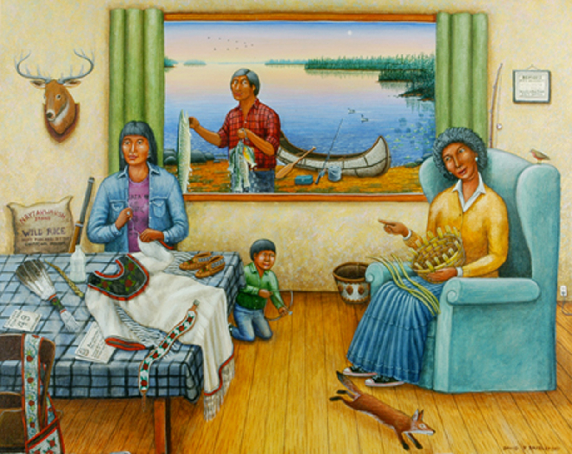

Slide 2
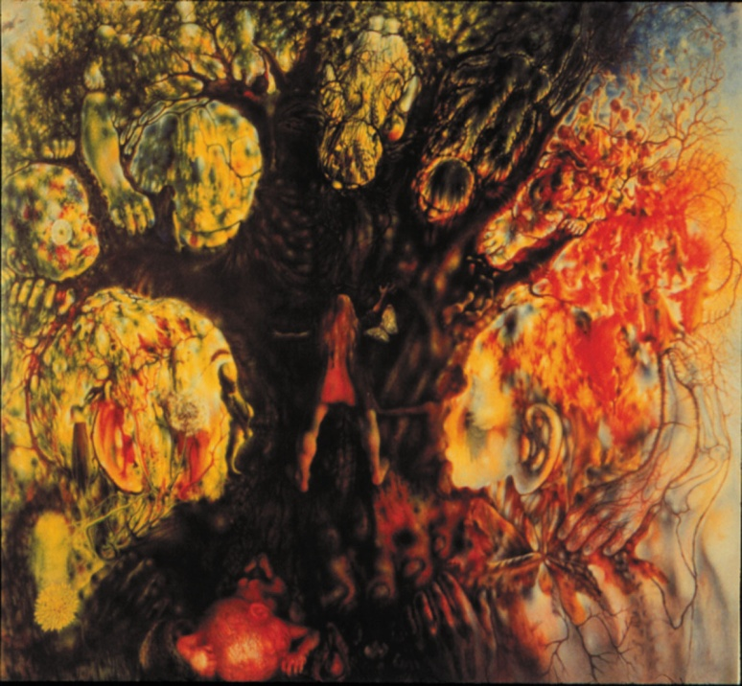
Take a minute to
Look at this picture.
What’s going on
in this picture?*
What do you
SEE that makes
you say that?
What more can
we find.
Paraphrase.
Point.
Link.
*For K-1, be more
Concrete and ask
“What do you SEE
in this picture.”

Slide 3
It’s not easy being
GREEN
Art 3700
Professor Raymond Veon
Notes:
Do colors have meaning?
Meaning arises from an image/attribute in context – not something inherent, essential

Slide 4
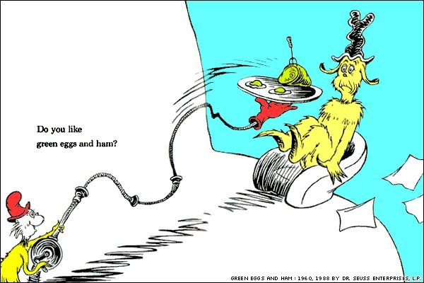

Slide 5
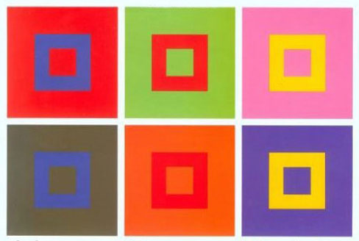
Notes:
Johannes Itten – Interaction of Color

Slide 6
Notes:
From Wikipedia 9_30_13
Etymology and linguistic definitions
The word green has the same Germanic root as the words for grass and grow.
Green in history and art
In the ancient world
Neolithic cave paintings do not have traces of green pigments, but neolithic peoples in northern Europe did make a green dye for clothing, made from the leaves of the birch tree. it was of very poor quality, more brown than green. Ceramics from ancient Mesopotamia show people wearing vivid green costumes, but it is not known how the colors were produced.^{[21]}
In Ancient Egypt green was the symbol of regeneration and rebirth, and of the crops made possible by the annual flooding of the Nile.
In the Middle Ages and Renaissance
In the Middle Ages the color of clothing often showed a person's social rank and profession. Red was worn by the nobility, brown and gray by peasants, and green by merchants, bankers and the gentry and their families. The Mona Lisa wears green in her portrait, as does the bride in the Arnolfini portrait by Jan van Eyck.
The Green Knight was one of the most famous characters in the tales of King Arthur, written in the 14th century.
Duccio di Buoninsegna painted the faces in this painting (1308-1311) with an undercoat of green earth pigment. The surface pink has faded, making the faces look green today.
In the Arnolfini portrait by Jan van Eyck (1434), the rich green fabric of the dress showed the wealth and high status of the family.
In the 15th century "Saint Wolfgang and the Devil" by Michael Pacher, the Devil is green. Poets such as Chaucer also drew connections between the color green and the devil.^{[28]}
In this 1503 painting by Perugino, malachite pigment was used to paint the bright green garments of the worshippers, while the background greens were painted in green earth pigments.
Dedham Vale (1802) by John Constable. The paintings of Constable romanticized the vivid green landscapes of England.
In the paintings of Jean-Baptiste-Camille Corot (1796-1875), the green of trees and nature became the central element of the painting, with the people secondary.
"Symphony in gray and green; The Ocean" by James McNeil Whistler (1866–72).
The Night Cafe, (1888), by Vincent van Gogh, used red and green to express what Van Gogh called "the terrible human passions."
In science
Green in optics and color theory
ColorFrequencyWavelengthviolet668–789 THz380–450 nmblue606–668 THz450–495 nmgreen526–606 THz495–570 nmyellow508–526 THz570–590 nmorange484–508 THz590–620 nmred400–484 THz620–750 nmGreen is the color you see when you look at light with a wavelength of roughly 520–570 nanometers.
It is one of the three additive colors, along with red and blue, which are combined on computer screens and color televisions to make all other colors.
In the subtractive color system, used in printing, it is not a primary color, but is created out of a mixture of yellow and blue, or yellow and cyan;
Green, blue and red are additive colors. All the colors you see on your computer screen are made by mixing them in different intensities.
The perception of greenness (in opposition to redness forming one of the opponent mechanisms in human color vision) is evoked by light which triggers the medium-wavelength M cone cells in the eye more than the long-wavelength L cones. Light which triggers this greenness response more than the yellowness or blueness of the other color opponent mechanism is called green. A green light source typically has a spectral power distribution dominated by energy with a wavelength of roughly 487–570 nm.^{[31]}
Green is complementary to a purplish red or reddish purple color, in both additive and subtractive mixtures, and in simultaneous contrast effects and afterimages.
Green pigments and dyes
The Chicago River is dyed green every year to mark St. Patrick's Day.
Aside from chlorophyll, the green pigment of growing grass and leaves, green pigments are rather rare in nature.
Emeralds, are colored green by trace amounts of chromium and sometimes vanadium.^{[35]}
Malachite, like many greens, is colored by the presence of copper, in this case by basic copper(II) carbonate.^{[36]}
Green earth is a natural pigment used since the time of the Roman Empire. It s composed of clay colored by iron oxide, magnesium, aluminum silicate, or potassium. Large deposits were found in the South of France near Nice, and in Italy around Verona, on Cyprus, and in Bohemia. The clay was crushed, washed to remove impurities, then powdered. It was sometimes called Green of Verona.^{[37]}
Cobalt green, sometimes known as Rinman's green or Zinc Green, is a translucent green pigment made by heating a mixture of cobalt (II) oxide and zinc oxide. Sven Rinman, a Swedish chemist, discovered this compound in 1780.^{[39]}
Green chrome oxide was a new synthetic green created by a chemist named Pannetier in Paris in about 1835.
Emerald green was a synthetic deep green made in the 19th century by hydrating chrome oxide. It was also known as Guignet Green.^{[40]}
Viridian, also called chrome green, is a pigment made with chromium oxide dihydrate, was patented in 1859. It became popular with painters, since, unlike other synthetic greens, it was stable and not toxic. Vincent van Gogh used it, along with Prussian blue, to create a dark blue sky with a greenish tint in his painting Cafe terrace at night.^{[40]}
Green has also often been made by mixing blue and yellow pigments. In antiquity, the Egyptians often mixed Egyptian blue and Naples yellow, while in the 19th century a color named English green was made by mixing Prussian blue and chrome yellow. Mixtures of oxidized cobalt and zinc were also used to create green paints as early as the 18th century.^{[41]}
Amazonite. For many years, the source of amazonite's color was a mystery. Widely thought to have been due to copper because copper compounds often have blue and green colors, the blue-green color is likely to be derived from small quantities of lead and water in the feldspar.^{[42]}
Phthalocyanine is an intense green synthetic dye which was accidentally created by Swiss chemists in 1927.
Malachite was used by the ancient Egyptians to make the first known green pigments, used in tomb paintings and eye makeup.
Cobalt green was one of the first synthetic green pigments. It was invented in 1780 by a Swedish chemist.
Verdigris, or copper carbonate, is the green patina that forms on copper plates. It was commonly used as a green pigment in the Renaissance.
Viridian was patented in 1859, and was used by Vincent van Gogh.
Why leaves and grass are green
Leaves and growing fresh grass are green because they contain a natural pigment known as chlorophyll. Chlorophyll takes the energy of sunlight and uses it to convert carbon dioxide and water into chemical energy, in the form of glucose, or natural sugar, which allows the plant to grow. This process is called photosynthesis. Chlorophyll absorbs the long wavelengths (red) and short wavelengths (blue) of the light, but the green light is reflected, making the grass and leaves appear green.^{[33]} Chlorophyll does not absorb green light because ….
Biology
Animals typically use the color green as camouflage, blending in with the chlorophyll green of the surrounding environment.^{[33]} Green animals include, especially, amphibians, reptiles, and some fish, birds and insects.
Frogs often appear green because light reflects off of a blue underlayer of chemicals and through a yellow upperlayer, filtering the light to be primarily green.
Lasers
Lasers emitting in the green part of the spectrum are widely available to the general public in a wide range of output powers. Green laser pointers outputting at 532 nm (563.5 THz) are relatively inexpensive compared to other wavelengths of the same power, and are very popular due to their good beam quality and very high apparent brightness.
Common associations of green
Nature, vivacity, and life
Green is the color most commonly associated in Europe and the U.S. with nature, vivacity and life.^{[54]} It is the color of many environmental organizations, such as Greenpeace, and of the Green Parties in Europe. Many cities have designated a garden or park as a green space, and use green trash bins and containers. A green cross is commonly used to designate pharmacies in Europe.
In China, green is associated with the east, with sunrise, and with life and growth.^{[55]} In Thailand, the color green is consider auspicious for those born on a Wednesday day (light green for those born at night).^{[56]}
Springtime, freshness, and hope
Green is the color most commonly associated in the U.S. and Europe with springtime, freshness, and hope.^{[57]} Green is often used to symbolize rebirth and renewal and immortality. In Ancient Egypt; the god Osiris, king of the underworld, was depicted as green-skinned.^{[58]}
Youth and inexperience
Green the color most commonly associated in Europe and the U.S. with youth. It also often is used to describe anyone young, inexperienced, probably by the analogy to immature and unripe fruit.^{[1]} ^{[60]} Examples include green cheese, a term for a fresh, unaged cheese, and greenhorn, an inexperienced person.
Jealousy and envy
Green is often associated with jealousy and envy. The expression "green-eyed monster" was first used by William Shakespeare in Othello: "it is the green-eyed monster which doth mock the meat it feeds on." Shakespeare also used it in the Merchant of Venice, speaking of "green-eyed jealousy."^{[61]}
Love and sexuality
Green today is not commonly associated in Europe and the United States with love and sexuality,^{[62]} but in stories of the medieval period it sometimes represented love^{[63]} and the base, natural desires of man.^{[64]} It was the color of the serpent in the Garden of Eden who caused the downfall of Adam and Eve. However, for the troubadours, green was the color of growing love, and light green clothing was reserved for young women who were not yet married.^{[65]}
In Persian and Sudanese poetry, dark-skinned women, called "green" women, were considered erotic.^{[20]} The Chinese term for cuckold is "to wear a green hat."^{[66]} This was because in ancient China, prostitutes were called "the family of the green lantern" and a prostitute's husband would wear a green headscarf.^{[67]}
The consumption of green M&M's has earned urban legendary status as a purported aphrodisiac, though the company that makes them has pointed out that they are identical in content to all the other colors.^{[68]}
Poison, sickness, and misfortune
Like other common colors, green has several completely opposite associations. While it is the color most associated by Europeans and Americans with good health, it is also the color most often associated with toxicity and poison. There was a solid foundation for this association; in the nineteenth century several popular paints and pigments, notably verdigris, vert de Schweinfurt and vert de Paris, were highly toxic, containing copper or arsenic.^{[72]}
A green tinge in the skin is sometimes associated with nausea and sickness.^{[73]} The expression 'green at the gills' means appearing sick.
Green is sometimes thought to be an unlucky color in British and British-derived cultures. In the Celtic tradition, green was avoided in clothing for its superstitious association with misfortune and death.^{[76]}
Safety and permission
Green can communicate safety to proceed, as in traffic lights.^{[2]} Green and red were standarized as the colors of international railroad signals in the 19th century. The first traffic light, using green and red gas lamps, was erected in 1868 in front of the Houses of Parliament in London. It exploded the following year, injuring the policeman who operated it. In 1912, the first modern electric traffic lights were put up in Salt Lake City, Utah. Red was chosen largely because of its high visibility, and its association with danger, while green was chosen largely because it could not be mistaken for red. Today green lights universally signal that a system is turned on and working as it should.
Social status, prosperity and the dollar
Green in Europe and the United States is sometimes associated with status and prosperity. From the Middle Ages to the 19th century it was often worn by bankers, merchants country gentlemen and others who were wealthy but not members of the nobility. The benches in the House of Commons of the United Kingdom, where the landed gentry sat, are colored green.
In the United States green was connected with the dollar bill. Since 1861, the reverse side of the dollar bill has been green. Green was originally chosen because it deterred counterfeiters, who tried to use early camera equipment to duplicate banknotes. Also, since the banknotes were thin, the green on the back did not show through and muddle the pictures on the front of the banknote. Green continues to be used because the public now associates it with a strong and stable currency.^{[80]}
Green on flags
The flag of Italy (1797) was modeled after the French tricolor. It was originally the flag of the Cisalpine Republic, whose capital was Milan; red and white were the colors of Milan, and green was the color of the military uniforms of the army of the Cisalpine Republic. Other versions say it is the color of the Italian landscape, or symbolizes hope.^{[81]}
The flag of Brazil has a green field adapted from the flag of the Empire of Brazil. The green represented the royal family.
The flag of India was inspired by an earlier flag of the independence movement of Gandhi, which had a red band for Hinduism and a green band representing Islam, the second largest religion in India.^{[82]}
The flag of Pakistan symbolizes Pakistan's commitment to Islam and equal rights of religious minorities where the larger portion (3:2 ratio) of flag is dark green representing Muslim majority (98% of total population) while a white vertical bar (3:1 ratio) at the mast representing equal rights for religious minorities and minority religions in country. The crescent and star symbolizes progress and bright future respectively.
Green is a symbol of Ireland, which is often referred to as the "Emerald Isle". The color is particularly identified with the republican and nationalist traditions in modern times. It is used this way on the flag of the Republic of Ireland, in balance with white and the Protestant orange.^{[90]} Green is a strong trend in the Irish holiday St. Patrick's Day.^{[91]}
The flag of Italy (1797) was modeled after the flag of France. It was originally the flag of the Cisalpine Republic, and the green came from the uniforms of the army of Milan.
The flag of Brazil (1889). The green color was inherited from the flag of the Empire of Brazil, where it represented the colors of the House of Braganza and the House of Habsburg.
The flag of Ireland (1919). The green represents the culture and traditions of Gaelic Ireland.^{[92][93]}
The flag of India (1947). The green has been said at different times to represent the Muslim community of India, hope, or prosperity.
The Flag of Saudi Arabia (1973) has the green color of Islam. The inscription in Arabic says: There is no God but Allah, and Mohammed is his Prophet,"
The flag of South Africa (1994) includes green, yellow and black, the colors of the African National Congress.
The former flag of Libya (1977-2011) was the only monochromatic flag in the world, with no design or details.
The flag of Nigeria (1960). The green represents the forests and natural wealth of the country.
The flag of Pakistan (1947). The green part represent the Muslim majority of the country.
Green in politics
The first recorded green party was a political faction in Constantinople during the 6th century Byzantine Empire. which took its name from a popular chariot racing team. They were bitter opponents of the blue faction, which supported Emperor Justinian I and which had its own chariot racing team. In 532 AD rioting between the factions began after one race, which led to the massacre of green supporters and the destruction of much of the center of Constantinople.^{[94]} (See Nika Riots).
Green was the traditional color of Irish nationalism, beginning in the 17th century. The green harp flag, with a traditional gaelic harp, became the symbol of the movement.
In the 1980s green became the color of a number of new European political parties organized around an agenda of environmentalism. Green was chosen for its association with nature, health, and growth.
Green in religion
Green is the traditional color of Islam. According to tradition, the robe and banner of Muhammed were green. and according to the Koran (XVIII, 31 and LXXVI, 21), those fortunate enough to live in paradise wear green silk robes.^{[3][96][97]} Muhammad is quoted in a hadith as saying that "water, greenery, and a beautiful face" were three universally good things.^{[98]}
Al-Khidr ("The Green One"), was an important Qur'anic figure who was said to have met and traveled with Moses.^{[99]} He was given that name because of his role as a diplomat and negotiator. Green was also considered to be the median color between light and obscurity.^{[96]}
Roman Catholic and more traditional Protestant clergy wear green vestments at liturgical celebrations during Ordinary Time.^{[100]}
Green is one of the Christmas colors as well, possibly dating back to pre-Christian times, when evergreens were worshiped for their ability to maintain their color through the winter season.
Romans used green holly and evergreen as decorations for their winter solstice celebration called Saturnalia, which eventually evolved into a Christmas celebration.^{[102]}
In Ireland and Scotland especially, green is used to represent Catholics, while orange is used to represent Protestantism. This is shown on the national flag of Ireland.
Green in metaphysics
In the metaphysics of the "New Age Prophetess", Alice Bailey, in her system called the Seven Rays which classifies humans into seven different metaphysical psychological types, the "third ray" of "creative intelligence" is represented by the color green. People who have this metaphysical psychological type are said to be "on the Green Ray".^{[103]} In Hinduism, Green is used to symbolically represent the fourth, heart chakra (Anahata).^{[104]} Psychics who claim to be able to observe the aura with their third eye report that someone with a green aura is typically someone who is in an occupation related to health, such as a physician or nurse, as well as people who are lovers of nature and the outdoors.^{[105]}
Green in gambling and sports
Gambling tables in a casino are traditionally green. The tradition is said to have started in gambling rooms in Venice in the 16th century.^{[106]}
Billiards tables are traditionally covered with green woolen cloth.
Tennis courts and ping-pong tables are traditionally painted green, in imitation of grass courts.
Green was the traditional color worn by hunters in the 19th century, particularly the shade called hunter green. In the 20th century most hunters began wearing the color olive drab, a shade of green, instead of hunter green.^{[108]}
A green belt in karate, taekwondo and judo symbolizes a level of proficiency in the sport.
Idioms and expressions
Having a green thumb. To be passionate about or talented at gardening. The expression was popularized beginning in 1925 by a BBC gardening program.^{[109]}
Greenhorn. Someone who is inexperienced.
Green-eyed monster. Refers to jealousy. (See section above on jealousy and envy).
Greenmail. A term used in finance and corporate takeovers. It refers to the practice of a company paying a high price to buy back shares of its own stock to prevent an unfriendly takeover by another company or businessman. It originated in the 1980s on Wall Street, and originates from the green of dollars.^{[109]}
Green room. A room at a theater where actors rest when not onstage, or a room at a television studio where guests wait before going on-camera. It originated in the late 17th century from a room of that color at the Theatre Royal, Drury Lane in London.^{[109]}
Greenwashing. Environmental activists sometimes use this term to describe the advertising of a company which promotes its positive environmental practices to cover up its environmental destruction.^{[110]}
Green around the gills. A description of a person who looks physically ill.^{[111]}

Slide 9
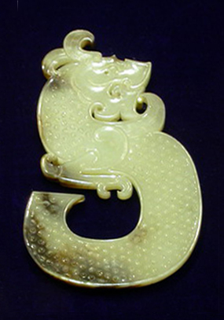

Slide 10
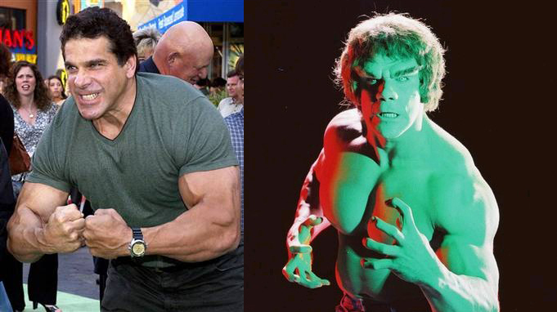
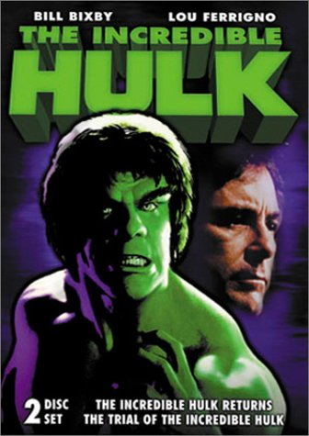
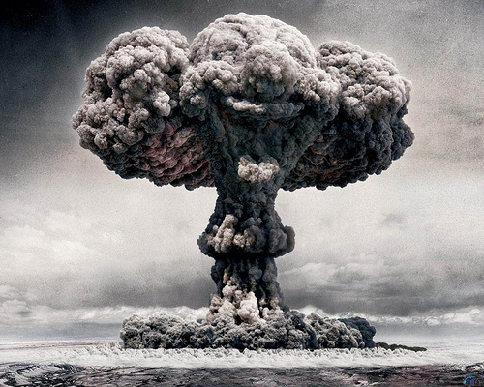
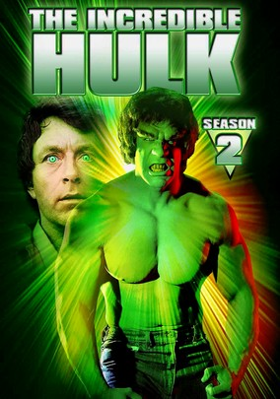
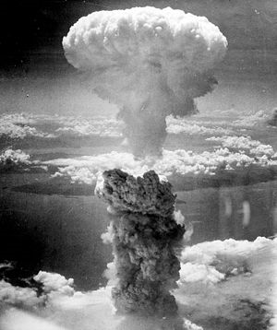
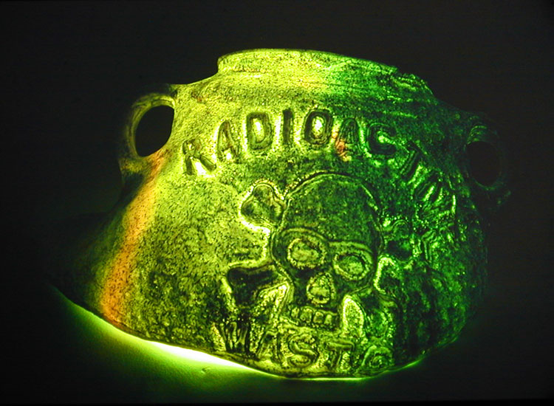
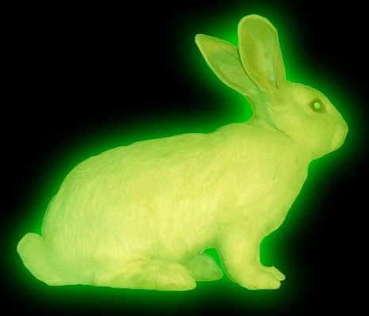
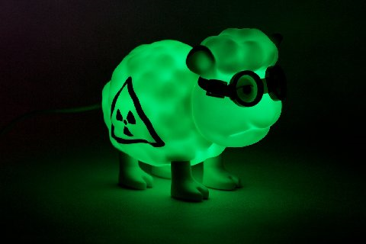
Notes:
First nuclear monster film 1954 Them! spider
The Beast from 20,000 Fathoms
Chernobyl, three mile island

Slide 11
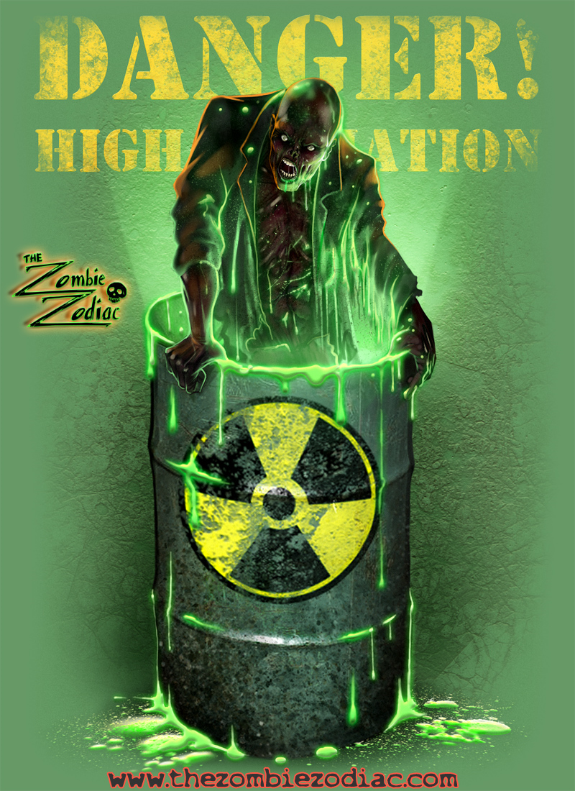

Slide 13
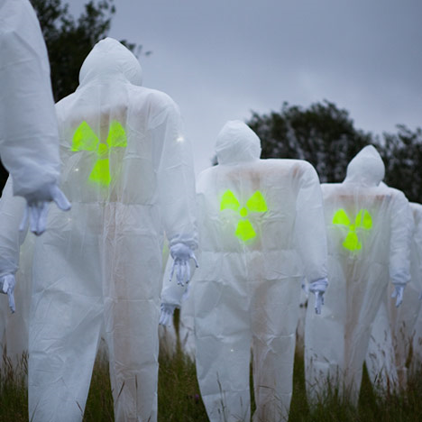

Slide 14
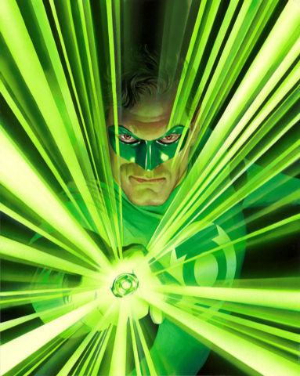
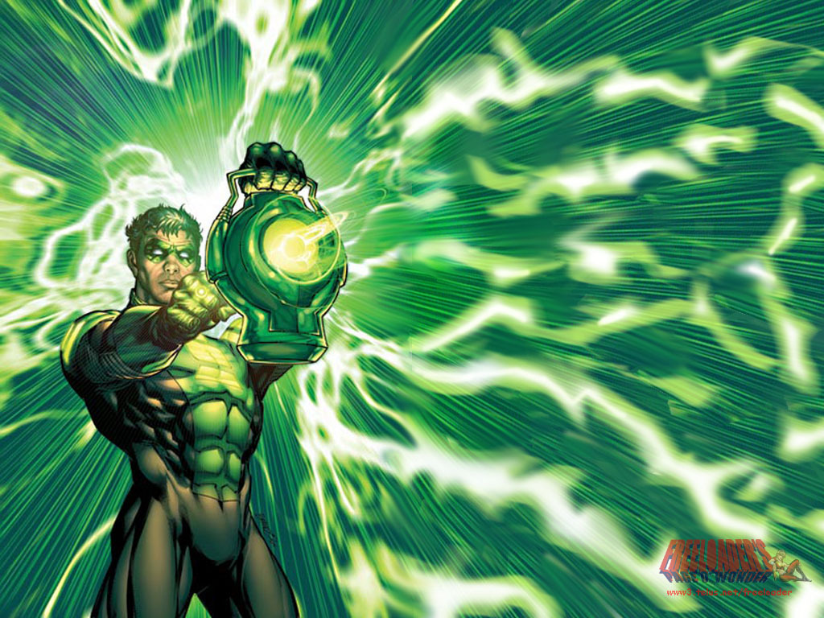
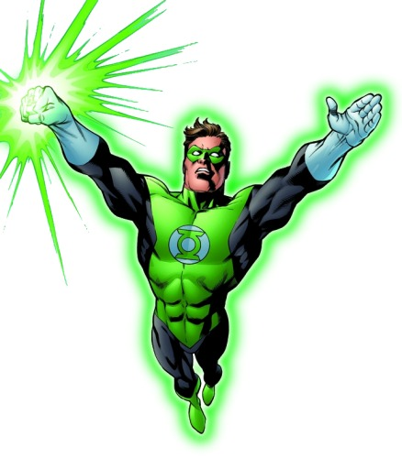
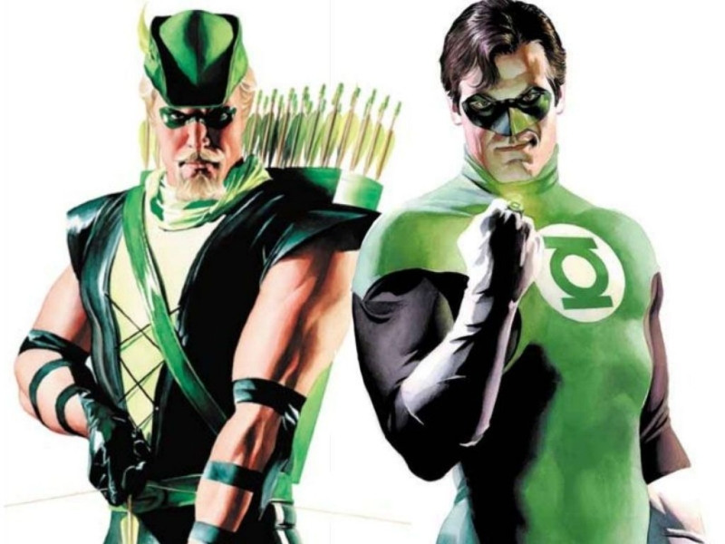

Slide 15
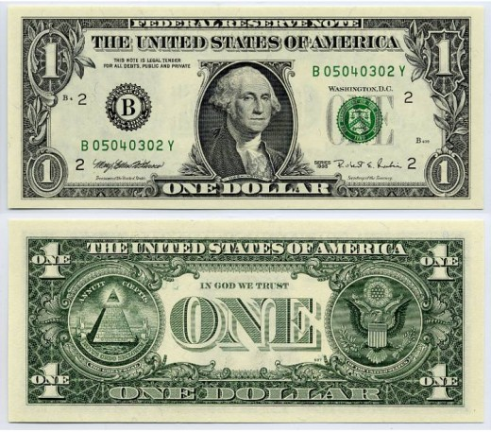
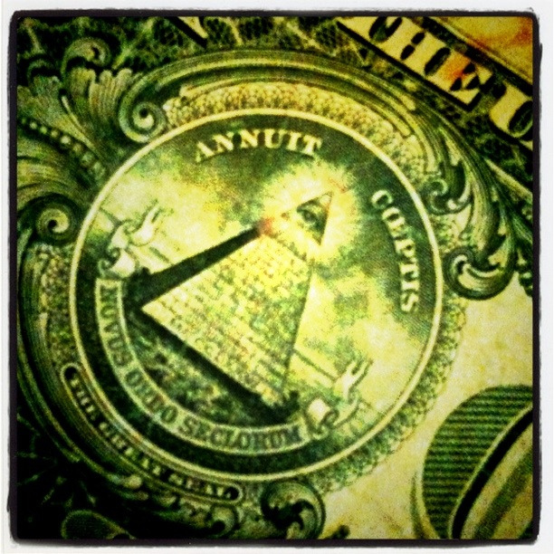
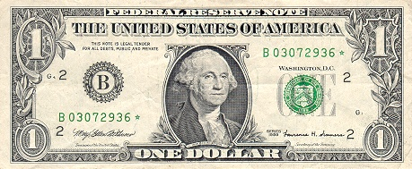

Slide 16
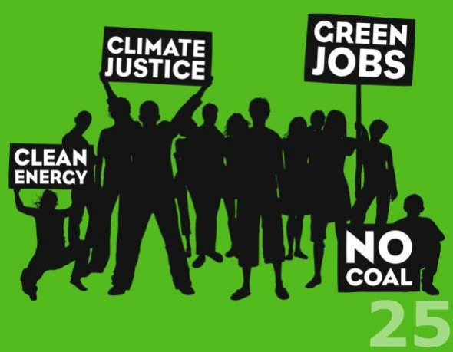
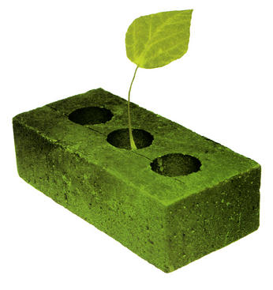
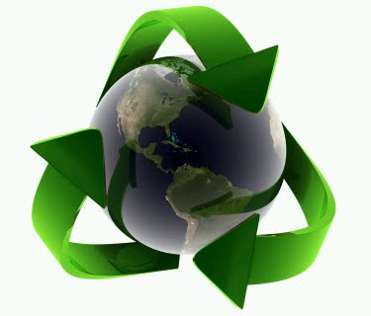
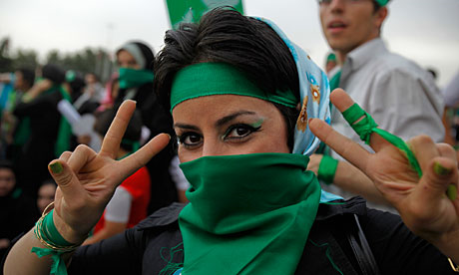
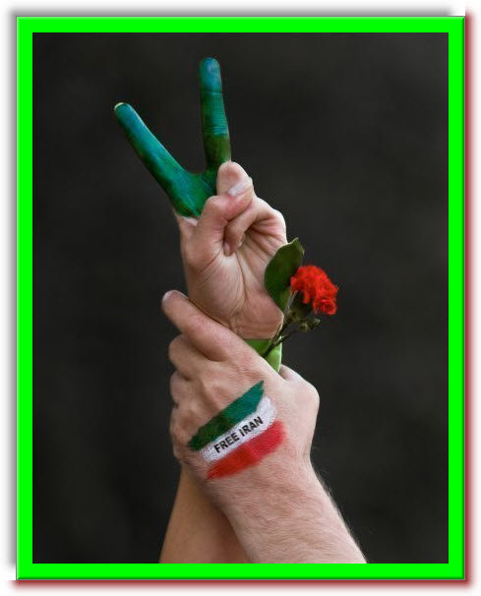
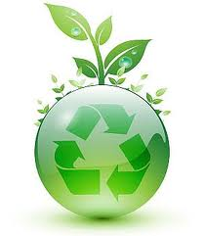
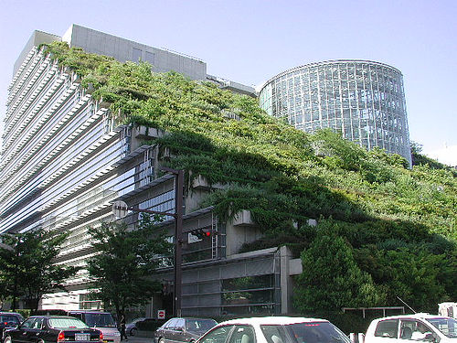
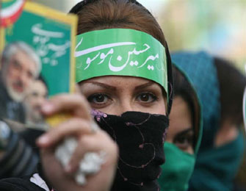
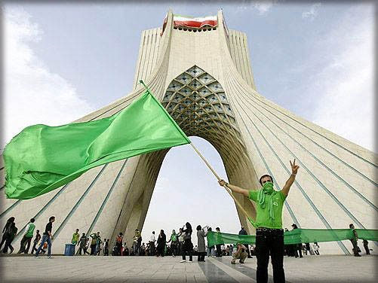

Slide 17
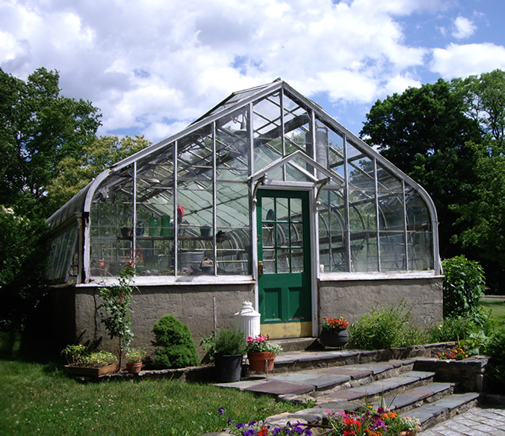
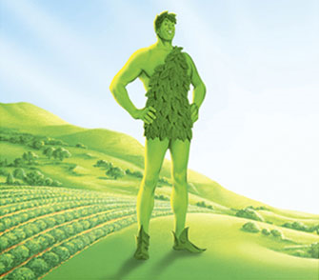
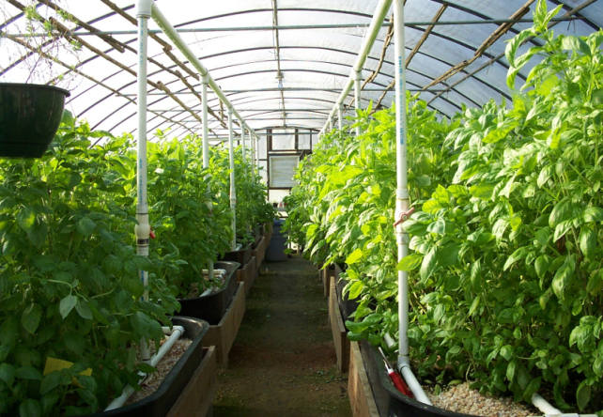
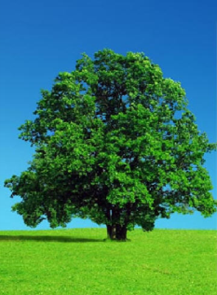
Gree
Green house by Sandy Skoglund n house by sandy skolglund

Slide 18
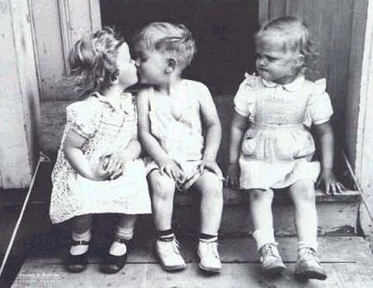
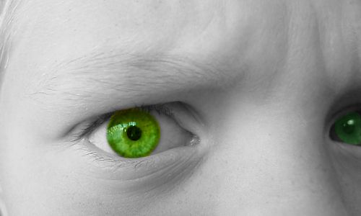
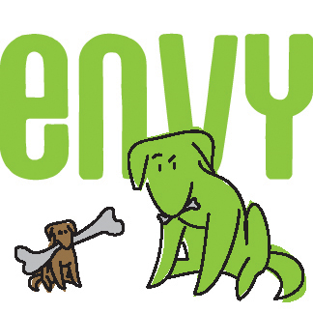
Green with envy

Slide 19
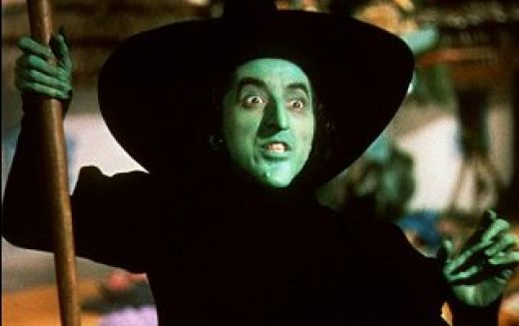

Slide 20
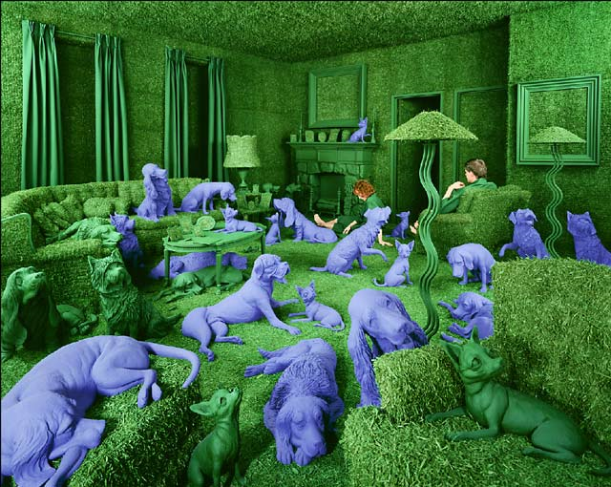

Slide 22
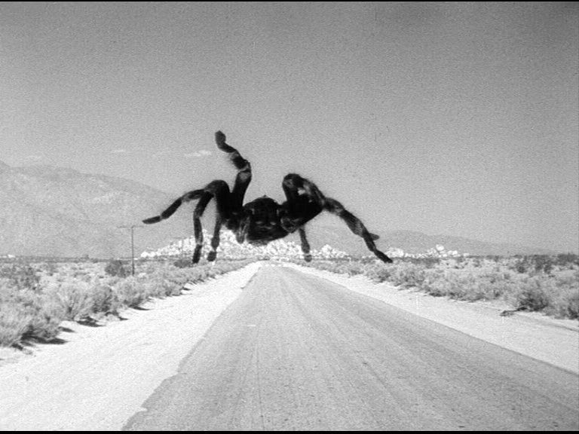
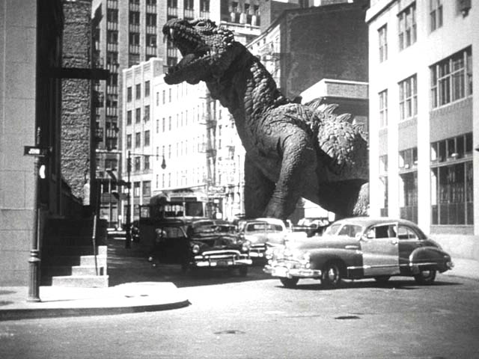
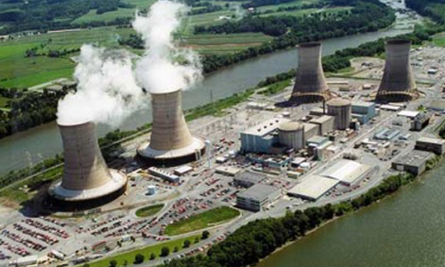
First nuclear monster film 1954 them! spider
The Beast from 20,000 Fathoms
Chernobyl, three mile island

