Slide 1
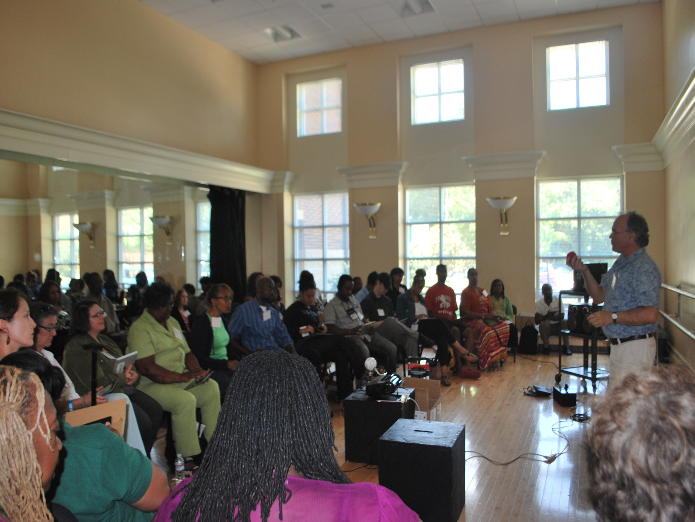
Creativity Infusion Training
A Framework for Developing Creative Mindsets
Notes:
Slide 1: Welcome to The Creativity Infusion Curriculum Framework presentation. My name is Raymond Veon; I am the assistant dean for arts education at Utah State University. Prior to this I was the director of fine and performing arts in the Atlanta Public Schools. My colleagues and I developed the Creativity Infusion program in Atlanta, and we are excited to share it with you today. We have a lot for you today, so we will be working from scripts to make sure we get everything in for you. Our training is experiential and connects directly to our creativity model and our K-12 instructional objectives that support the development of a creative mindset.

Slide 2
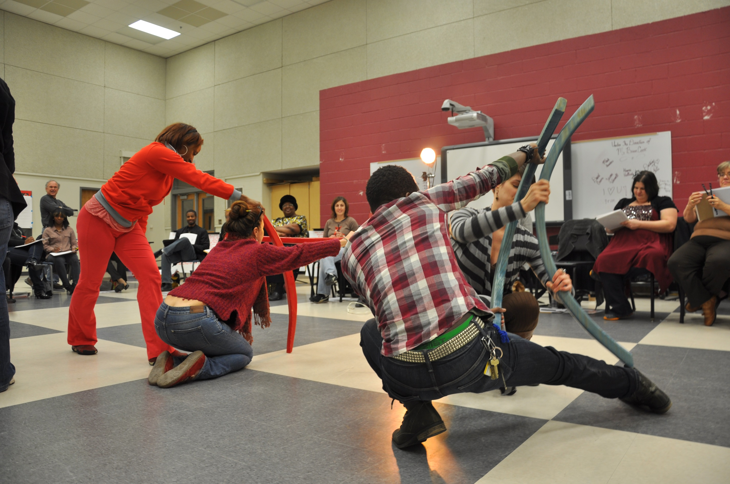
Creativity Infusion Team:
Tiffany Mingo
Barry Stewart Mann
Jeff Mather
Adriana Van Rensburg
Raymond Veon
Notes:
Slide 2: Each activity is designed so that participants can make a connection to the creative process. We’ve developed this training for schools and districts. Today, you will learn about our framework. A Creativity Model is important to help everyone see the Big Picture and to chart the way forward using a common way of talking about creativity. The Creativity Instructional Matrix, with specific objectives for each grade level, is used to make sure we keep our eyes on the prize from Kindergarten through Grade 12. We will also share professional development exercises that help teachers understand our approach.

Slide 3
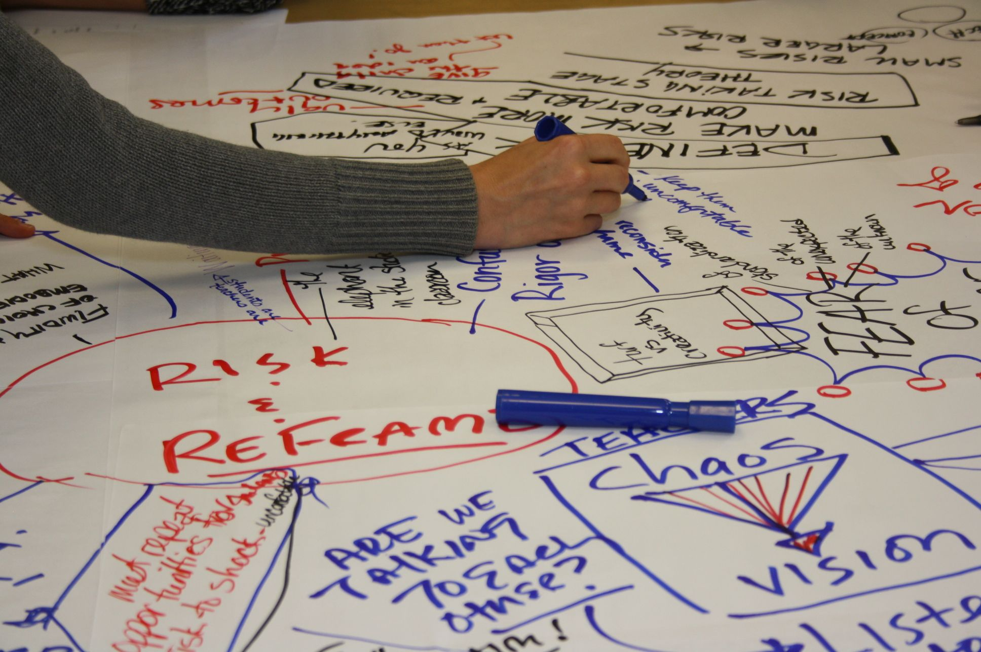
Core Values Exercise
Notes:
Slide 3: Our goal is to leave teachers with a deeper understanding of creativity, and to position them to provide instruction that cultivates a creative mindset from Kindergarten through Grade 12. We start with your values about art and creativity.

Slide 4
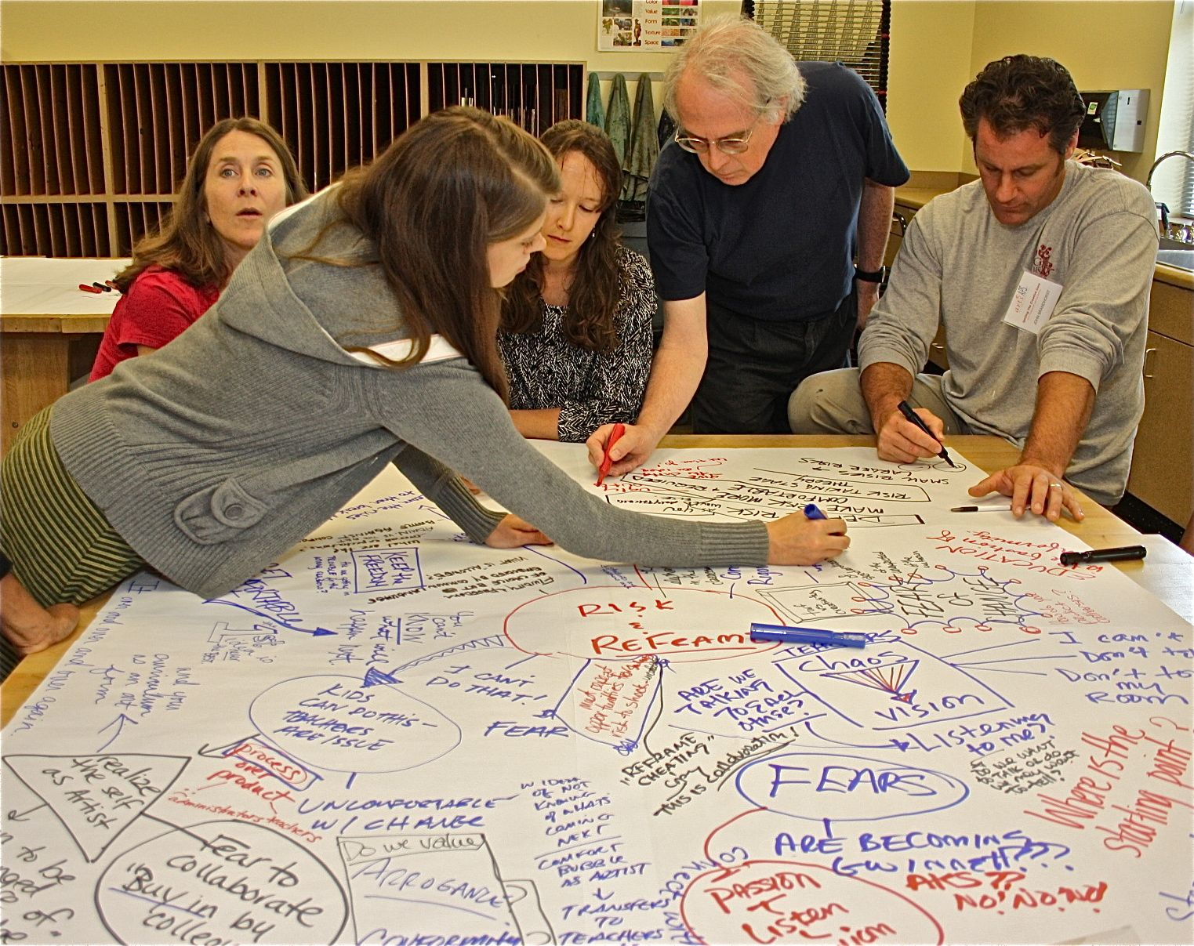
Notes:
Slide 4: In Core Values, we ask teachers in small groups to share their most powerful creative experience. We record their stories on chart paper around the room, and then ask them to look for common themes.

Slide 5
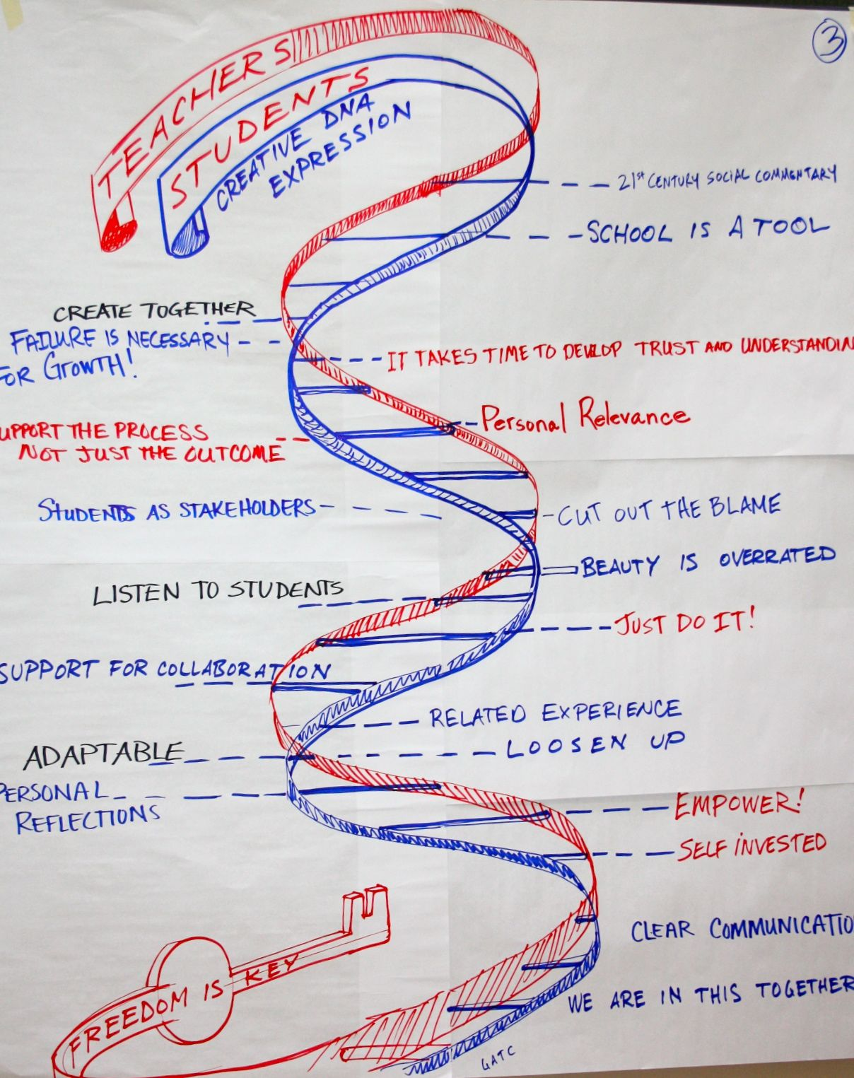
Notes:
Slide 5: Ultimately, the group reviews all of their core values about creativity and condenses them into 4 or 5 common qualities or themes found in all of the stories. This set of core values, slightly different for each group, is the on-ramp to exploring Creativity Infusion.

Slide 6


The term “creativity” is like a Rorschach—we see what we want to see.
Notes:
Slide 6: We use a model of creativity and the Core Values exercise because the challenge for those of us wanting to develop creativity in the schools is that creativity is like Rorschach test – everyone sees something different.

Slide 7
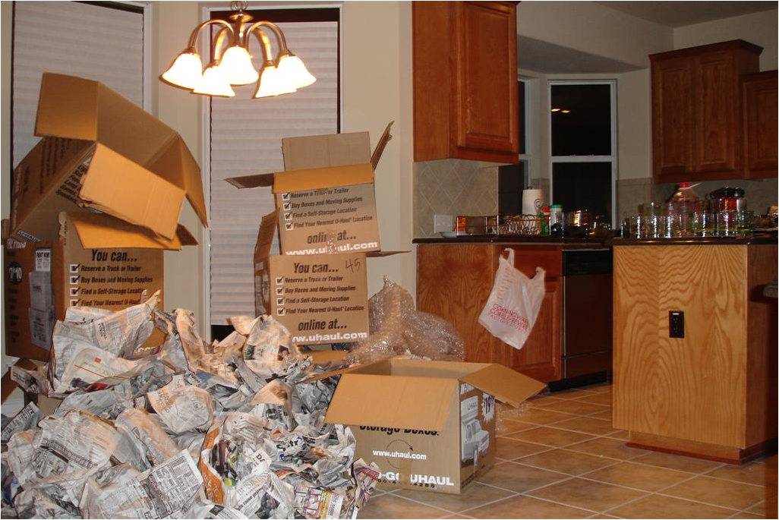
Unpacking the concept based on our model.
Notes:
Slide 7: By unpacking the concept of creativity, schools and school districts can develop a common vocabulary and a common vision to help all students develop a creative mindset. The core values exercise, our Model and the Creativity Instructional Matrix all help schools develop a sustainable approach to creativity infusion.

Slide 8

A complex, executive-level cognitive process
Creativity
Meta-Cognition
Higher Order Thinking
Affective Domain Skills
Develops over time
Not just a whacky way of
producing zany ideas
Basic Reasoning Skills
Psychomotor Skills
Notes:
Slide 8: First we need to realize that creativity is not the same as talent. It is something that can be developed. We are all born with innate drives and skills to explore and discover. More mature forms of creativity are complex; they involve the coordination of reasoning skills, psychomotor skills, and metacognitive skills. Creators engage in a form of open-ended research in which the process is shaped as it unfolds.

Slide 9
3 Stage Model
Risk and Reframe
Question and Connect
Mindset and Stance
Stage 3 7-12
Stage 2
4-6
Stage 1
K-3
Notes:
Slide 9: In the Creativity Infusion framework, we use a three stage model of the creative process. We ask students in lower grades to Risk and Reframe; in middle grades to Question and Connect; and in older grades to develop a creative stance, one based on the skills developed in the first two stages.

Slide 10
Frame Shifting
Two men are playing golf on a lovely day. As the first man is about to tee off, a funeral procession goes by in the cemetery next door. He stops, takes off his hat, and bows his head.
The second man says, “Wow, you are incredibly thoughtful.”
The first man says, “It’s the least I could do. She and I were married for 25 years.”
Notes:
Slide 10: (Tell Joke) This is an example of Frame Shifting, or reframing experience. Here is another example…

Slide 11
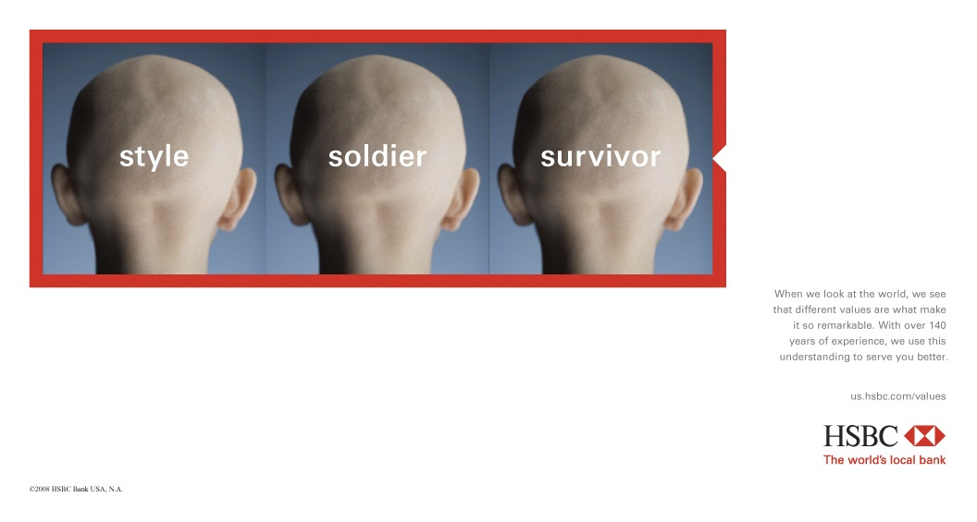
Risk and Reframe
Notes:
Slide 11: Notice we have the same image – but each word provides a different frame that shifts how we view it so that the image means something different each time. Frame shifting requires us to think differently about what we take as self-evident in life –and so requires risk. This is the first stage of our model, which we explore in the early grades. If you look at the handouts, we have provided a K-12 set of creativity objectives for each grade level that are matched to each of these stages.

Slide 12
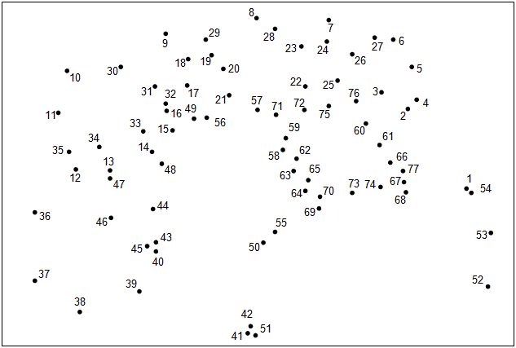
Question hierarchies of logic (explicit/implicit rules for what can and cannot be combined)
Notes:
Slide 12: You all know how to complete this task, right? You start with the number 1, connect it to number 2…and in the end you have a picture. You understand the unspoken logic behind the task based on prior experience.

Slide 13

Reflect on and critique assumptions about the systems of value and logic they are familiar with
Reason speculatively
Challenge assumptions about how and what to connect
…and whether it is important and valuable…
The Unknown: Where to start…what is the problem?
Notes:
Slide 13: But what if we take away the numbers? Where do you start? What should you connect? Rather than following a predetermined formula, you need to explore and develop your own response. A creative mindset asks us to go beyond personal experience and the embedded protocols about “how its done.”

Slide 14
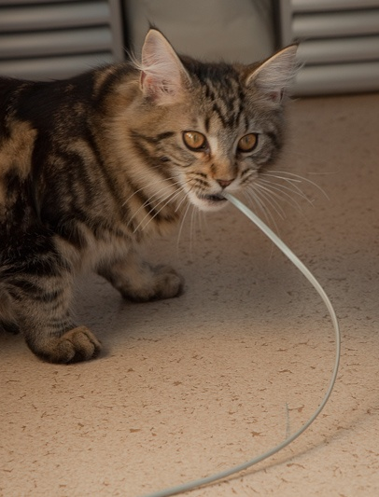
Question
and
Connect
Notes:
Slide 14: This is stage 2 of our model, Question and Connect – which we explore in the middle grades. If you look at the handouts, you see that one of our creativity objectives at this stage is “The student questions hierarchies of logic and value.” Let’s look at one more example of what this means.

Slide 15
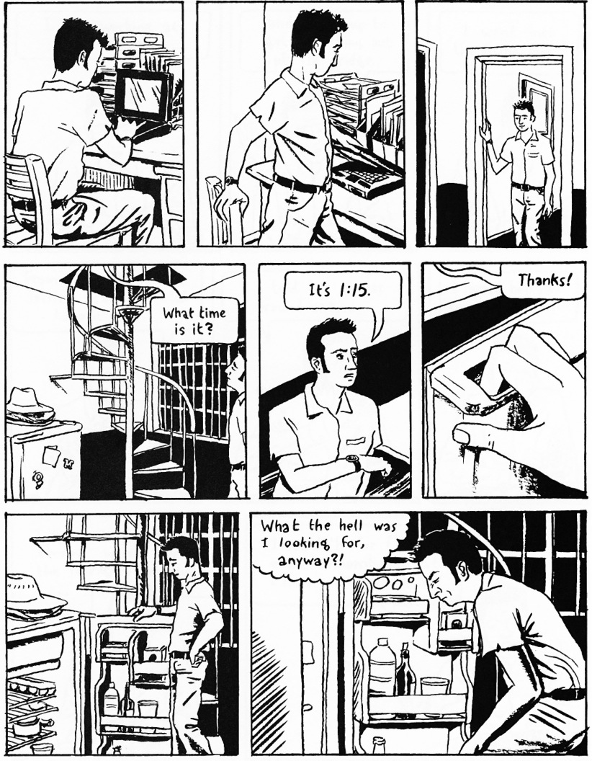
Notes:
(It will take maybe 30 – 40 seconds to show all Madden slides)
Slide 15: Artist Mike Madden published a book called “99 Ways to Tell a Story” in which he literally comes up with 99 ways to tell a very simple story – a man gets up to go to the kitchen, someone asks him what time it is, and then he forgets what he wanted from the refrigerator. Notice you know how to read this story – I doubt anyone started reading this comic by starting at the bottom, or by looking at the right hand panel and then reading to the left.

Slide 16
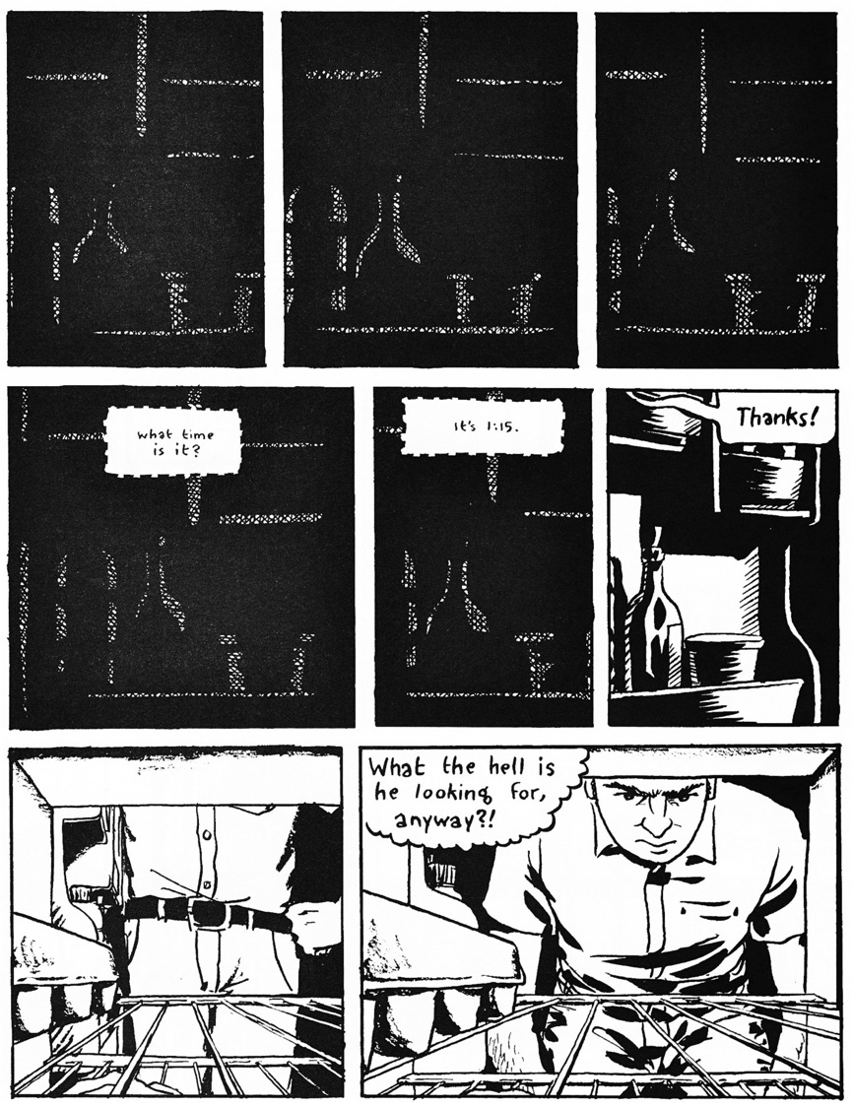
Notes:
Slide 16: Here is the same story – but from the refrigerator’s point of view.

Slide 17
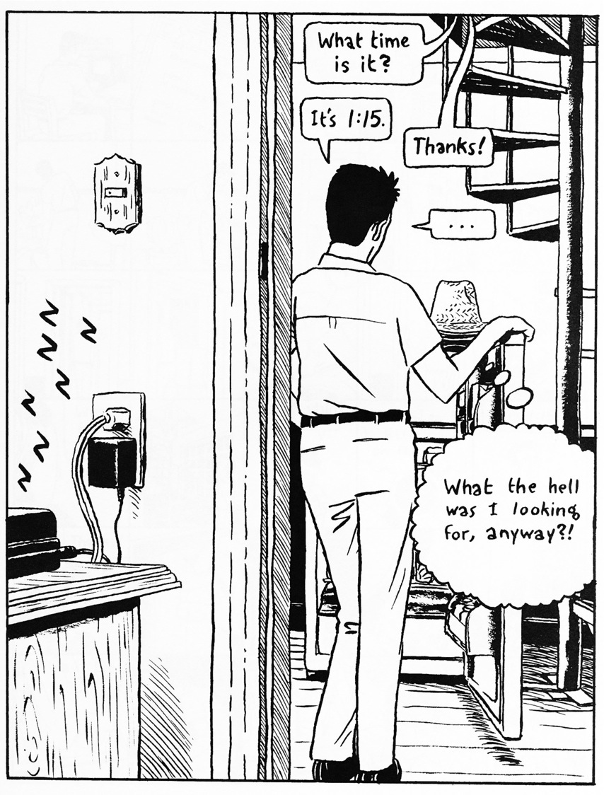
Notes:
Slide 17: Same story – but all at once.

Slide 18
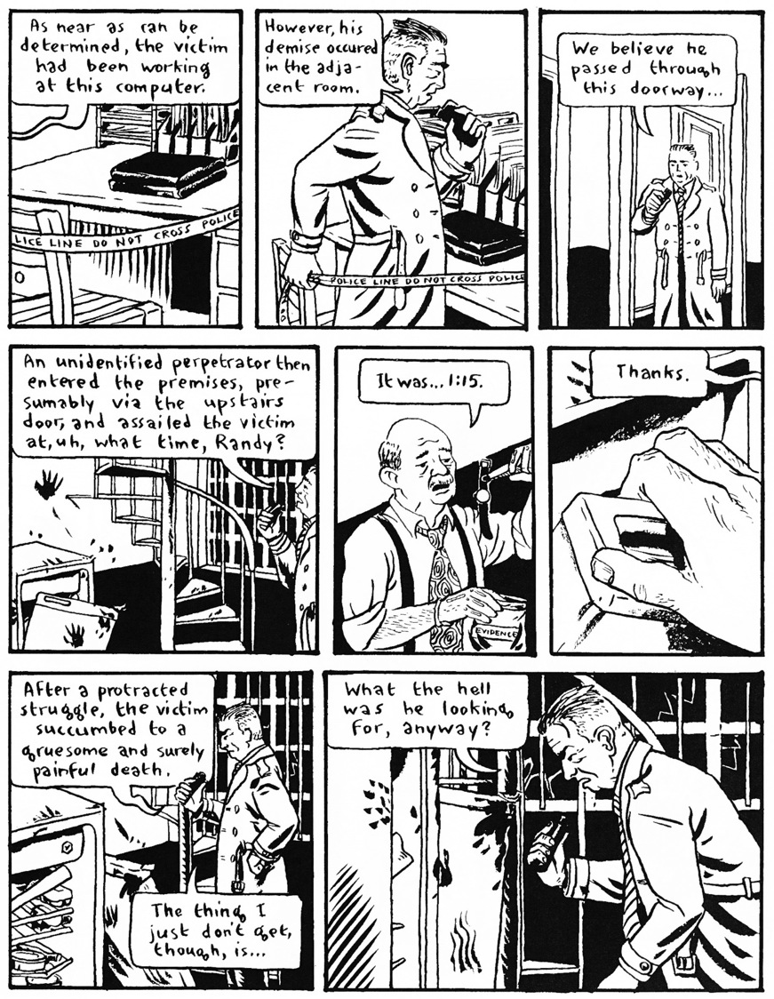
Notes:
Slide 18: Same story – but told as if it was a crime scene.

Slide 19
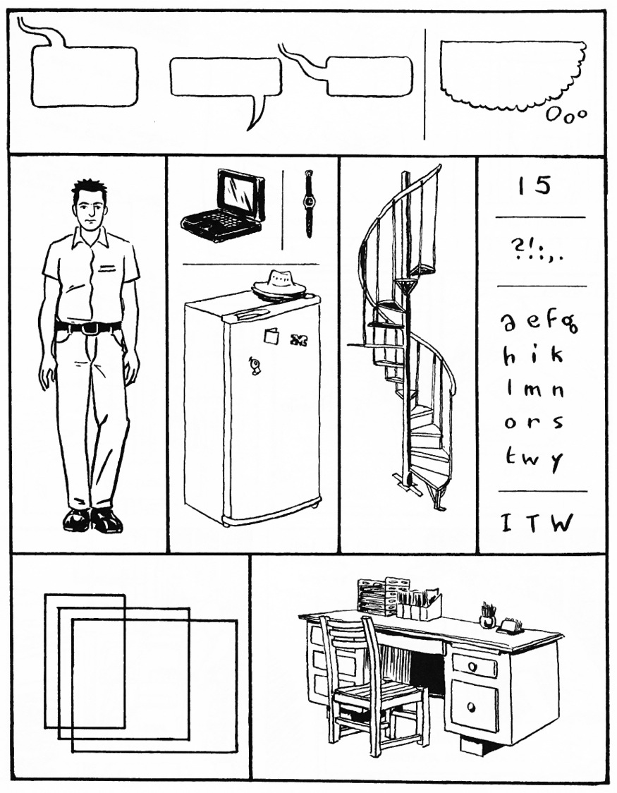
Notes:
Slide 19: Same story – every single element that was in the first slide I showed is here. But if I showed this to you first, could you read it? Would you know what it was about? We all navigate the world according to learned, often unconscious rules and values. Creators often excavate these rules and values and find new ways of connecting them.

Slide 20

Creative Stance
Notes:
Slide 20: In Stage 3, we see a young creator as bringing all of their skills in risking, reframing, questioning and connecting together in a new mental space – a space furnished with their own aspirations, passions, points of view, preferred working methods, and evolving standards of excellence.

Slide 21
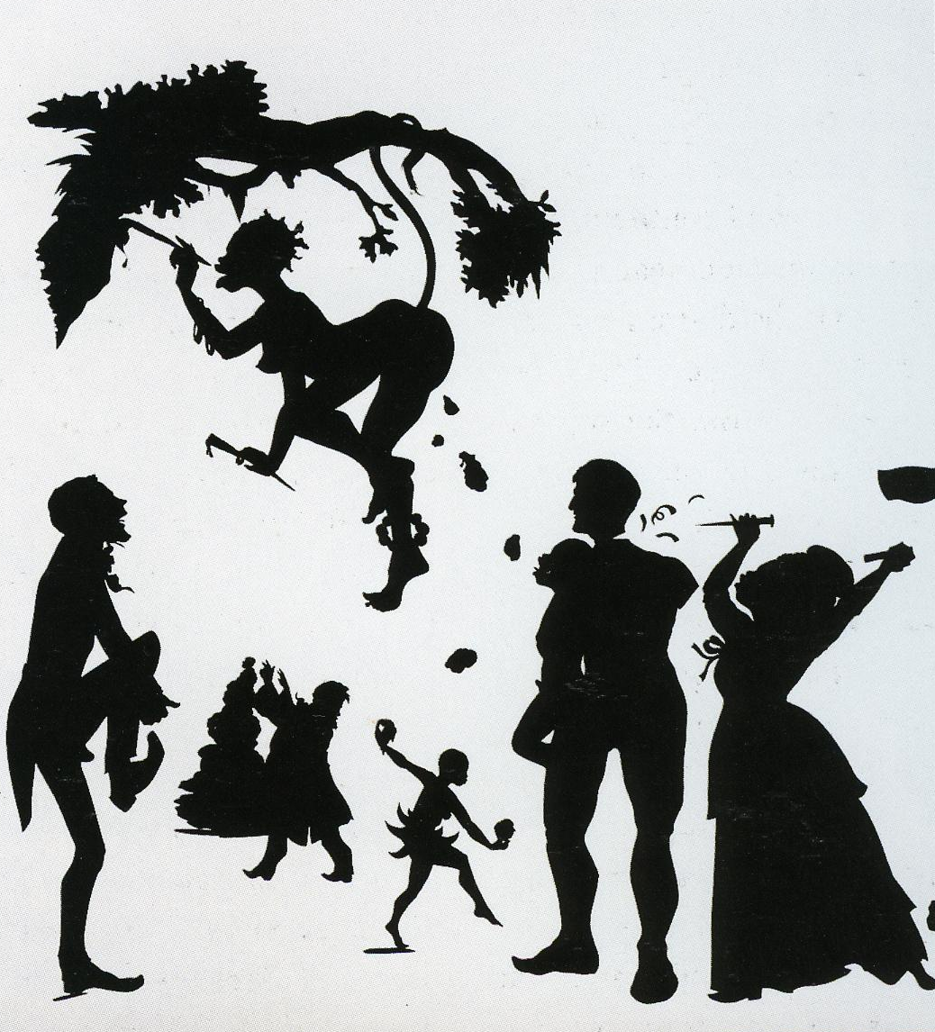
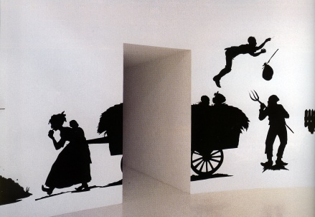
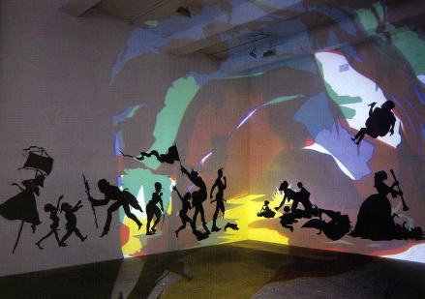
“When stereotypes attempt to take control of their own bodies, they can only do what they are made of and they are made of the pathological attitudes of the Old South.
Therefore, racist stereotypes occurring in my art can only partake of psychotic activities.”
-Kara Walker
Notes:
Slide 21: To quickly and clearly communicate the idea of a creative stance – of developing your own mental space in which you define and pursue your own creative challenges – let’s look at the artwork of Kara Walker. The imagery may disturb some people – and this is part of Kara’s intent. It comes directly from her stance of as a creative artist, which she summarized in this quote: “When stereotypes attempt to take control of their own bodies, they can only do what they are made of and they are made of the pathological attitudes of the Old South. Therefore, racist stereotypes occurring in my art can only partake of psychotic activities” By reframing an old art form, the silhouette portrait, which were often made in the South by trained slaves, and then connecting the embedded history of this practice to questions about race today, Kara develops a coherent creative stance that makes us think deeper and in different ways about our past and about our present. Although we may not have students who use such disturbing imagery, we certainly have students who feel just as passionate about their own lives – and we can help give their passion a voice and coherent vision.

Slide 22
Based on Arne Ludvigsen, 1980;
Developed as Creativity Infusion
Curriculum by R. Veon 2009-2013
Notes:
Slide 22: So this is our model – Stage 1, Risk and Reframe; Stage 2, Question and Connect; Stage 3, the Creative Stance.

Slide 23
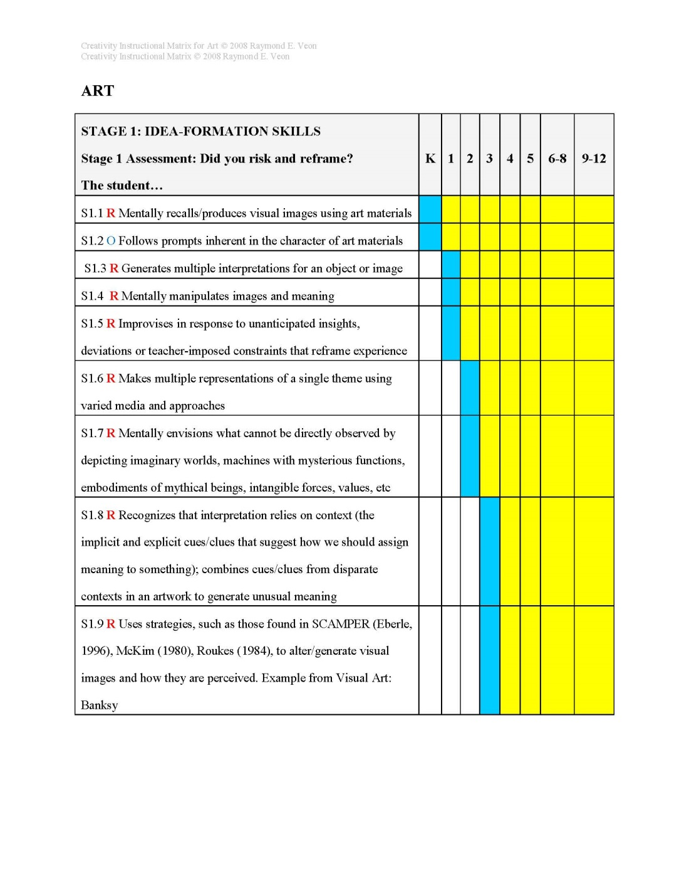
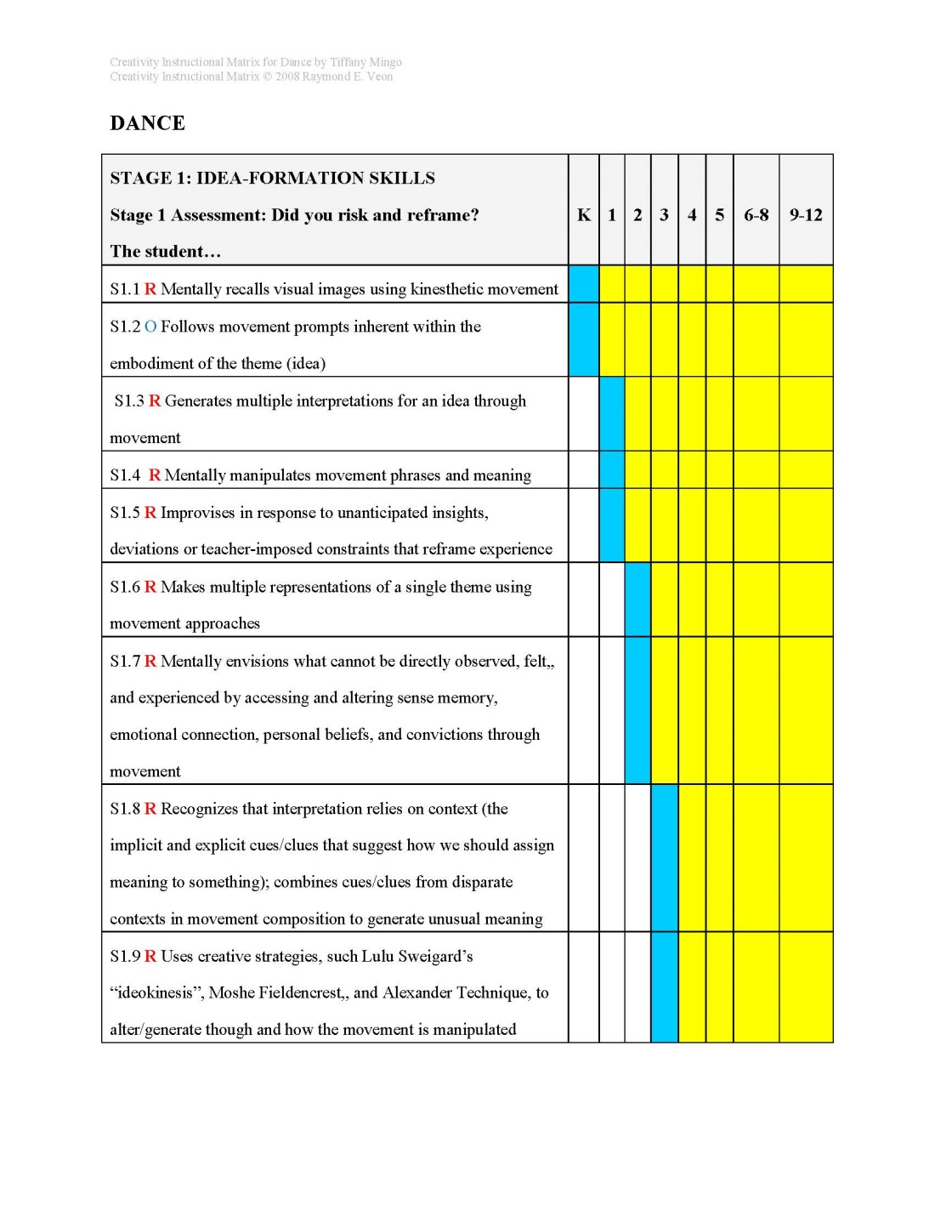
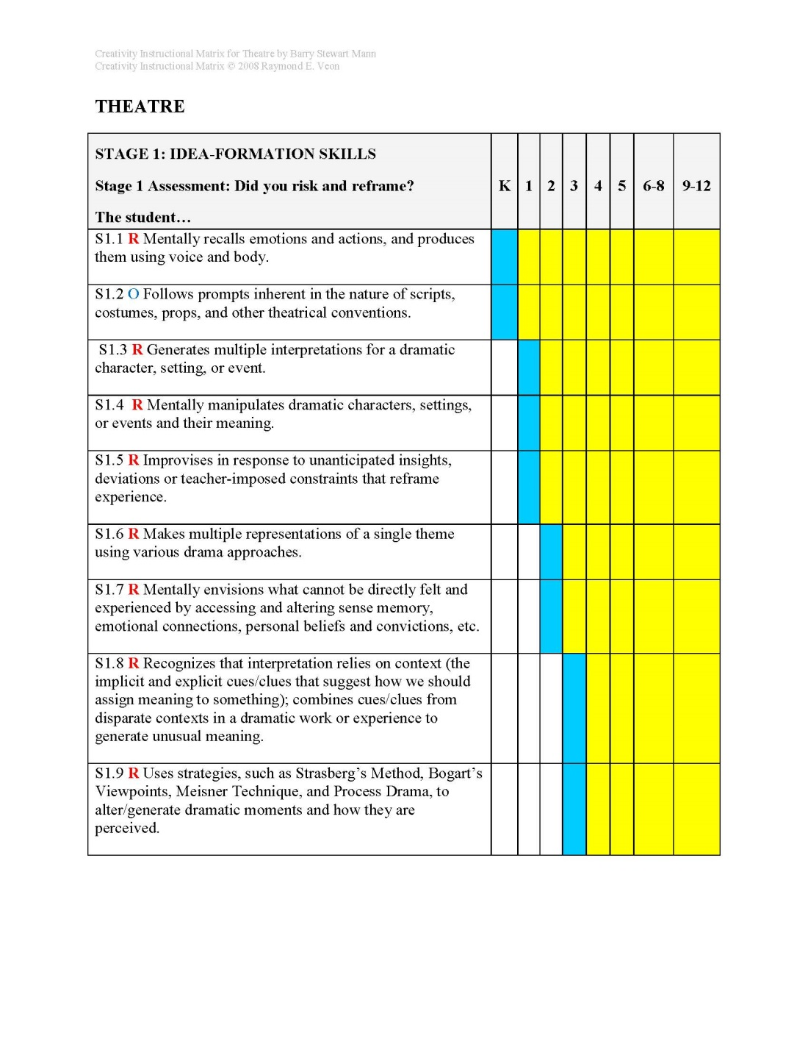
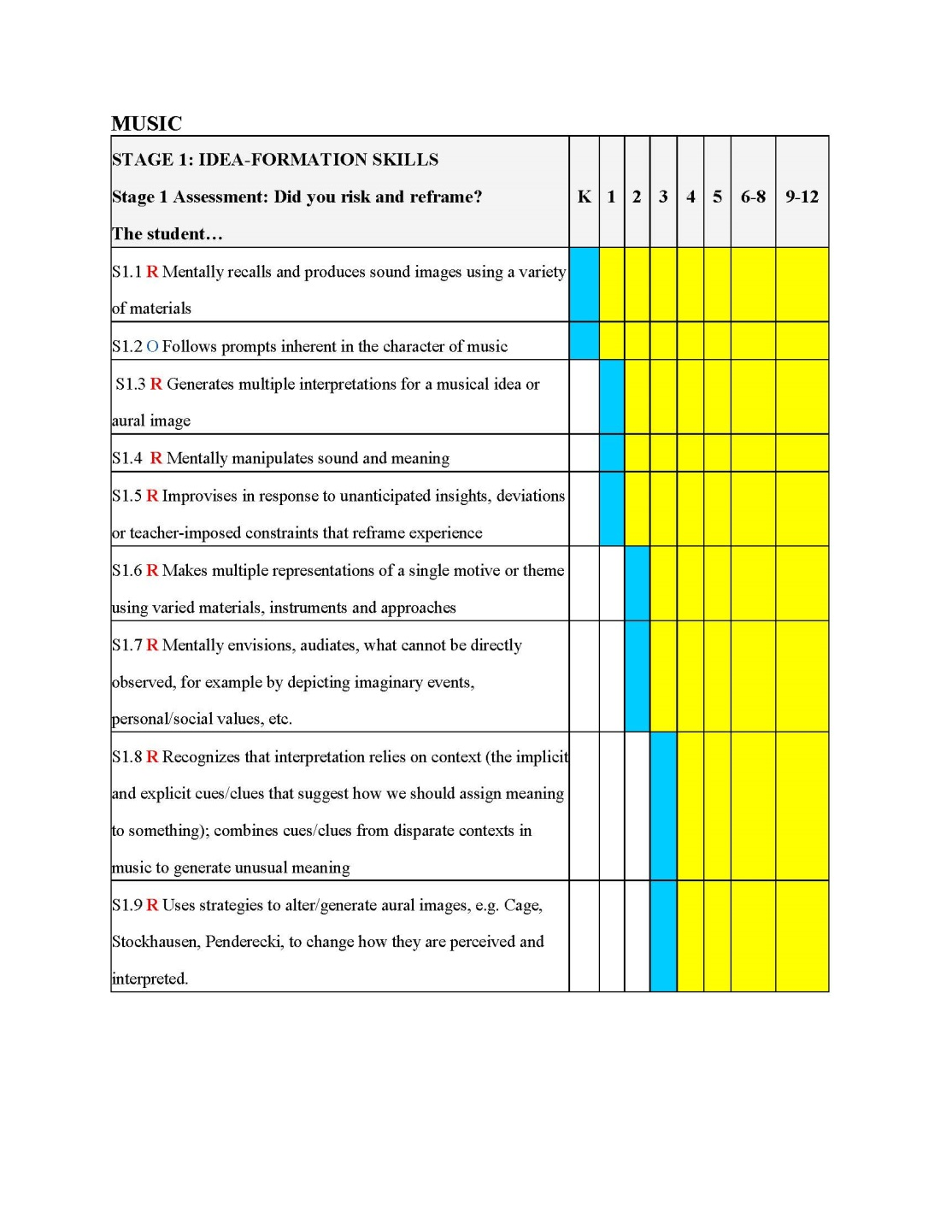
Creativity Instructional Matrix
K-12 Objectives
Each Art Form
Notes:
Slide 23: We use a multi-arts approach, using cognitive skills that support creativity in music, dance, theatre and visual art. In this way, an art teacher gets to see how creativity is developed in other art forms, providing opportunities to experience and understand each cognitive skill in our Model from multiple perspectives.

Slide 24

2-3 Creativity Objectives per Grade Level
Notes:
Slide 24: There are 2-3 Creativity Objectives per grade level.

Slide 25
Common Cognitive Skills That Support Creativity in Each Subject
Notes:
Slide 25: To ensure a comprehensive approach, common cognitive skills for creativity are used across subjects – with the same 2-3 objectives for each grade level adapted to each subject. The example here asks Kindergarten students to form mental representations of visual images, sound images, emotion and action, and kinaesthetic sensations.

Slide 26
Infuse into the Scope/Sequence
CIM Objectives Integrated with Content and Pedagogy in Scope and Sequence
Notes:
Slide 26: In Atlanta, we took the Creativity Instructional Matrix, or CIM, and infused it into our scope and sequence. We also provided questioning strategies aligned to the CIM to help develop creative mindsets.

Slide 27
Teaching for Creativity:
Tweaks and Small Shifts
5 + 5 = ?
? + ? = 10
Notes:
Slide 27: What we are after, then, is finding those tweaks and small shifts in our teaching that help promote creativity. For instance, we all know the answer to 5 + 5 = ? But what if we tweaked this a little? Which one requires deeper thinking? Today, we are going to provide some experiences for you that we hope will help you understand our approach and that will trigger insights into small shifts that you can make in your teaching to develop a creative mindset. If you or your district is interested, we provide training to schools and districts.

Slide 28
Synthesizer vs. Creator
“The synthesizer’s goal is to place what has already been established in as useful and illuminating a form as possible. The creator’s goal, on the other hand, is to extend knowledge, to ruffle the contours of a genre, to guide a set of practices along new and hitherto unanticipated directions.”
Howard Gardner, Five Minds for the Future, page 98
Notes:
Slide 28: Our goal in developing a creative mindset finds expression in this quote from Howard Gardner: “The synthesizer’s goal is to place what has already been established in as useful and illuminating a form as possible. The creator’s goal, on the other hand, is to extend knowledge, to ruffle the contours of a genre, to guide a set of practices along new and hitherto unanticipated directions.”

Slide 29

Notes:
Slide 29: Our task: to resist the dumbing down and reduction of our discipline to a carbon copy of standardized tests—which are all about conveying inert, isolated facts in ways that try to convince students that pleasing someone else is more important than honoring one’s sense of emotional, intellectual, and aesthetic well being. Arts teachers are the guardians of our democracy—of the insight that to be fully human is to integrate heart, head and hand. Now my colleagues will share some exercises we use in Creativity Infusion Training.

Slide 30
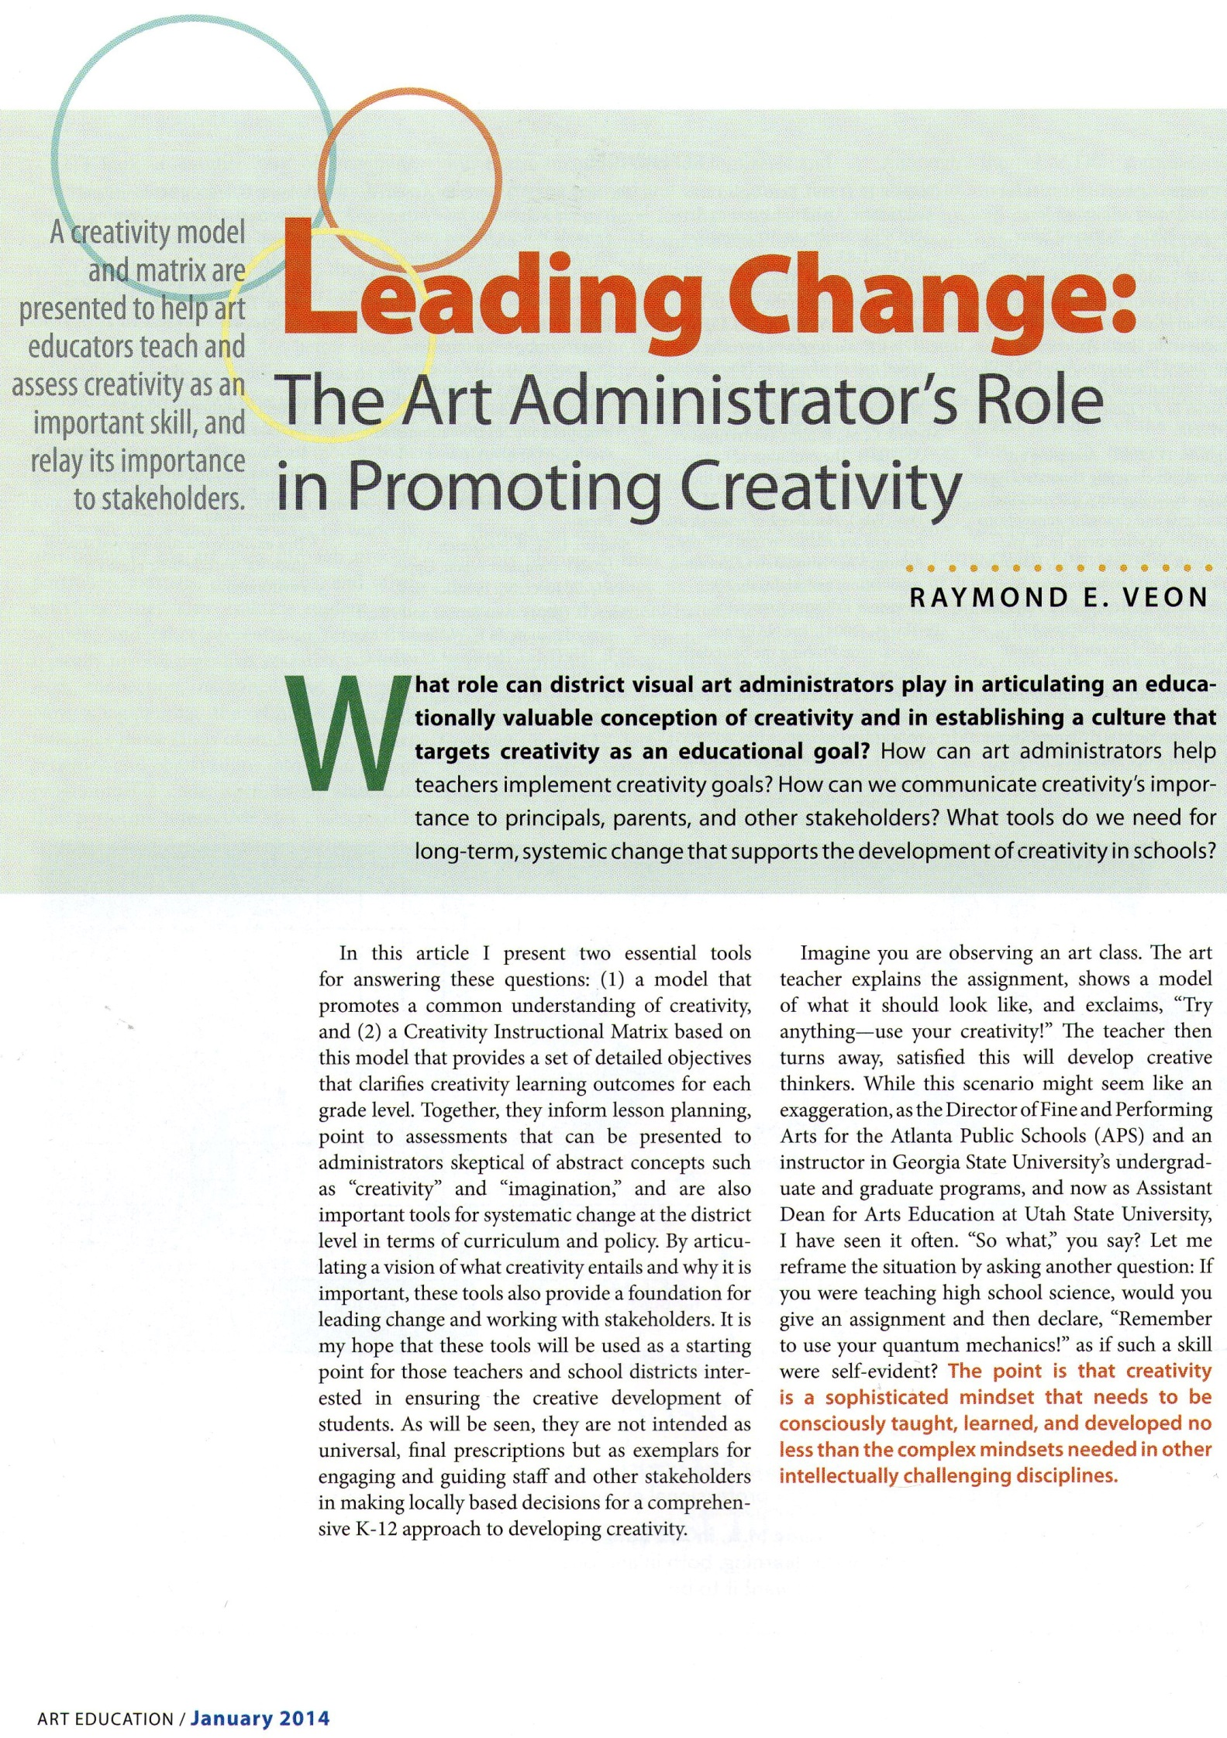
Download article on our Model
www.igniteart.weebly.com
Click on NAEA 2014 in navigation bar
From
Art Education Journal
Jan. 2014
Notes:
Slide 30: You can find a more in-depth article on our model and the Creativity Instructional Matrix by going to www.igniteart.weeble.com and downloading this article. You can also download this PowerPoint and handouts, including an abridged list of research about creativity and instructional strategies that promote it.

Slide 31
Creativity “Quick Fix”
Unit/Lesson Planning | Open* |  | Closed
Problem, Question or Task | Not Provided | Guided | Provided
Process or Strategies | Not Provided | Guided | Provided
Product, End State | Not Provided | Guided | Provided
* Not determined by teacher/more student choice
Task Design Matrix (Sue Brookhart)
Notes:
Slide 31: One thing you can do as soon as you get back to school is to look at how you deliver lessons. How many opportunities are there for students to find or define the problem or task? Can they choose a process or strategy from multiple options, some of which you have not predetermined for them? To what extent can they choose the product or end-result of their learning, again choosing among options not all of which have been predetermined by you? Children come into this life as enthusiastic learning machines – but creativity among young people is declining because we school it out of them. You can help by empowering them to guide their own learning.

Slide 32
Creativity Infusion Process
Creativity Objectives
  Risk and Reframe
  Question and Connect
  Creative Stance
Strategies
  Developmental Science
  Strong Theory
Content
  Your curriculum
  Available resources
Notes:
Slide 32: This is our process. Start with your content, which is shaped by where your students learn and by available resources. Then find strategies that work best with your content. Align your content and strategies to the objectives in our 3 stage model to ensure students stay on course to develop a creative mindset.

Slide 33
Creativity Infusion Curricular Framework
 | Strategies (small tweaks)
Risk and Reframe | Start with a handling collection Start with open-ended image generation Use Art Synectics/SCAMPER to stretch and explore Use theatre, dance, and music exercises to motivate and reframe Collaborate – works in pairs and small groups
Question and Connect | Use Visual Thinking Strategies (min. 1x/month) Start units with 100 Questions Adapt Gude’s Spiral “worksheets” to generate thinking frameworks Use dialogue, Socratic seminars Use student-generated problem solving strategies
Creative Stance | Use Stage 3 Guiding Questions (see handout) Make self-scan a class ritual Let students generate the curriculum Student s routinely self-generate project-planning Student goal setting, resource identification, criteria selection
* See handout for assessment ideas, approaches, a sample instrument, and research
Notes:
Slide 33: But what strategies? Developmental science and other research provides the information we need to select creativity-enhancing strategies. (Select examples from chart based on time)

Slide 34
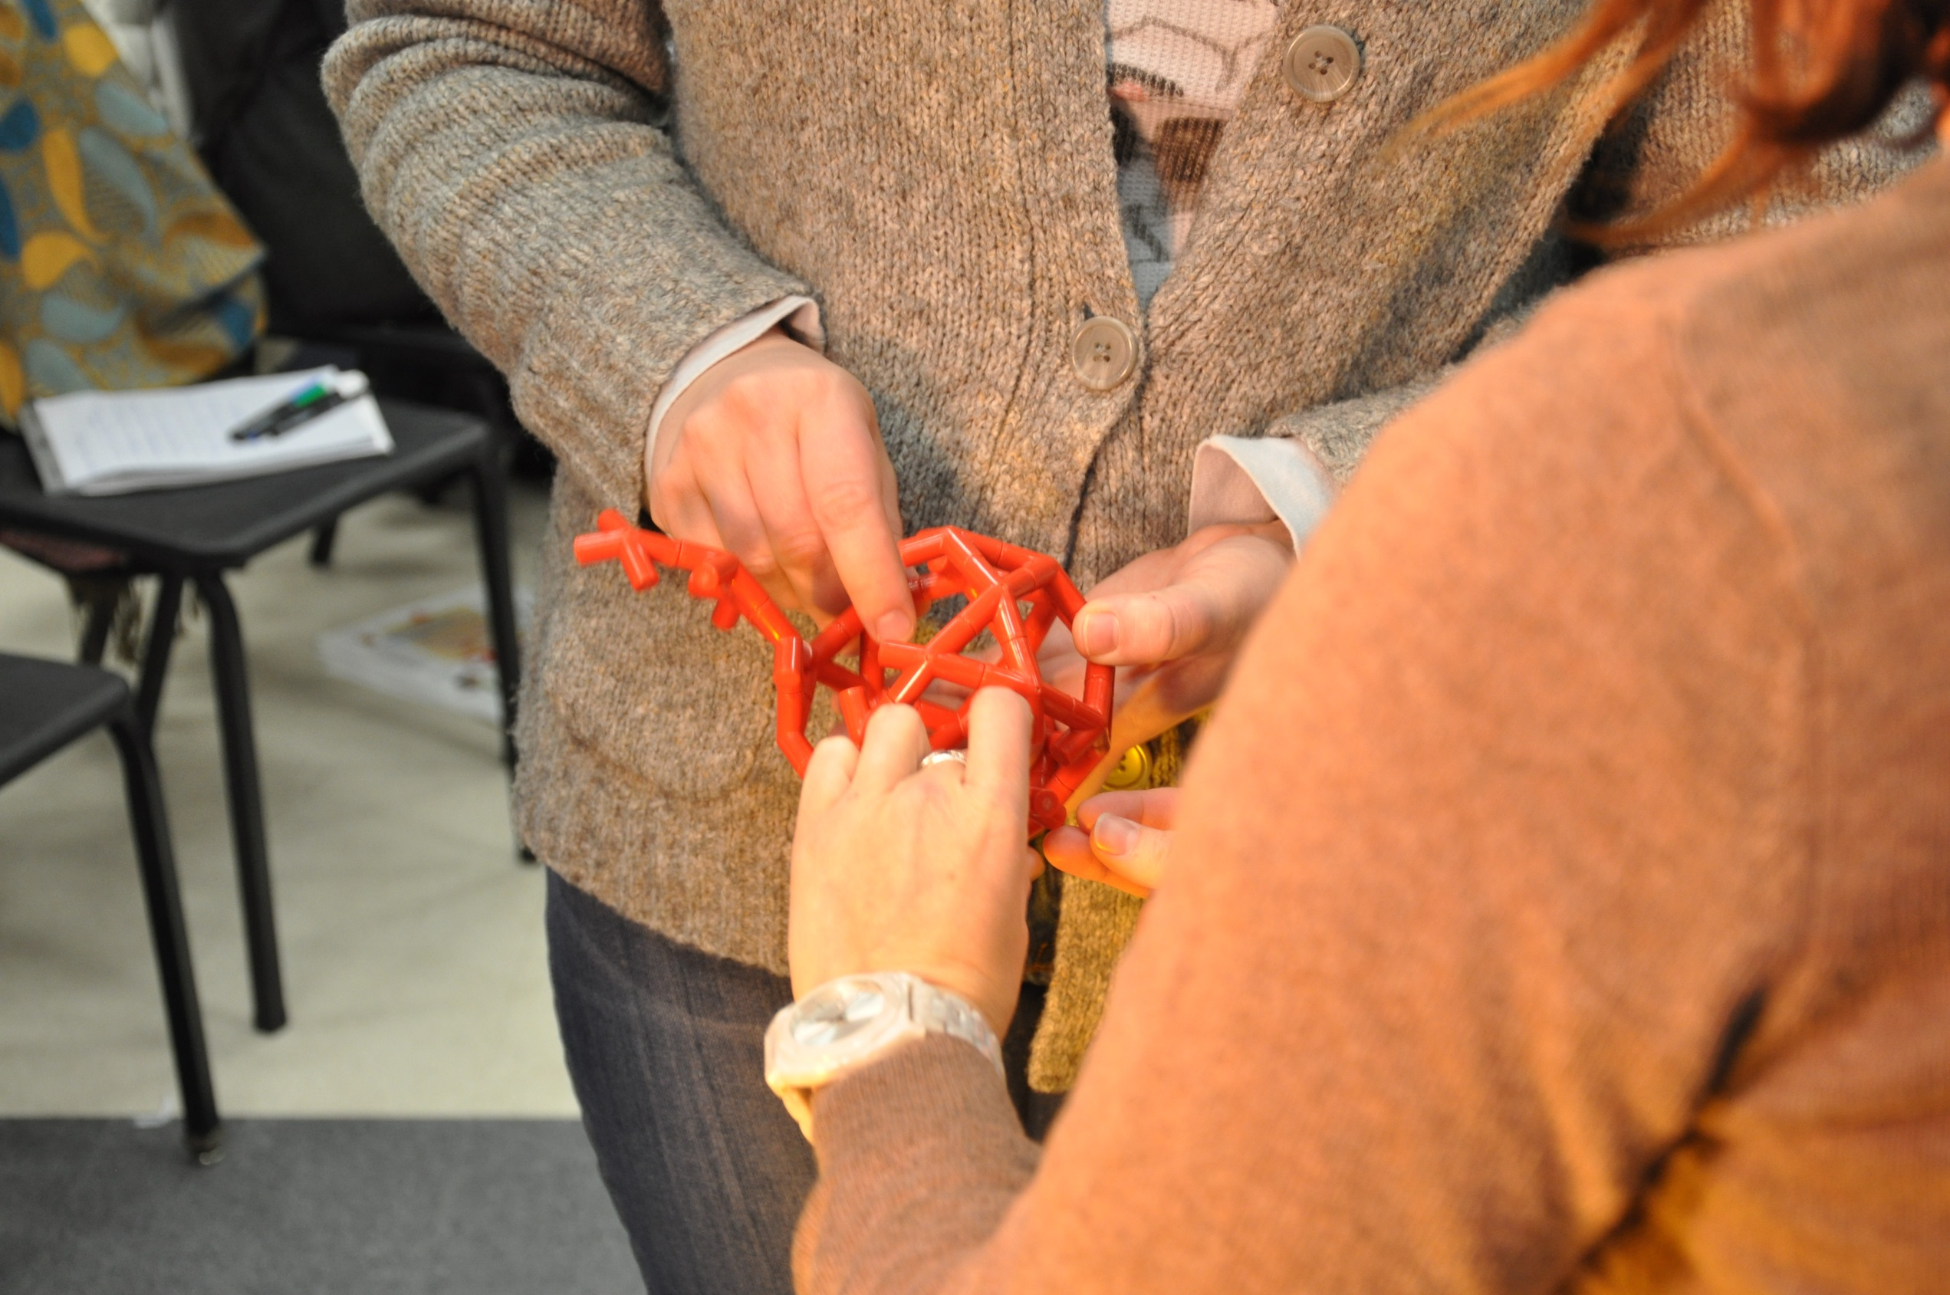
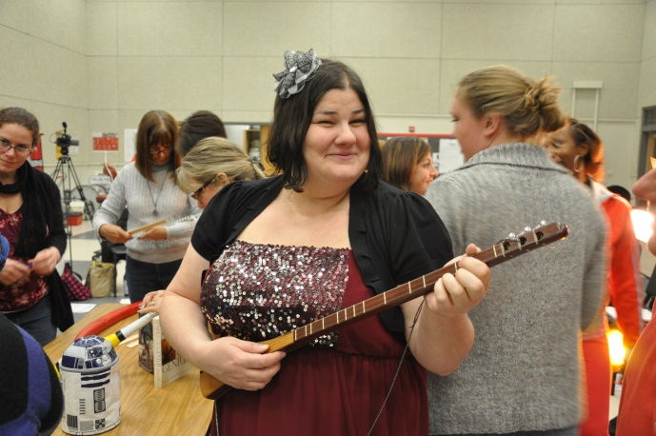
Handling Collection

Slide 35
Creativity Infusion Training
 | Available PD Options
Do your own! | Use Model/Matrix as conversation starter*
Up to 1 Day | One person; free (you cover travel costs)
2-3 Days | Team; fee plus travel
Academic Year | Team; fee plus travel
* Handout has questioning strategies for lessons/units
Notes:
Slide 34: How can you, your school, or district consciously develop a creative skills and a creative mindset from Kindergarten through Grade 12? You can use the ideas we’ve shared to start your own program, aligned to your context and unique district. Download and use the article and resources from the website. We are also available to consult provide training. (If time, refer to chart)

Slide 36
Five Core Questions for Creativity Development:
What more can you do?
How did you take a chance?
What can you connect it to? (What more can you add?)
What is another way of doing it? Can it be better?
Are you letting your personality come through?

Slide 37
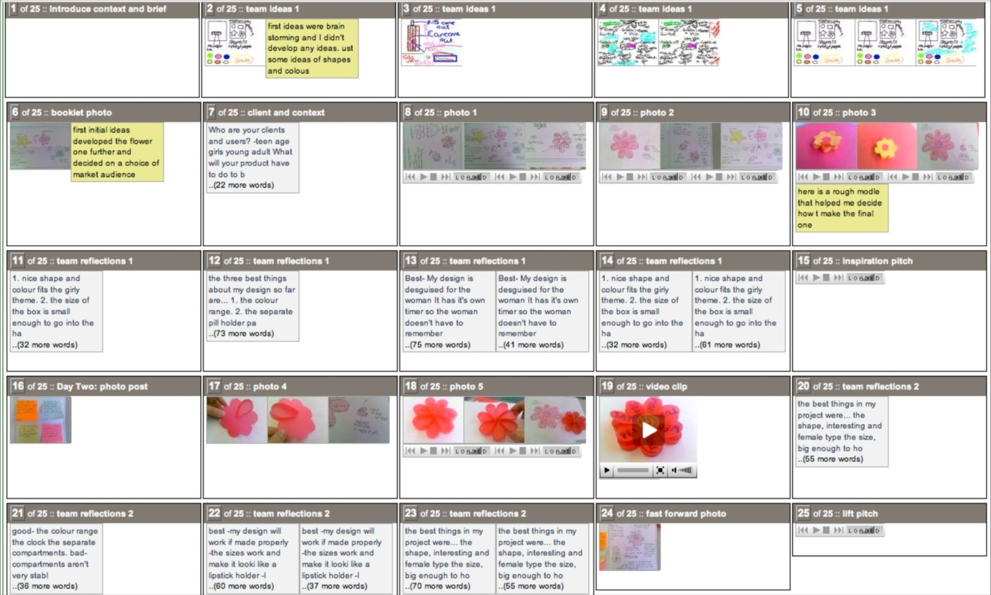
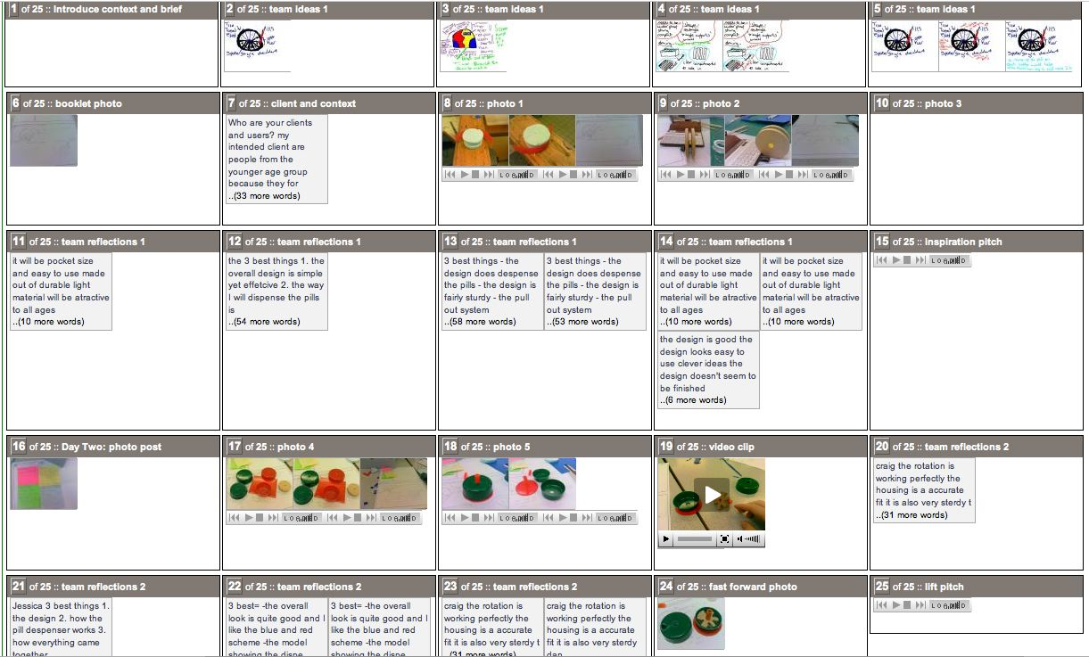

the ‘pairs engine’ manages
the assessment process
E-scape Portfolio
0.95 Reliability
Qualitative
portfolio A
portfolio B

Slide 38
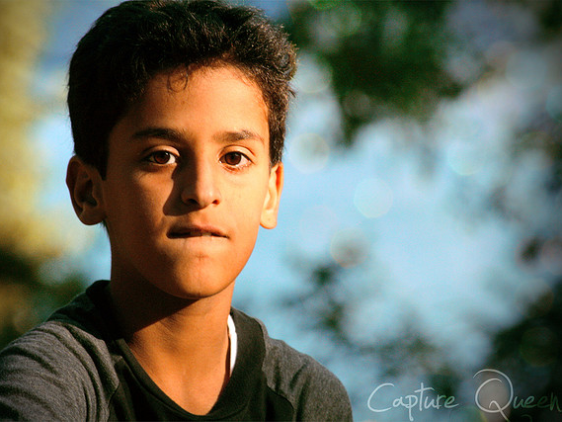
Students need a long term creative agenda to see the long term benefits of creativity training.
If it is sporadic and random, they look back and see it as frivolous and impractical.
Notes:
Slide 35: This young man faces an unknown future, one that almost certainly involve jobs that we can not know imagine. Rule-governed jobs that do not require creativity will exist – but they won’t pay much. More and more, good paying jobs require creative skills. We also have to look beyond training students for just one vocation, since it is likely that they will need skills to adapt to a different career or environment at some point in their lives. The creative mindset cultivated in the arts and humanities empowers them with the cognitive and emotional flexibility to navigate a future we can not predict. More importantly, creativity contributes to a fulfilling life full of unique, individual meaning and exploration.

Slide 39
Understanding the Creativity Instructional Matrix
Please work in small groups and rotate to each poster, adding your thoughts; at the end, all posters are shared.
Creativity Objective
S1.8 R Recognizes that interpretation relies on context (the implicit and explicit cues/clues that suggest how we should assign meaning to something); combines cues/clues from disparate contexts in an artwork to generate unusual meaning
Key Terms and/or thoughts on Creativity Objective
Interpretation; Context; Clues that tell us how to interpret; Fits in to definition of Imagination (Image + Context = Idea); Objective is focused on CONTEXT rather than Image
Fact Sheet Details and Important Research
Conceptual combination bears a special relationship to creativity, having been mentioned frequently in historical accounts of creative accomplishments (e.g., Rothenberg, 1979; Thagard, 1984; Ward, 2001; Ward et al., 1995). In addition, combining concepts is a crucial component in several process models of creative functioning (e.g., Davidson, 1995; Mumford et al., 1991; Sternberg, 1988),
Suggested Activity –
What lesson, activity, or experience can you provide students to achieve this creativity objective?
VTS; An automobile made of postage stamps (Check for Stage 1: Does it ask students to risk and reframe?) Are we assessing image transformation, context transformation, or idea generation (image + context)? Is the focus on the transforming and combining the visual structure of cars and stamps, or on the meaning cars/stamps have for us (context), or both (idea)? Cohort-Based Assessment: class sets standards of exploration, resolution, novelty
“Look Fors” - Evidence that the objective is being met (Indicators, Sample Behaviors)
Students are asking questions and talking about the meaning we attach to cars and stamps, not just the visual structure of these objects (“Well, both cars and stamps travel, and some go fast in first-class style, while some go slow”)
“Red Flags” for creativity objective
Students only focused on visual structure, not on meaning
Questions we should expect teachers to ask when helping students meet the objective
Can you combine or recombine the purposes or uses of the parts? Can you take a risk and make it even more different??
Questions we should
expect students to ask when meeting objective
What if it was only going to be used by kids instead of grown ups? Will it be sticky on the outside if it gets wet? Could we buy it from a postman instead of at a car dealership? What else could it mean? What more can we find?

