Slide 1
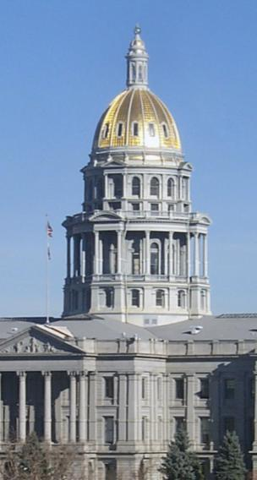
State Roles & Responsibilities
Local Implementation
An ARTS Agenda

Slide 2
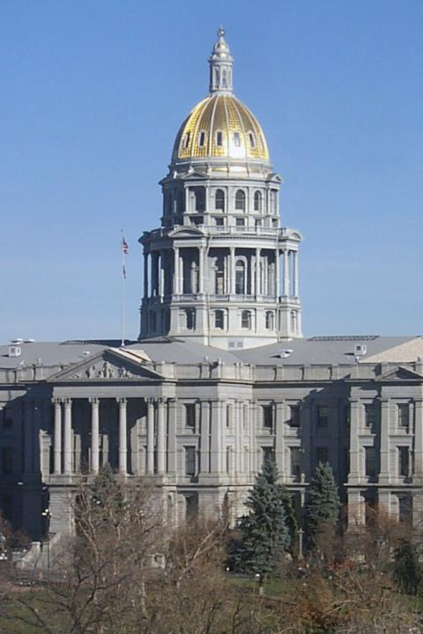
State policy sets the terms and conditions for advancing arts education locally

Slide 3
States have primary responsibility for the education and well-being of their citizens.
Direction
Legislation
Resources

Slide 4
State policy is the meat in the education policy sandwich.
Federal Policy
State Policy
Local Policy

Slide 5
Where States Stand on Arts Education Policies
Source: AEP 2007-08 Arts Education State Policy Survey, Fall/Winter 2007

Slide 6
State policy for arts education isn’t always the problem: It’s local compliance.

Slide 7
NCLB is considered the #1 barrier to implementing arts education policies.

Slide 8
But NCLB is not the only barrier: Other barriers also affect what happens in schools.
Vague or voluntary state laws
Inadequate funding
Increased course or graduation requirements
Not enough qualified teachers
Implementation left to local district
Lack of accountability

Slide 9
Common Core of Indicators
How many states collect this information?
Source: AEP 2007-08 Arts Education State Policy Survey, Fall/Winter 2007

Slide 10
Formats Used to Publicly Report
State Level Information about Arts Ed

Slide 11
A state ARTS Agenda to strengthen arts education in public schools

Slide 12
Raise public
awareness
and deepen understanding
of the benefits of
arts education.
A
Awareness

Slide 13
Call for
and contribute to
better state level research
and data to inform
policy and practice.
A
Awareness
R
Research

Slide 14
Develop
tools
and strategies
for
high quality
arts education programs.
A
Awareness
R
Research
T
Tools

Slide 15
Exercise
state leadership
in arts education
to ensure
access, equity and excellence
for all students.
A
Awareness
R
Research
T
Tools
S
State Leadership

