Slide 1
8th Grade Visual Arts Assessment
May 2011

Slide 2
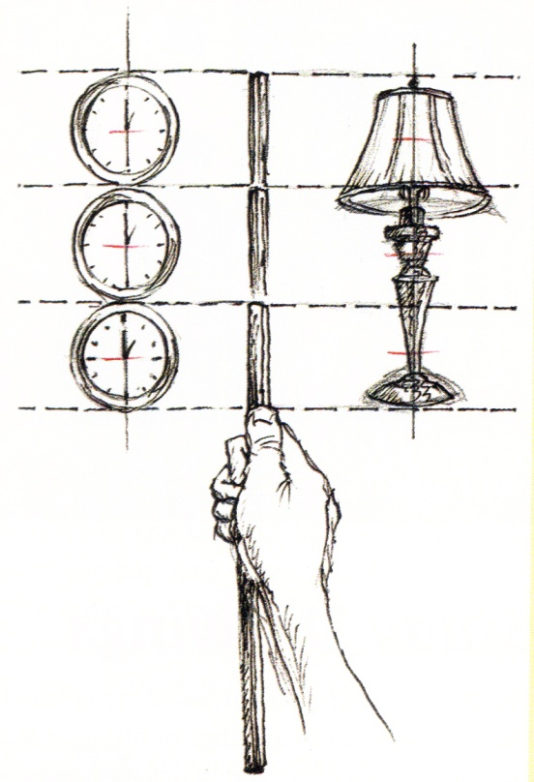
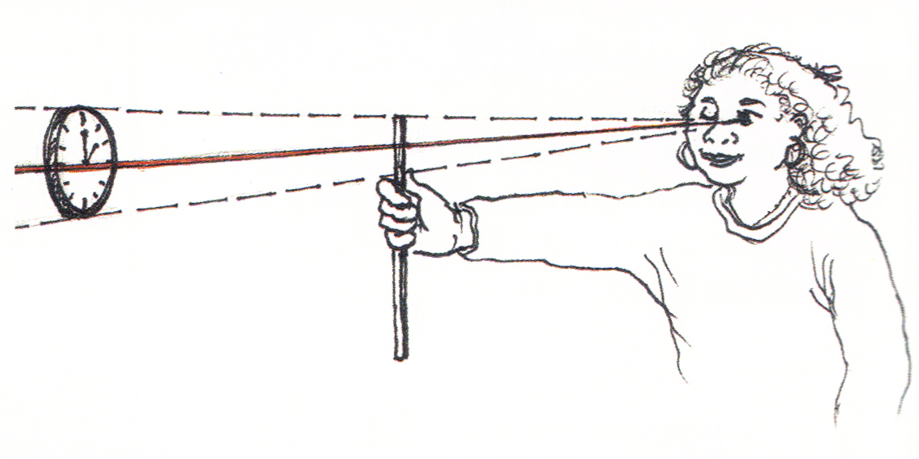
When drawing or painting from life, why would you use the sighting strategy illustrated above?
A. To determine the proportion of one object in terms of another
B. To determine the height of a vertical line
C. To measure the width of an area
D. To determine how to depict an angle

Slide 3
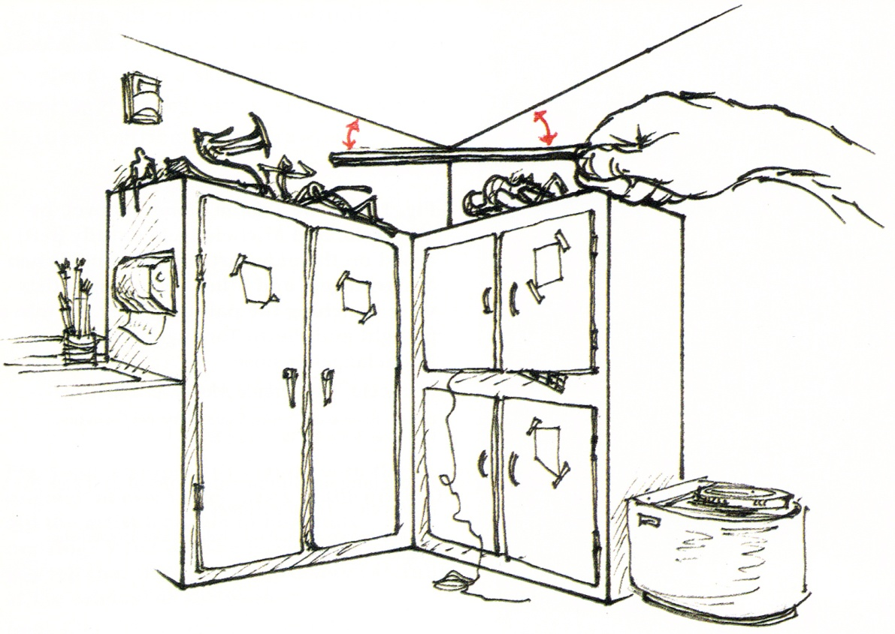
When drawing or painting from life, why would you use the sighting strategy illustrated above?
A. To determine how to draw a straight line
B. To determine the height of a vertical line
C. To measure the width of an area
D. To determine how to depict an angle

Slide 4
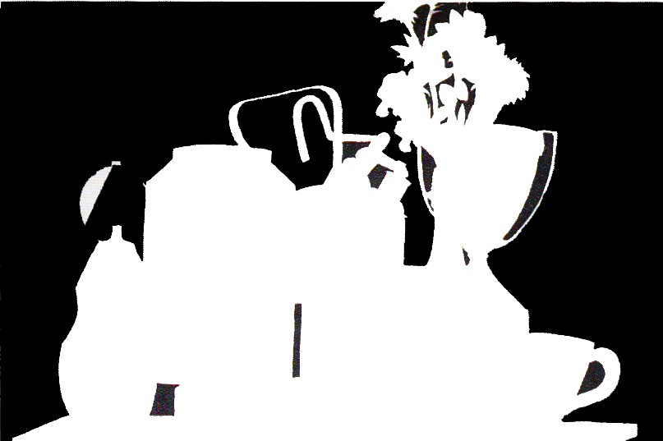
The drawing exercise above was made while the artist was looking at a still life arrangement. What does this exercise help an artist learn?
A. It teaches artists that positive space is more important than negative space
B. It teaches artists that negative space helps define positive space
C. It teaches artists that they should always use high contrast in their artworks
D. It teaches artists that positive space is always in the foreground

Slide 5
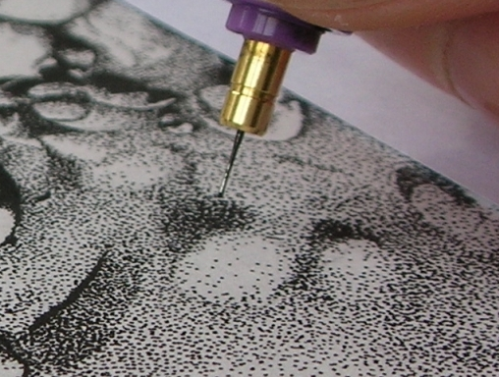
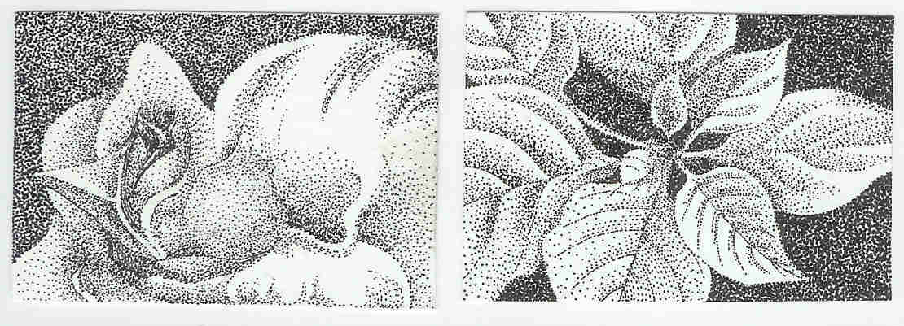
What drawing technique is being demonstrated?
A. Cross hatching
B. Gesture
C. Contour
D. Stippling

Slide 6
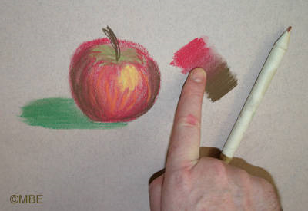
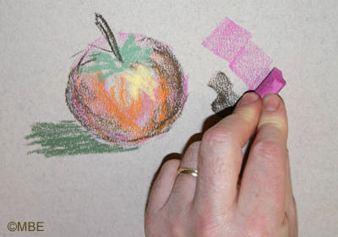
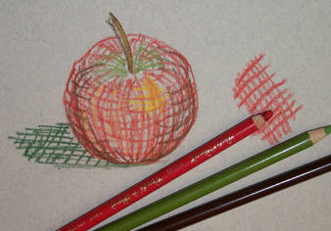
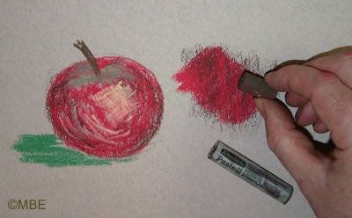
What drawing technique is illustrated in the picture above?
A. Cross hatching
B. Gesture
C. Contour
D. Stippling

Slide 7
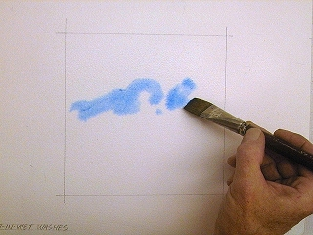
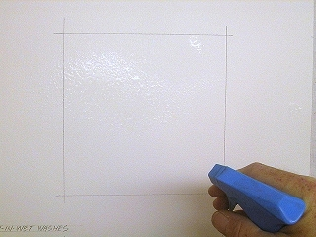
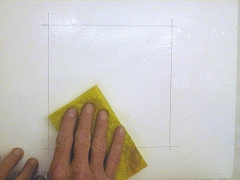
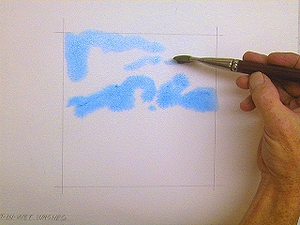
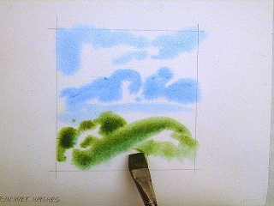
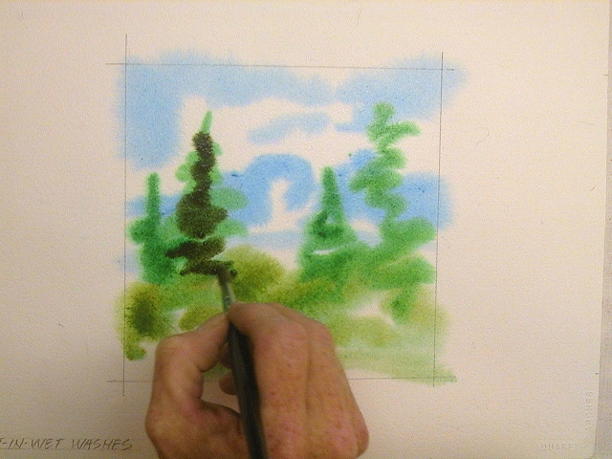
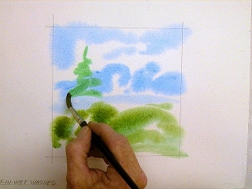
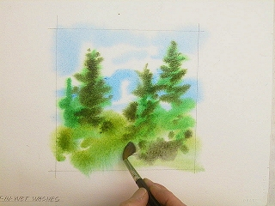
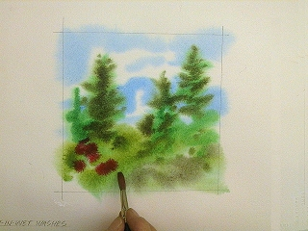
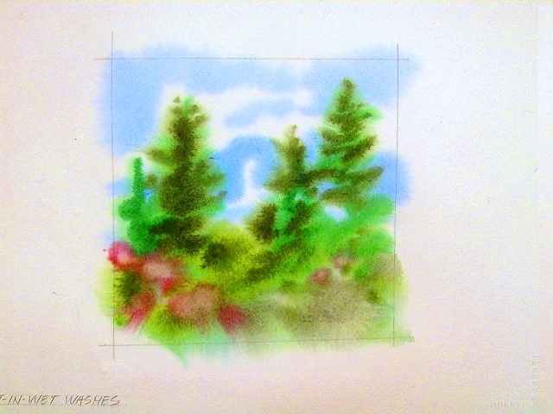
In the pictures above, what painting technique is being used?
A. Scumbling
B. Wet-into-wet
C. Dry brush
D. Impasto

Slide 8
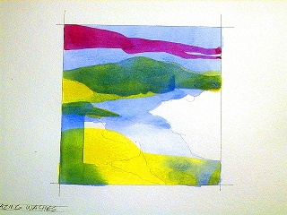
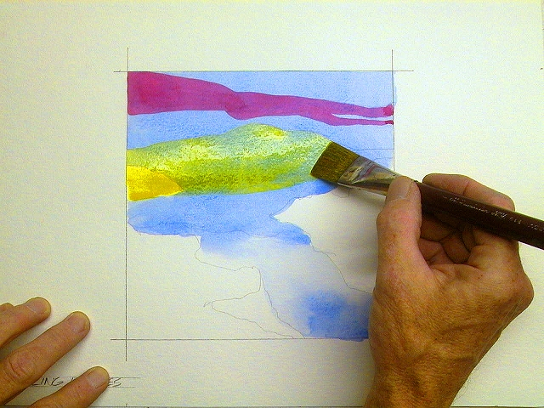
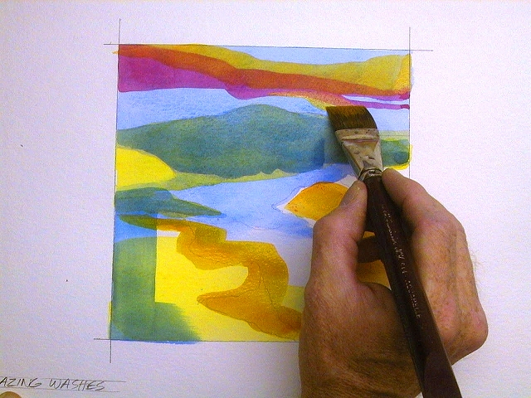
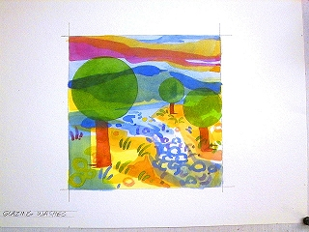
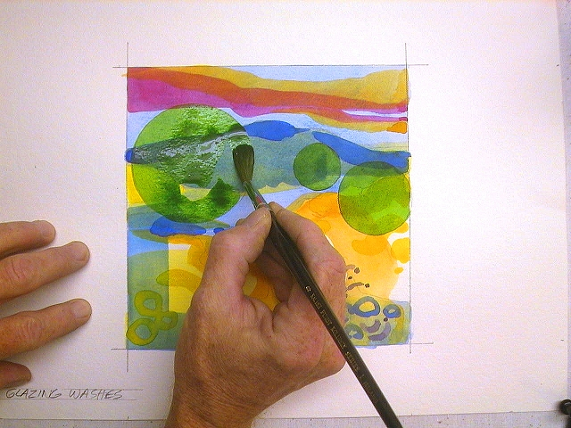
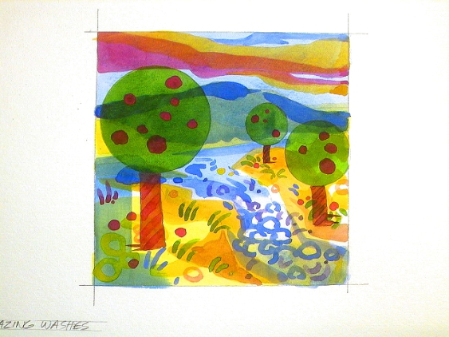
In the pictures above, what painting technique is being used?
A. Glazing
B. Wet-into-wet
C. Dry brush
D. Impasto

Slide 9
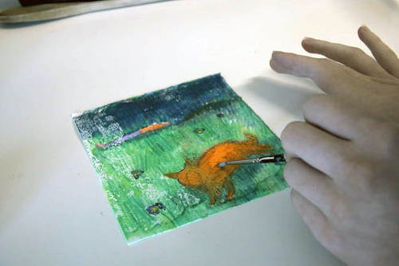
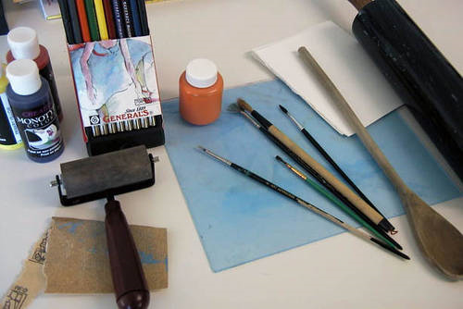
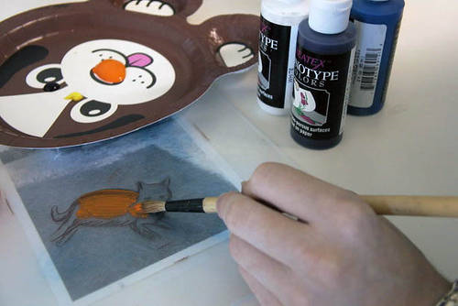
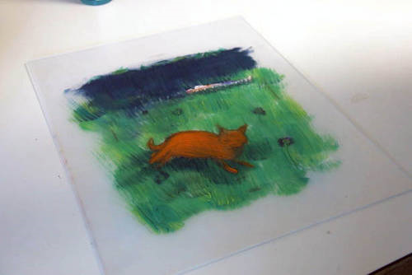
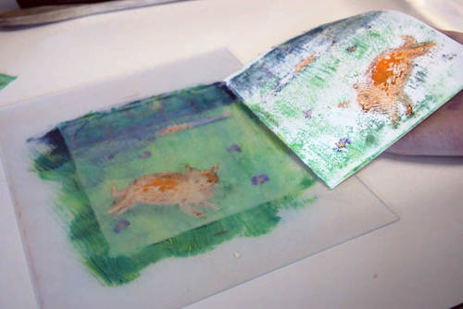
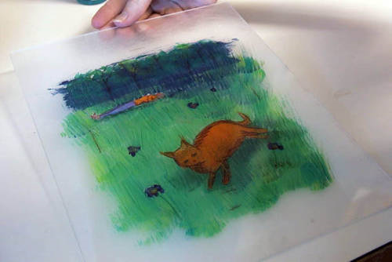
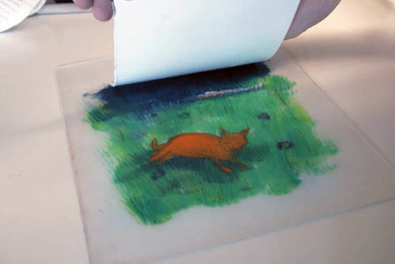
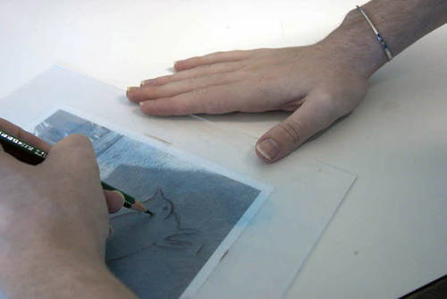
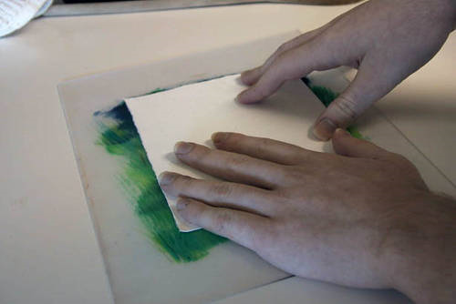
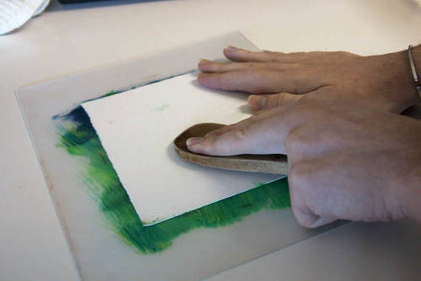
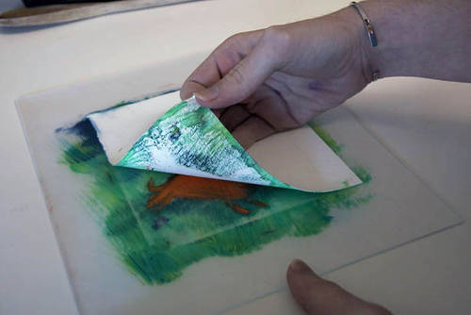
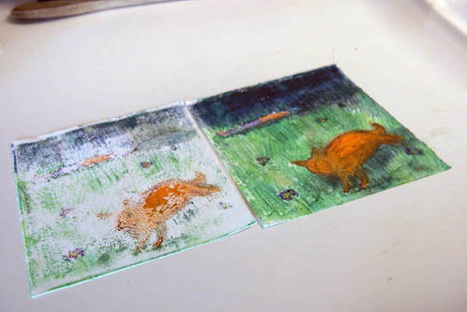
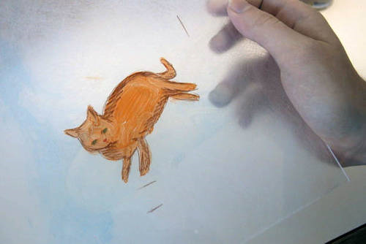
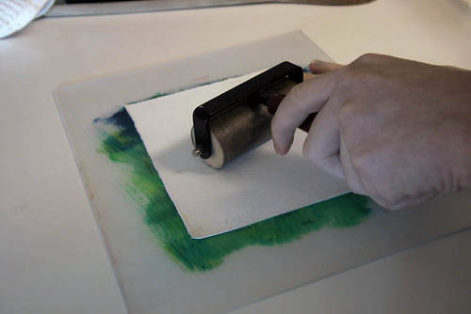
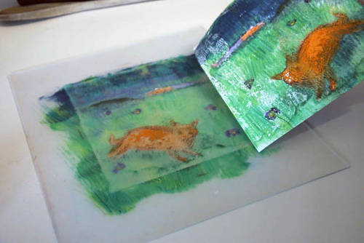
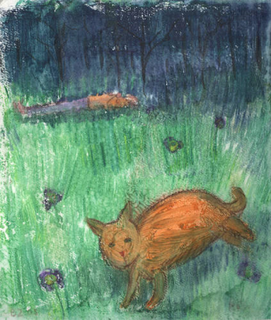
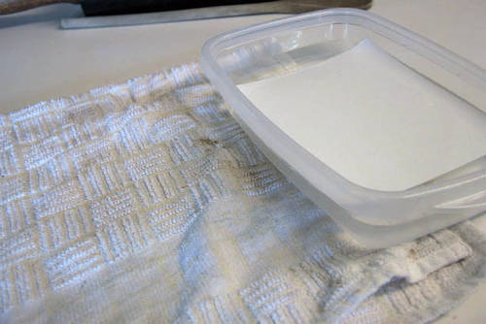
What printmaking technique is being demonstrated?
A. Relief Printing
B. Monoprint or Monotype Printing
C. Stamp Printing
D. Block Printing

Slide 10
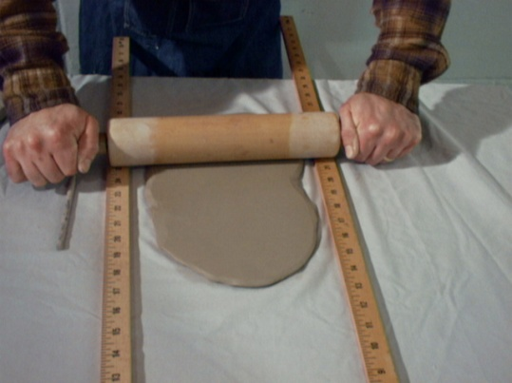
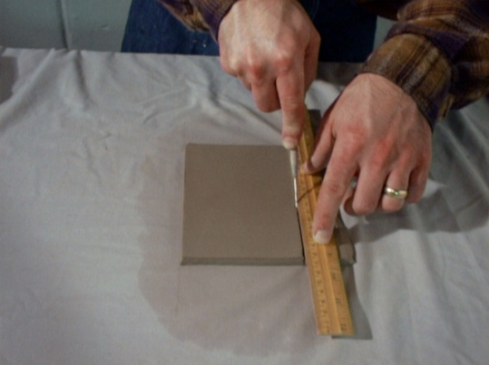
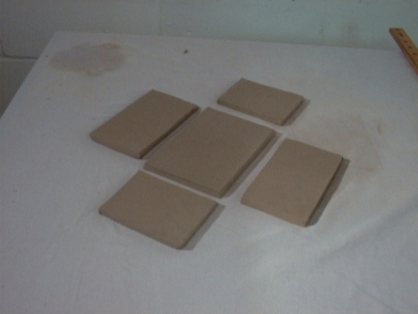
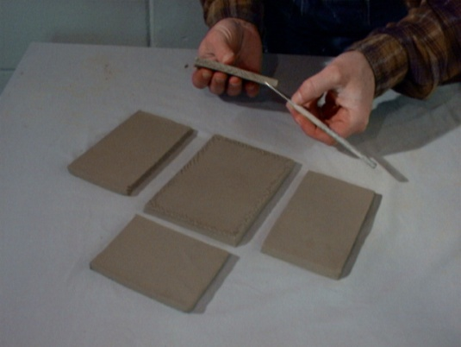
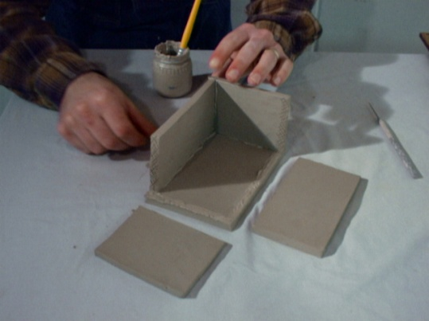
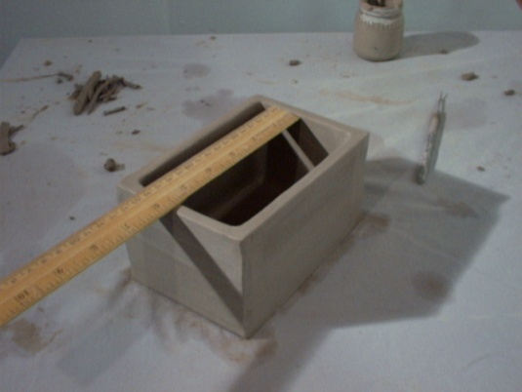
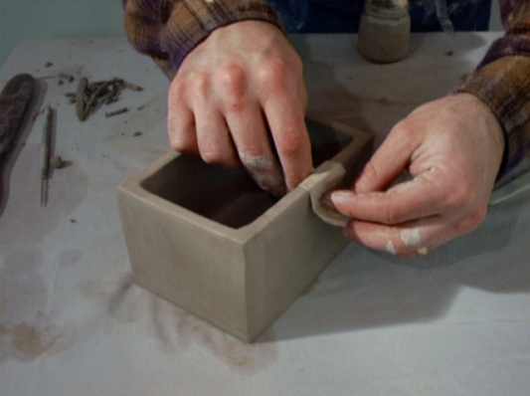
What step in the process is NOT shown in the pictures above?
A. Preparing the clay
B. Applying slip
C. Scoring the clay
D. Attaching slabs

Slide 11
In the pictures above, what digital imaging tool is being used?
A. Eraser Tool
B. Drawing Tool
C. Move Tool
D. Fill or Paint Bucket Tool

Slide 12
Original
Look at the pictures. The four pictures below the original have been changed. What digital imaging tool was used to make the four variations that we see below the original?
A. Eraser Tool
B. Filter Tool
C. Move Tool
D. Selection Tool

Slide 13
What principle of art best describes all of the pairs shown in the illustration?
A. Balance
B. Repetition
C. Unity
D. Contrast
1
2
3
4
5
6

Slide 14
What color scheme does Peter Reginato use in this painting, entitled Changing Scenes?
A. Complimentary
B. Analogous
C. Split Complimentary
D. Monochromatic

Slide 15
The boxes on the left illustrate a visual principle. The painting on the right, by Mexican American artist Robert Giles de Montes, uses this visual principle to help make an effective composition. Which visual principle is being used?
A. Diagonal shapes are dynamic because they imply motion or tension
B. We tend to group similar shapes together more than similar colors
C. We tend to group similar colors together more than similar shapes
D. Horizontal shapes give a sense of stability and calm

Slide 16
Look carefully at these three pictures. What visual principle do they illustrate?
A. Overlapping
B. Visual Tension
C. Perspective
D. Repetition

Slide 17
Artists often use “hidden” basic shapes to organize the overall visual dynamics in their art. Which of the choices below shows the major, dominant shape motif that George Bellows used in composing his painting, Dempsey and Firpo (1924)?
A
B
C
D

Slide 18
What type of perspective is used in this Renaissance painting of an ideal city by Piero Della Francesca?
A. One-point Perspective
B. Two-point Perspective
C. Three-point Perspective
D. Multiple-point Perspective

Slide 19
What type of perspective is used in this contemporary artwork by David Hockney?
A. One-point Perspective
B. Two-point Perspective
C. Three-point Perspective
D. Multiple-point Perspective

Slide 20
Look at each picture. These pictures show 7 different ways to show the same scene. Each picture presents different visual information and gives us a different feeling. As a result, we respond to each in different ways.
Which of the following BEST describes what the artist, Mike Madden, does to change the way we respond to each of the pictures?
A. He changes the words
B. He changes the point of view
C. He changes the types of line
D. He changes the characters

Slide 21
1
2
Picture 1 shows a famous painting of the French military leader, Napoleon Bonaprte, by artist Jaques Louis David. Picture 2 shows a painting by contemporary African-American artist Kehinde Wiley. What postmodern principle does Wiley use to convey meaning in his painting?
A. Gazing
B. Juxtaposition
C. Interaction of text and image
D. Appropriation

Slide 22
What one postmodern principle BEST describes this painting by Pakistani artist Shahzia Sikander?
A. Interaction of Image and Text
B. Juxtaposition
C. Layering
D. Appropriation

Slide 23
Artists use many different creative strategies to generate original artworks. From the list below, identify THREE creative strategies used in the artworks above.
Magnification | Negative Space | Multiple Perspective
Unity | Minification | Recontextualization

Slide 24
This sculpture by African American artist Willie Cole is based on a visual analogy. Visual analogies are based on similarities between how something looks (its structure) or how something works (its function).
The visual analogy shown in this sculpture is based on the:
A. The structural similarity between the feathers and fire
B. The functional similarity between the feathers and fire
C. The structural similarity between the feathers and steam
D. The functional similarity between steam and fire

Slide 25
This sculpture by Robert Arenson is based on a visual analogy. Visual analogies are based on similarities between how something looks (its structure) or how something works (its function).
The visual analogy shown in this sculpture is based on the:
A. The structural similarity between binoculars and eyes
B. The functional similarity between binoculars and eyes
C. The structural similarity between eyes and glasses
D. The functional similarity between glasses and binoculars

Slide 26
In the pictures above, the artist has shown the same scene in 6 different ways. The point of view stays the same, with the man on the right side of the composition. What has the artist changed to explore a full range of creative possibilities?
A. Each panel has a different center of interest
B. Each panel emphasizes a different person
C. The artist changes the horizon line in each panel
D. The artist changes the visual/graphic style in each panel

Slide 27
Look at the pictures above. From the list below, identify THREE concepts that best describe the architecture shown in these pictures.
Ancient Rome | Neo-Classical | Gothic
Flying Buttresses | Middle Ages | Ancient Greece

Slide 28
The pictures above show how an artist can draw inspiration from nature without actually copying what nature looks like in the final artwork. The process above shows which of the following art styles in action?
A. Expressionism
B. Surrealism
C. Abstraction
D. Photorealism

Slide 29
The artwork above is by Rosa Bonheur. From the list below, identify THREE concepts that best describe this painting.
Implied Diagonal Line | Representational | Formalism
Symmetrical Balance | Functionalism | Asymmetrical Balance

Slide 30
Picture A is a photograph of the famous Aztec Sun Stone, a kind of calendar. Picture B is a mask used by Northwest Native Americans. From the list below, identify THREE concepts that best describe the characteristics of the art shown in these pictures.
Expressionism | Radial Symmetry | Formalism
Pattern | Functionalism | Center of Interest

Slide 31
The picture above show s an artwork by Jennifer Bartlett. From the list below, what is the best term that describes this kind of artwork?
A. Installation Art
B. Site Specific Art
C. Land Art
D. Public Art

Slide 32
The picture above show s an artwork in Utah by Robert Smithson . It is called Spiral Jetty. From the list below, what is the best term that describes this kind of artwork?
A. Installation Art
B. Site Specific Art
C. Land Art or Earthwork
D. Public Art

Slide 33
The picture s above show artwork s by Andy Goldsworthy. From the list below, what is the best term that describes this kind of artwork?
A. Installation Art
B. Site Specific Art
C. Abstract Art
D. Public Art

Slide 34
All of the artwork on this page comes from different periods of history. However, all of these works have at least one thing in common.
From the list below, what term best describes what all of these works have in common?
A. Impressionist Art
B. Surrealist Art
C. Abstract Art
D. Narrative Art

Slide 35
SHORT ANSWER
Look carefully at all of these artworks by Kathy Kollowitz. Interpret these works by writing at least THREE sentences that:
Describe her main THEME
Describe the MOOD of these works
Describe what she repeatedly uses in each artwork to communicate this mood.

Slide 36
End 8th Grade CKV Assessment
Alternate Slides Below

Slide 37
A
B
C
In the pictures above, what oil pastel technique did the artist use to achieve the smooth, rounded look that we see in Picture C?
A. Scumbling
B. Cross-hatching
C. Blending
D. Mineral Spirit Wash

Slide 38
What step in the process is NOT shown in the pictures above?
A. Wedging
B. Rolling the coils
C. Pinching/smudging together
D. Smoothing

Slide 39
In the pictures above, what digital imaging tool is being used?
A. Eraser Tool
B. Drawing Tool
C. Move Tool
D. Selection Tool

Slide 40
Look at the pictures above. From the list below, identify THREE concepts that best describe the architecture shown in these pictures.
Ancient Greece | Mausoleum | India
Symmetry | Gothic | Palace

Slide 41
The picture above show s an artwork by Miriam Shapiro. From the list below, what is the best term that describes this kind of artwork?
A. Installation Art
B. Site Specific Art
C. Land Art
D. Public Art

Slide 42
2
1
Look carefully at these three pictures. Identify the points of greatest visual tension.
A. 2 only
B. 1 and 2
C. 2 and 3
D. 1 and 3
3

Slide 43
Once they choose a dominant shape motif , artists often use subordinate or minor shape motifs to add contrast and interest. Japanese artist Katsushika Hokusai uses curved, circular lines as the major shape motif in this famous print.
Look at the options below. Which one best shows Hokusai’s use of minor, subordinate shapes?
A
The Diagonal
B
The Square
C
The Rectangle
D
The Triangle

Slide 44
1
2
3
Picture 1 shows Stonehenge, a famous prehistoric monument in England. Picture 2 shows Carhenge, built in Nebraska by artist Jim Reinders. What postmodern principle did Reinders use in building Carhenge?
A. Layering
B. Juxtaposition
C. Interaction of text and image
D. Appropriation

Slide 45
Although he lived much earlier than the postmodern era, what postmodern principle can be used to describe this painting, made in 1564, by Giuseppe Arcimboldo?
A. Gazing
B. Juxtaposition
C. Interaction of text and image
D. Appropriation

Slide 46
1
2
3
The art in picture 1 was made by Native Americans; in picture 2 by Australian Aborigines; and in picture 3 by South African tribal artists. What aesthetic category best describes all of these artworks?
Formalism
Realism
Functionalism
Expressionism

Slide 47
These artworks express two very different views of life, the universe, and our place in it. Write at least FOUR sentences that:
1. Briefly describe the worldview expressed in Sculpture A
2. Briefly describe the worldview expressed in Sculpture B
3. Describes how each sculpture conveys this worldview.

